Slide 1
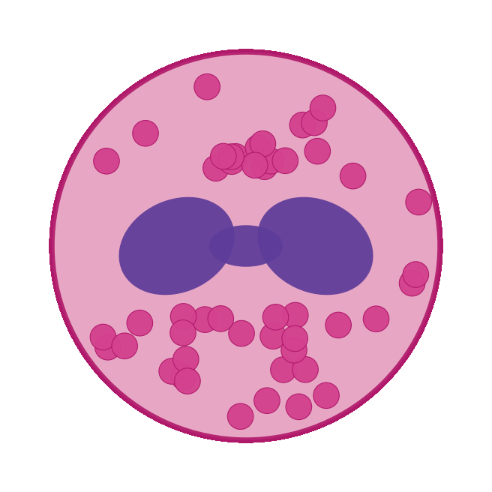
BUILT WITH CLAUDE · LIFE SCIENCES HACKATHON · RESEARCHER TRACK
I have EoE.
This week I designed a therapy for it.
A PhD scientist and rare-disease advocate who doesn't code —
empowered by Claude Science to build from the bench.
Ruth-Anne Pai, PhD · Project Tolera
Notes:
My name is Ruth-Anne Pai and I live with eosinophilic esophagitis. This week, with Claude Science, I went from public omics data to a designed therapy for my own disease. I don't write Python and I'd never touched a protein model. This is 'build from the bench' — starting from a biological question I've lived with, and showing you how Claude Science got me there.

Slide 2
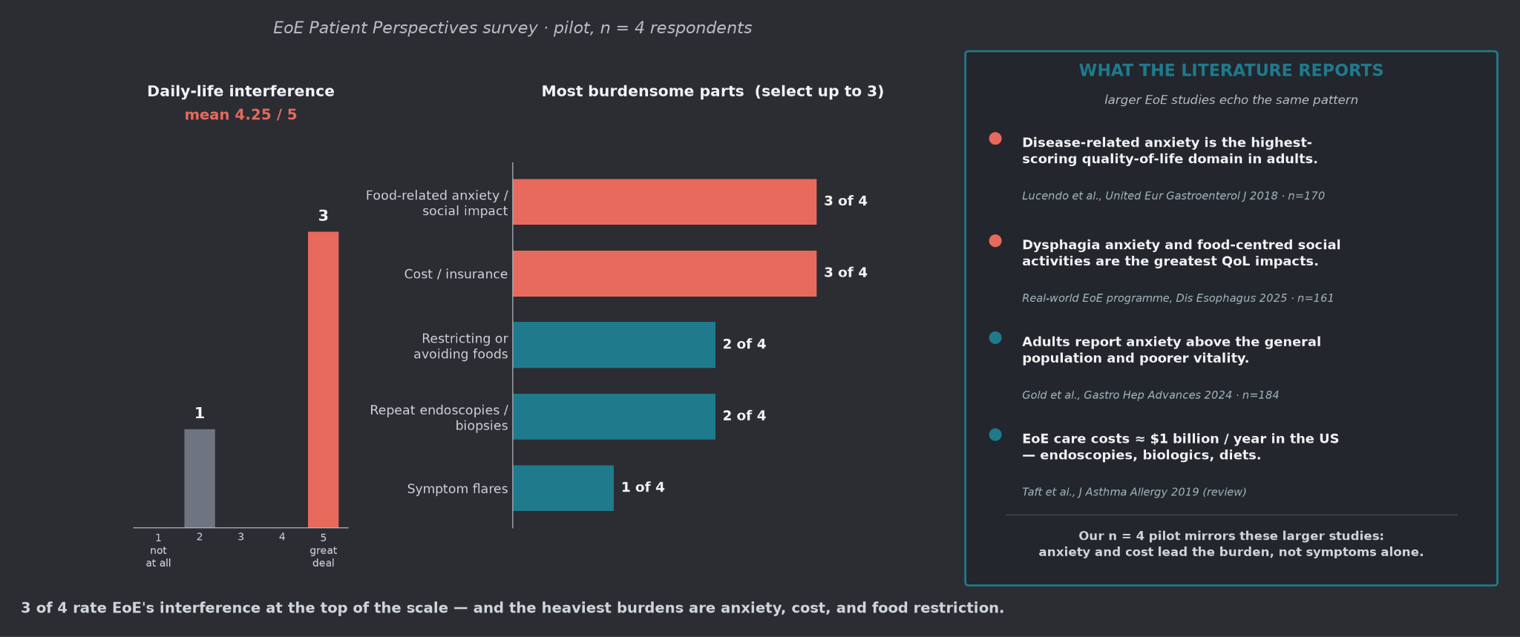
WHERE WE STARTED · CHAPTER 1
Why we are here
Notes:
"I don't just study EoE — I live with it. Every burden on this slide is one I've felt myself."
when you ask what's actually most burdensome, it isn't the symptoms first. It's the food-related anxiety. The cost and insurance fights. The constant restriction of what you can eat."
Patients report anxiety above the general population. And EoE costs the US healthcare system around a billion dollars a year."
"This is who I'm building for. A treatment that just quiets symptoms — that you take forever — doesn't touch the anxiety or the cost. That's the gap this project is trying to close."

Slide 3
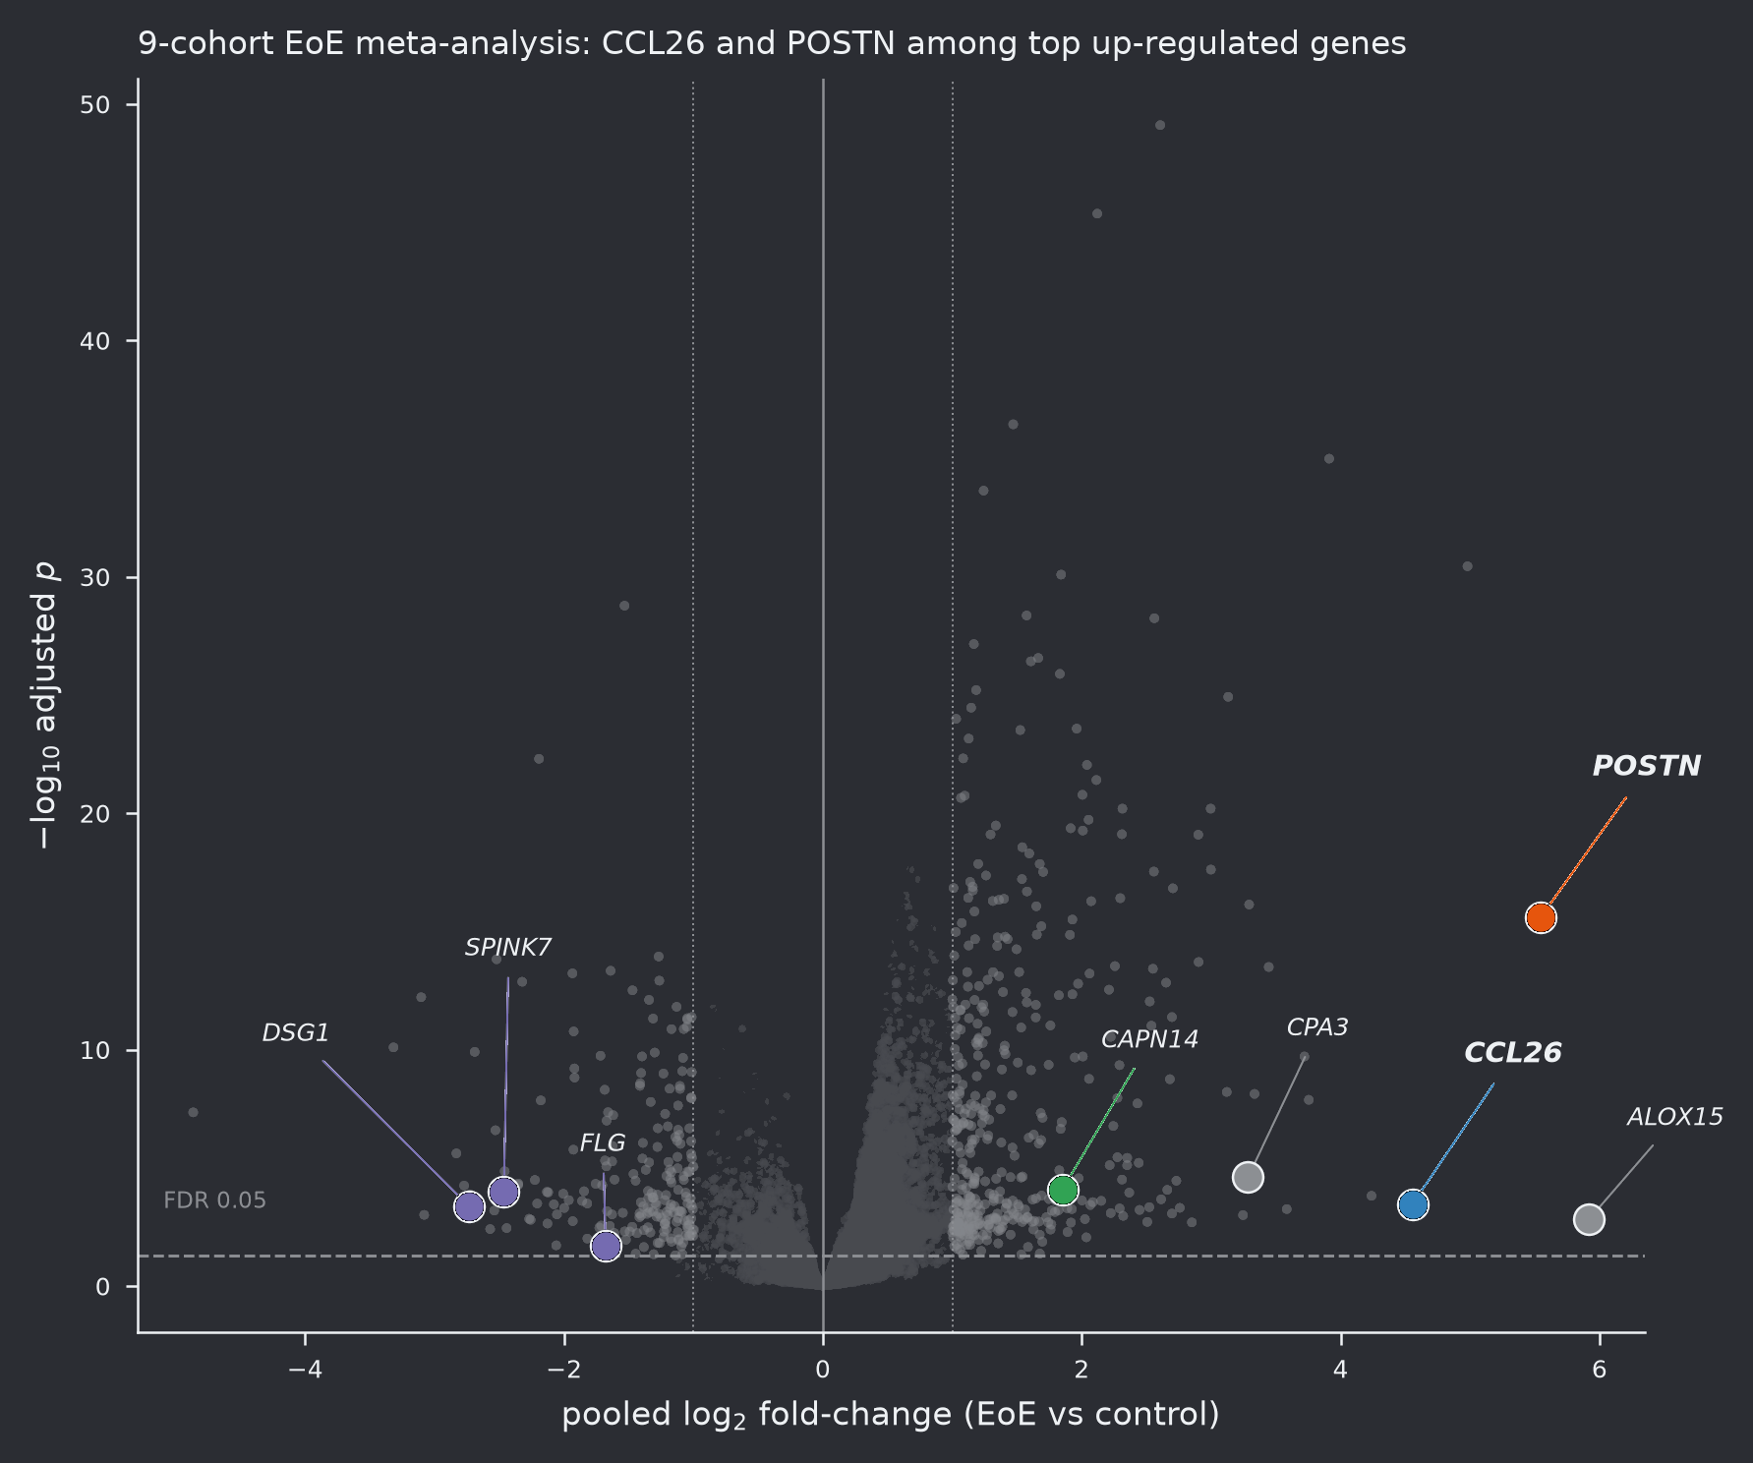
WHERE WE STARTED · CHAPTER 1
We began with the omics
Public EoE datasets — the 'existing data
and tools' the brief asks for:
• Bulk transcriptomes of esophageal biopsy
• Single-cell atlases of inflamed mucosa
• Proteomic & clinical-trial evidence
The question that started it all:
what is truly dysregulated here —
and can we act on it?
Meta-analysis volcano · pooled EoE cohorts
Notes:
We went back to the very beginning — the omics. Publicly available bulk and single-cell EoE datasets. I didn't generate this data; I learned to find and mine it. The first question was simple: what is truly dysregulated in EoE, and is any of it druggable?

Slide 4
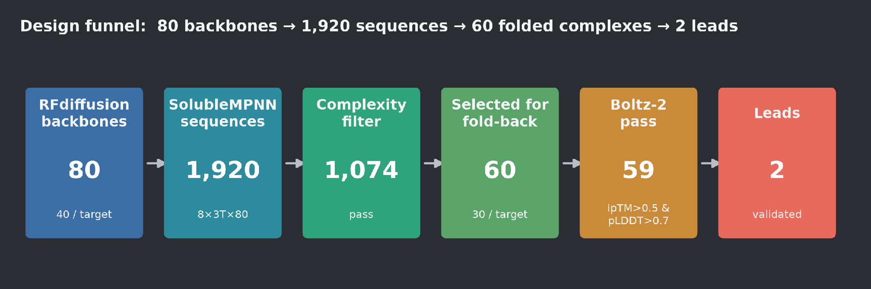
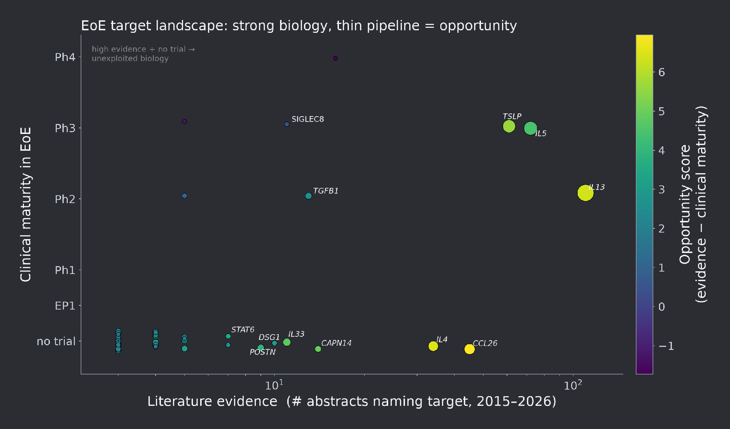
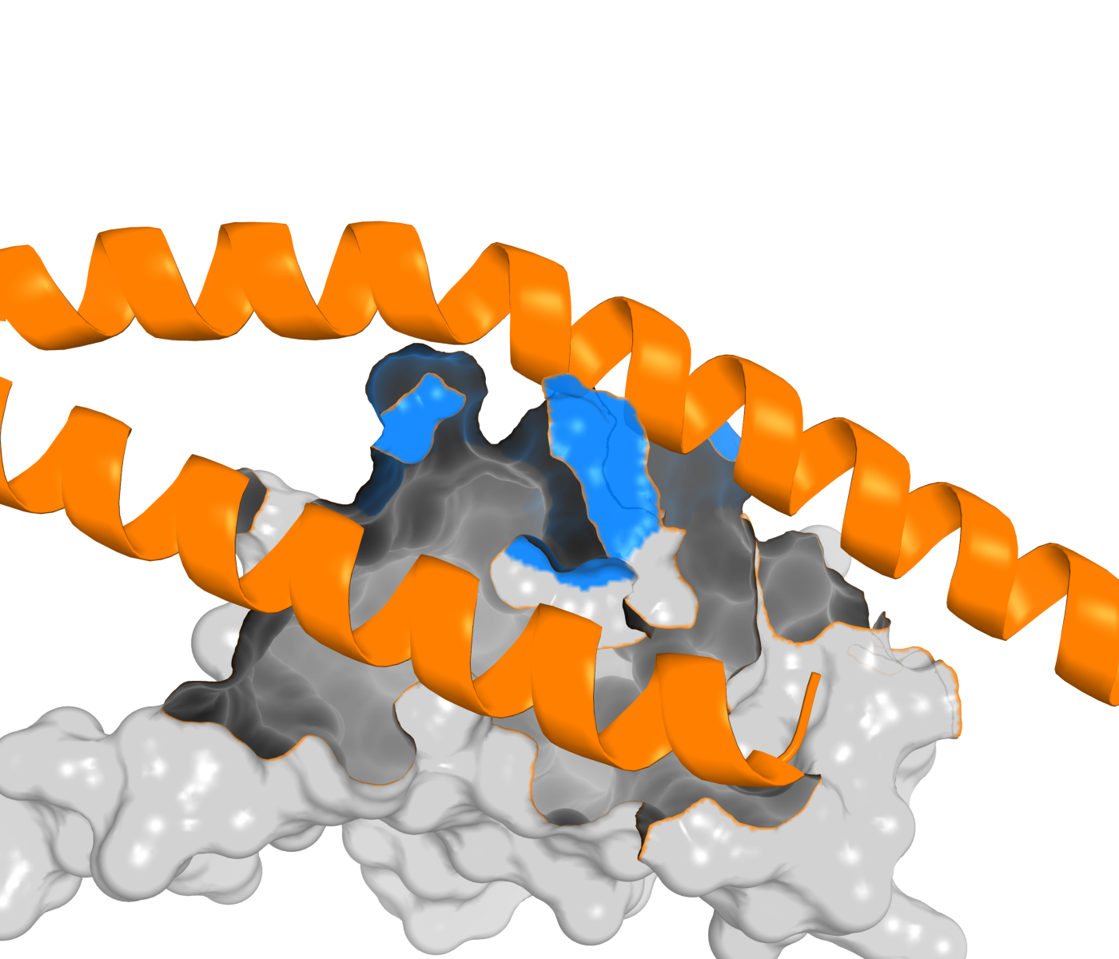
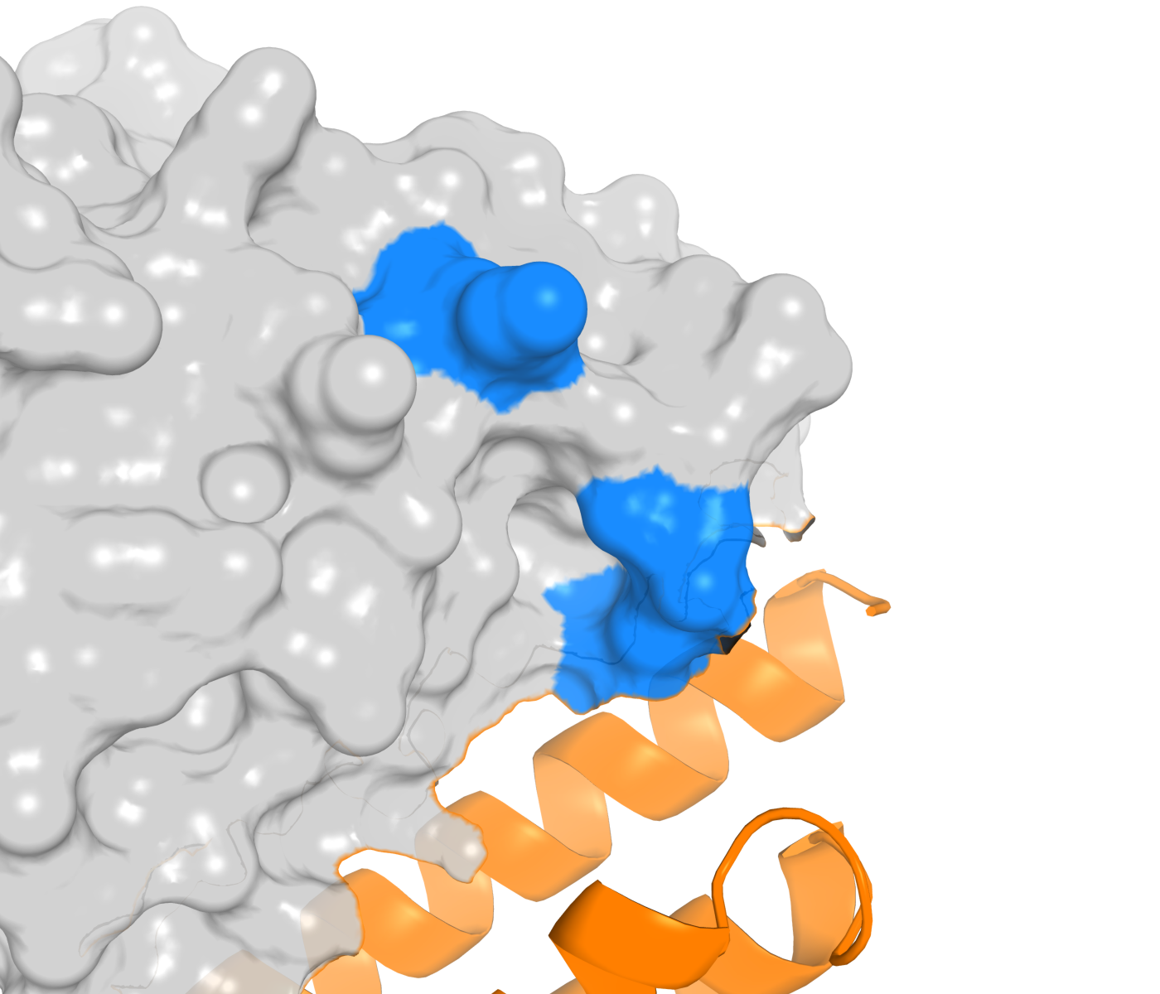
CHAPTER 2 · FROM SIGNAL TO TARGET
Differential expression → target discovery
De novo binders, docked to real EoE targets
Notes:
We turned that data into a ranked target landscape. Then a druggability funnel and a literature cross-reference — separating what's already known from the unexploited gaps. CCL26 and POSTN surfaced as the targets worth pursuing.
Here's what still amazes me: I had never used a protein model in my life. This week, with ESM-family and structure-prediction models, I designed de novo binders against CCL26 and POSTN

Slide 5
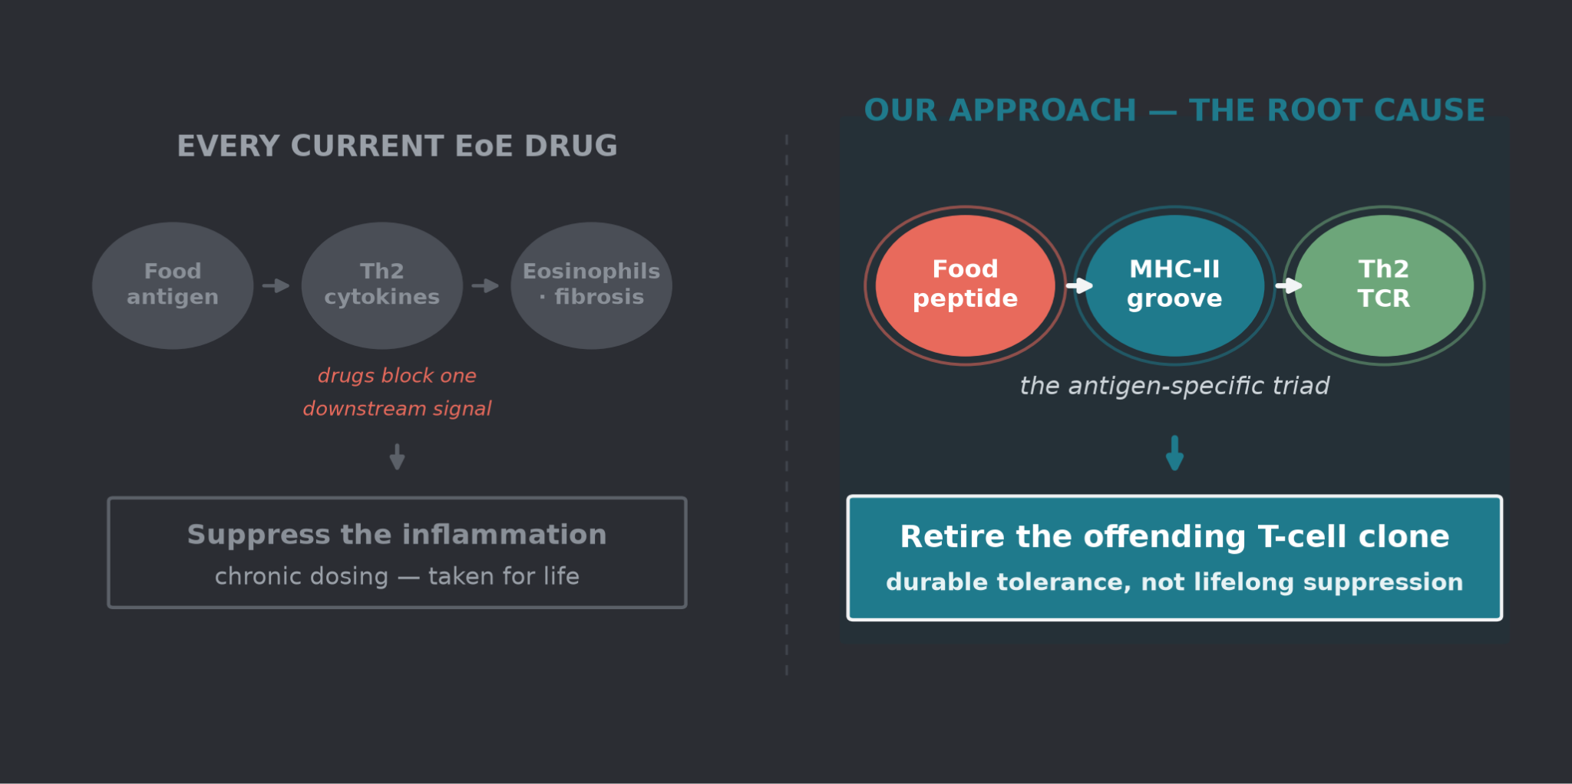
CHAPTER 3 · THE PIVOT
The Tolera Project: Target the cause
Notes:
Then the pivot — this is the heart of the science. Every EoE drug on the market or in the pipeline blocks a downstream cytokine, and you take it forever. But EoE is antigen-specific: a food peptide, presented on MHC-II, seen by a pathogenic Th2 T-cell — a defined triad. If we target that triad instead, we can retire the offending T-cell clone and induce durable tolerance, rather than suppressing the whole immune system for life.This became the Tolera project. Tolerize the T cells.

Slide 6
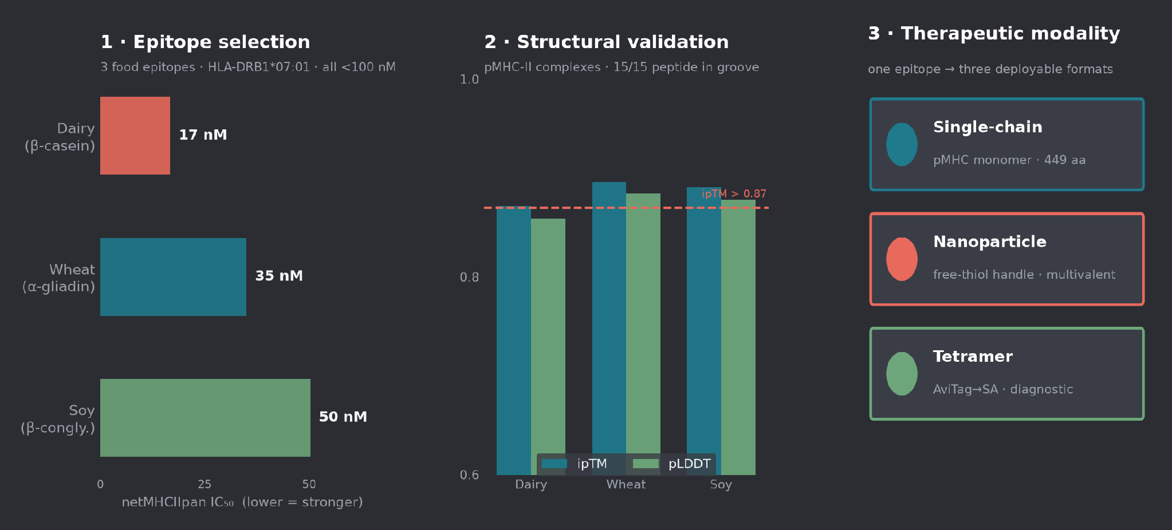
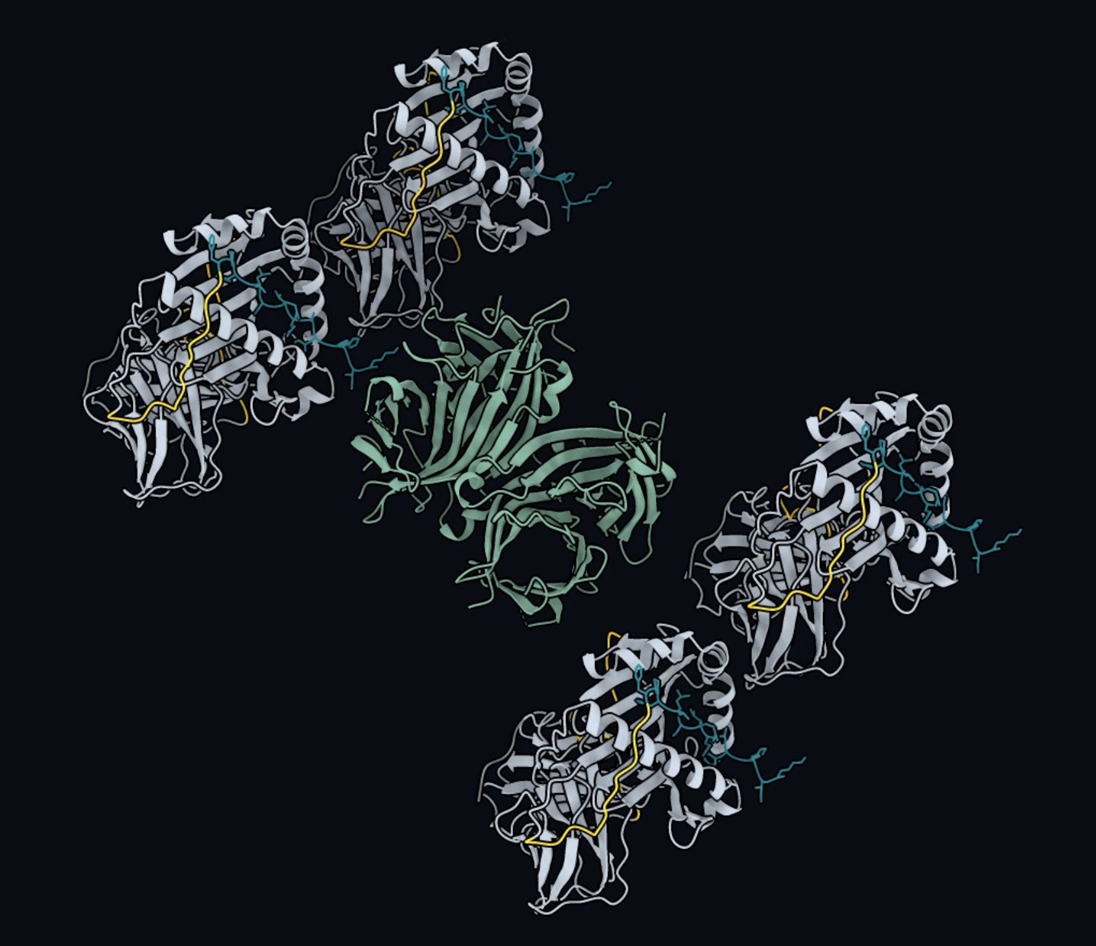
CHAPTER 4 · I HAD NEVER USED A PROTEIN MODEL
From target to designed protein
Notes:
As a proof of concept for AI design, I selected dairy, wheat, and soy epitopes — all restricted by HLA-DRB1*07:01 — and ran each through AI structural modeling of the peptide–MHC complex, which placed the peptide in the binding groove with high confidence for all three. I then designed each into three deployable formats: a single-chain construct and a nanoparticle as therapeutic tolerance reagents, and a tetramer as a diagnostic to detect the antigen-specific T cells.

Slide 7
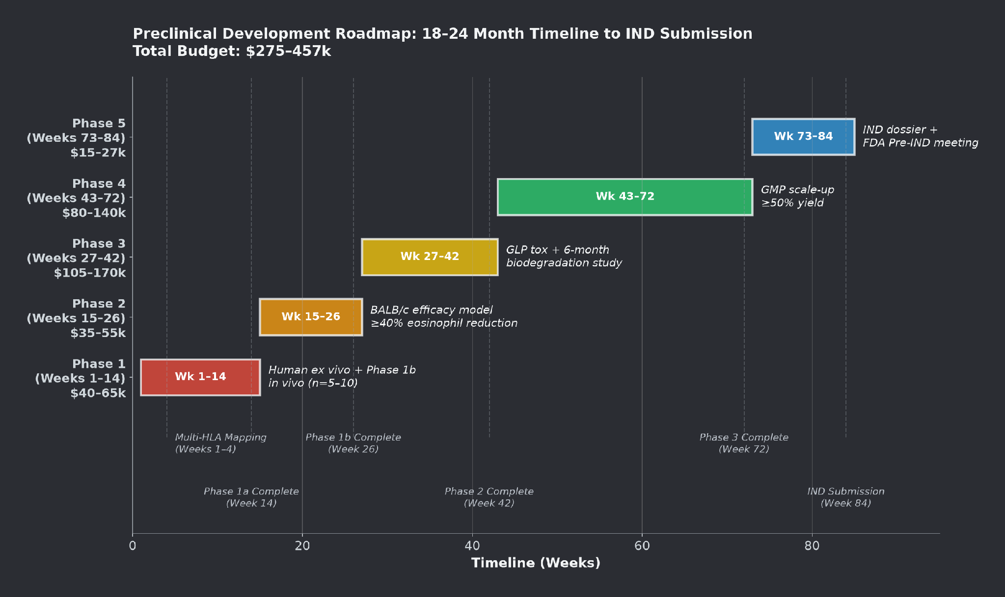
CHAPTER 6 · FROM WEEK TO ROADMAP
A full AI-to-clinic plan
Out of one week:
• 2 Peer-review–style manuscripts
with synthetic reviewer responses
• Preclinical → IND roadmap
• Regulatory & market strategy
• The Project Tolera deck
A credible line from a public
dataset to the clinic.
Notes:
I then laid out a complete AI-to-clinic pipeline: preclinical roadmap, regulatory strategy, market and payer analysis, and the Tolera Project deck. A path from a public dataset all the way to a patient.

Slide 8
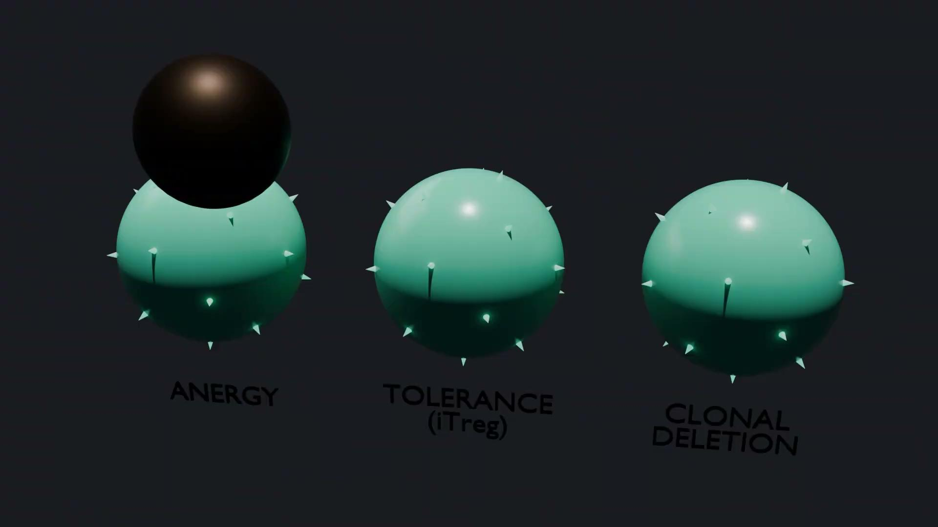
CHAPTER 5 · LEARNING BY BUILDING
I built skills and pushed them to the world
1
Created GitHub & Modal accounts
First time ever — from zero to publishing.
2
Published my first skills
Reusable pipelines anyone can run.
3
Learned ChimeraX & Blender
Rendered my own molecular videos…
4
…on Claude Science + Modal GPUs
Claude ran and rendered them for me.
github.com/ruthannepai-tech · rendered on Modal
Notes:
I didn't just consume tools — I built them. I made GitHub and Modal accounts and published my first skills. I downloaded ChimeraX and Blender and made my own molecular videos with Claude Science. I wondered what else I could build.I wanted to scale Tolera. And scale my process.

Slide 9
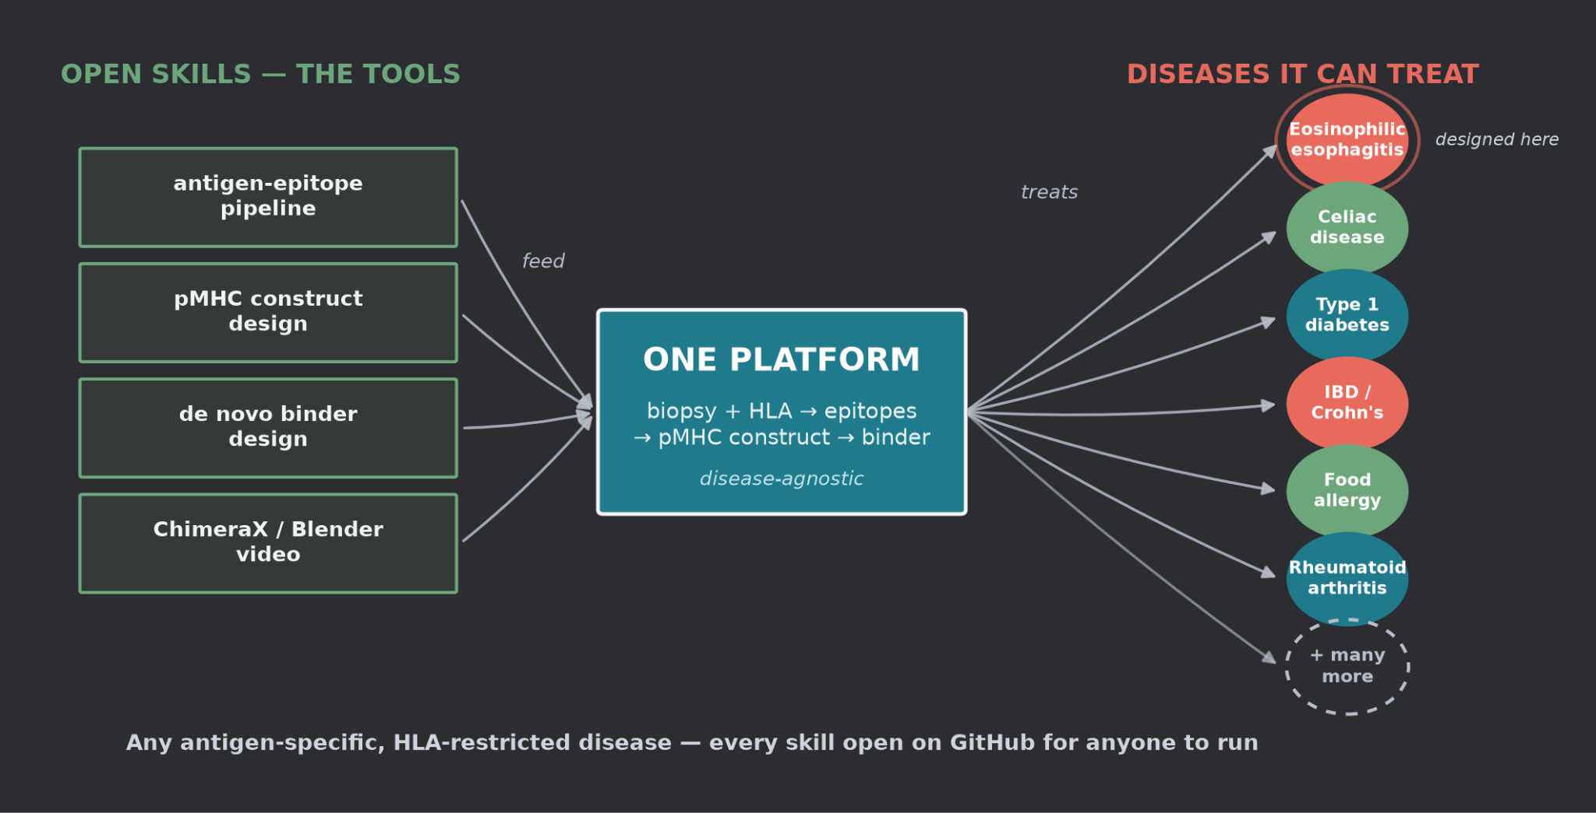
CHAPTER 7 · ONE PLATFORM, MANY DISEASES
Built to overcome disease — at scale
Notes:
EoE was the proving ground, but the platform is antigen-agnostic. The very same pipeline applies to any antigen-specific, immune-mediated disease. And because every step is an open, reusable skill, any researcher can point it at their own disease. That's the potential to advance science that overcomes disease — not one drug, but a method the whole community can run.

Slide 10
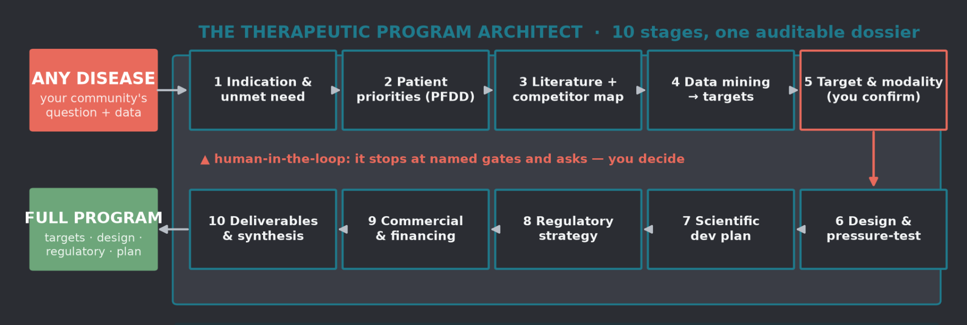
CHAPTER 8 · THE REUSABLE ENGINE
The Specialist Agent: any disease → a full drug program
Demonstrated on EoE. I packaged the whole method as an installable specialist — now anyone can point it at their disease and run.
Notes:
And everything I did for EoE — I packaged into one reusable Specialist Agent: the Therapeutic Program Architect. You give it any disease and your community's question; it runs ten stages, from unmet need through deliverables, into a single auditable dossier. I know that the research landscape is quite different in monogenic disease - and I built this nuance into the Specialist Agent. I also taught it to use person first language and be patient centered. It never silently commits — at every gate, like target and modality selection, it stops and asks you to decide. It's installable and open, so anyone can pick it up and run their own program.

Slide 11
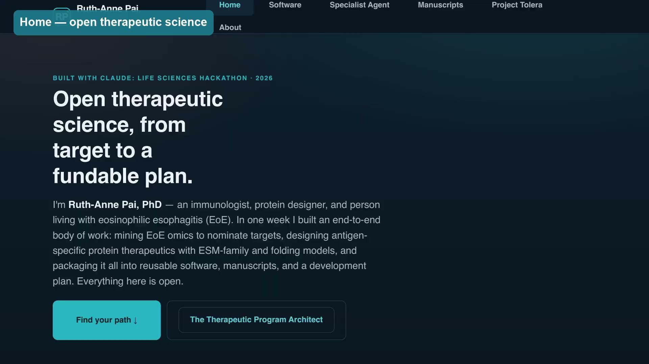
CHAPTER 9 · THE FRONT DOOR
One website — the whole project, open to anyone
ruthannepai.netlify.app
Six pages, six audiences:
• Patient orgs & advocates
• Scientists using protein models
• Biotech, investors & partners
• Claude Science developers
• Academics & data scientists
9 constructs 8 repos
2 manuscripts 0.87–0.90 ipTM
Every result, skill, and structure —
downloadable, open, reproducible.
ruthannepai.netlify.app · walkthrough video embedded — click to play
Notes:
And all of it lives in one place — a website, open to anyone. The whole body of work — nine constructs, eight open repositories, two manuscripts, every structure and skill — is downloadable and reproducible from here. This is the front door so the community can walk straight in and pick up wherever they want.

Slide 12
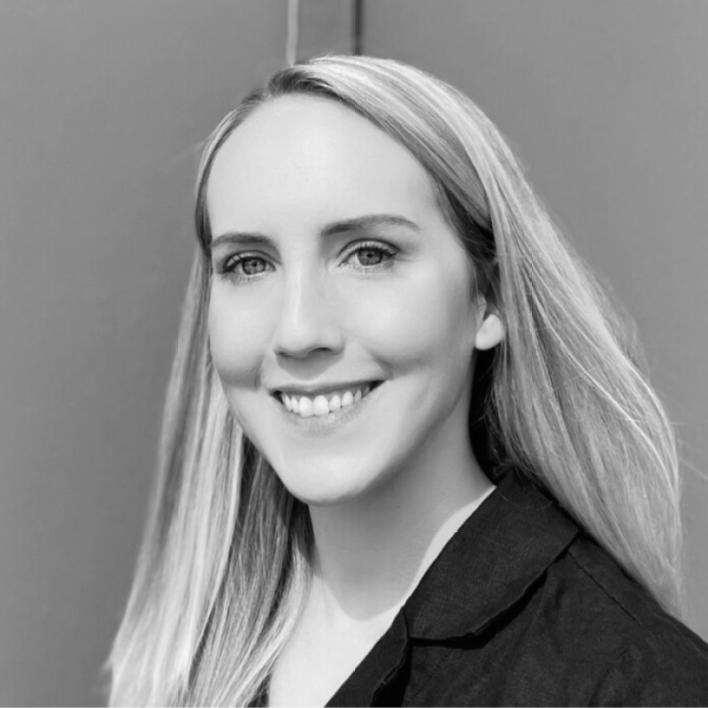
WHY THIS MATTERS
Science, democratized.
As an EoE patient, I was empowered to lean into
the science and design a therapy for my own disease.
Patient-driven, patient-centered drug development
is now genuinely possible.
500 hackers + a growing wave of AI adopters can close the gap —
and change lives.
Thank you hackathon organizers — Anthropic · Gladstone Institutes · Cerebral Valley — Ruth-Anne Pai, PhD
Notes:
I want to close on the same truth I opened with: this is deeply personal. As someone living with EoE, being empowered to lean into the science and design a therapy for my own disease — that's the democratization of science. Patient-driven, patient-centered drug development is now genuinely possible. Five hundred of us, plus everyone adopting these tools, can close the gap and change lives. Thank you to the organizers and developers who made this week possible.

