Slide 1
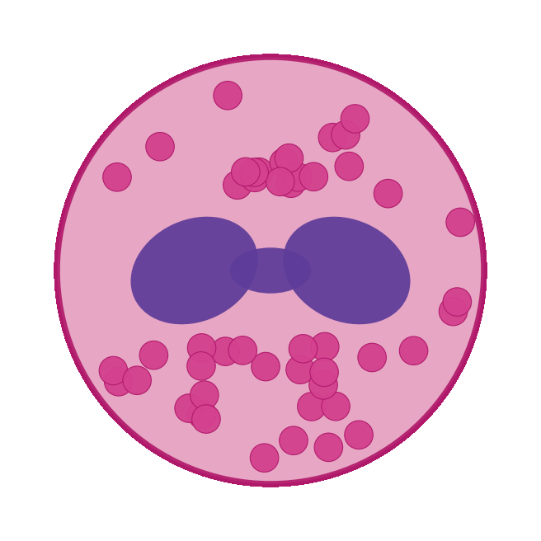
BUILT WITH CLAUDE · LIFE SCIENCES HACKATHON · RESEARCHER TRACK
I have EoE.
This week I designed a therapy for it.
A PhD scientist and rare-disease advocate who doesn't code —
empowered by Claude Science to build from the bench.
Ruth-Anne Pai, PhD · Project Tolera
Notes:
My name is Ruth-Anne Pai, and I live with eosinophilic esophagitis. This week, with Claude Science, I went from public omics data to a designed therapy for my own disease — never having written Python or touched a protein model. This is build from the bench.

Slide 2
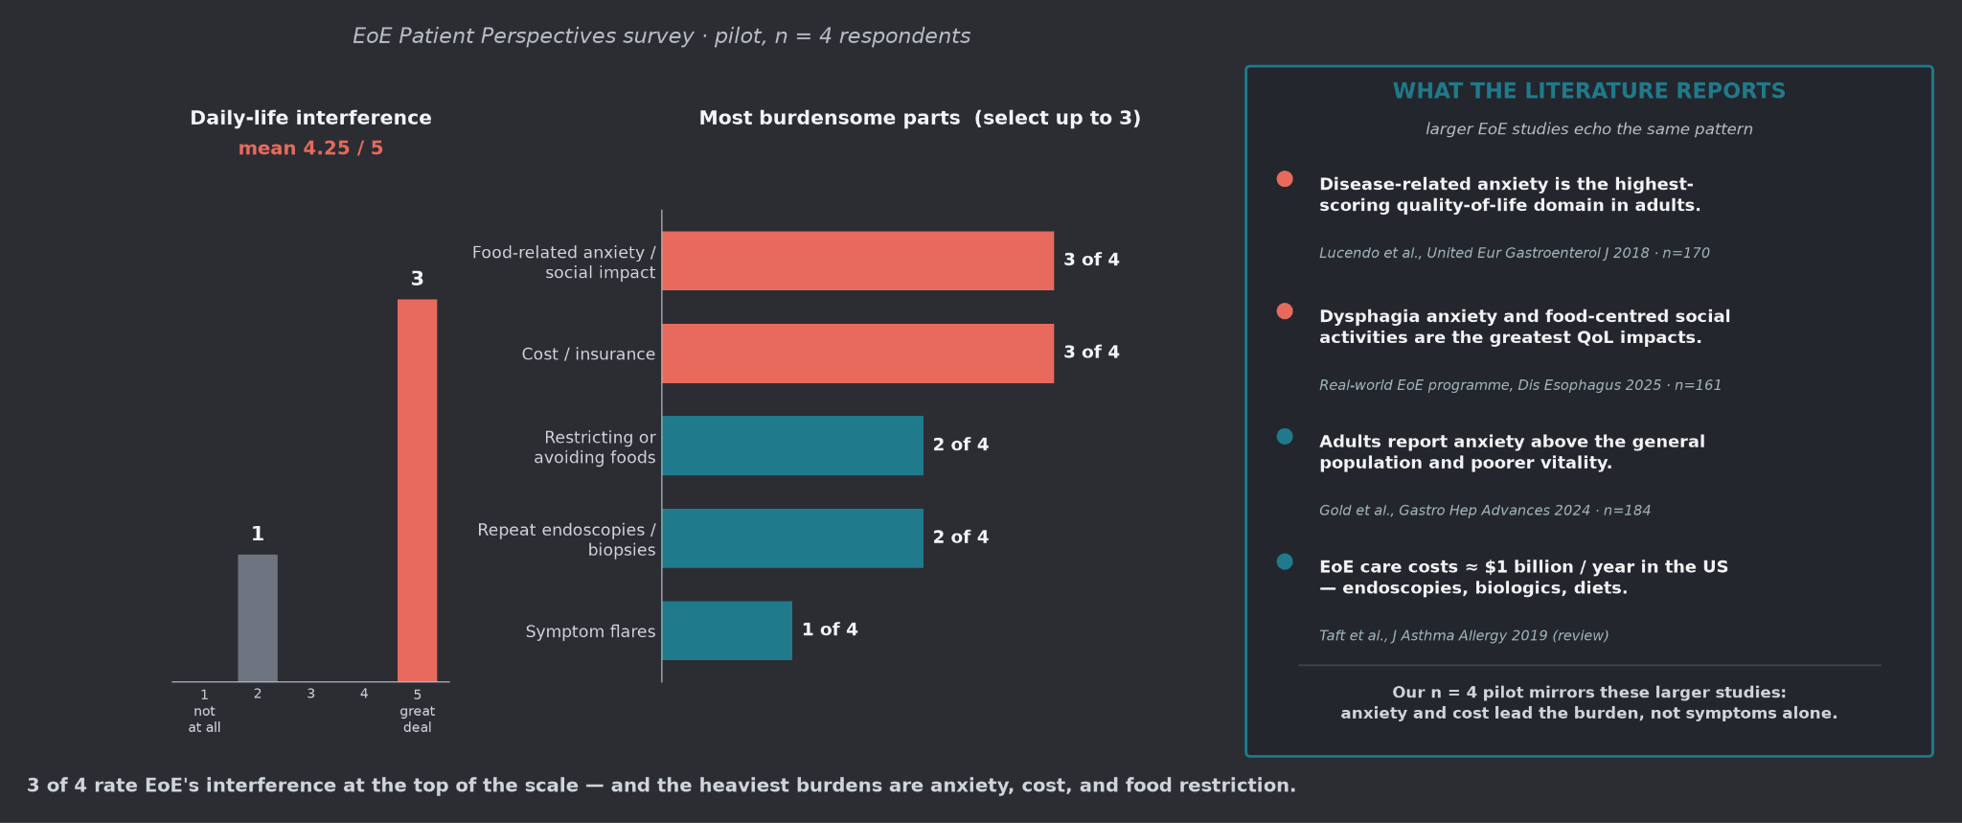
WHERE WE STARTED · CHAPTER 1
Why we are here
Notes:
I don't just study EoE — I live it. The heaviest burden isn't the symptoms; it's the anxiety, the cost, the constant food restriction — and larger studies agree. A drug you take forever doesn't touch that. This is who I'm building for.

Slide 3
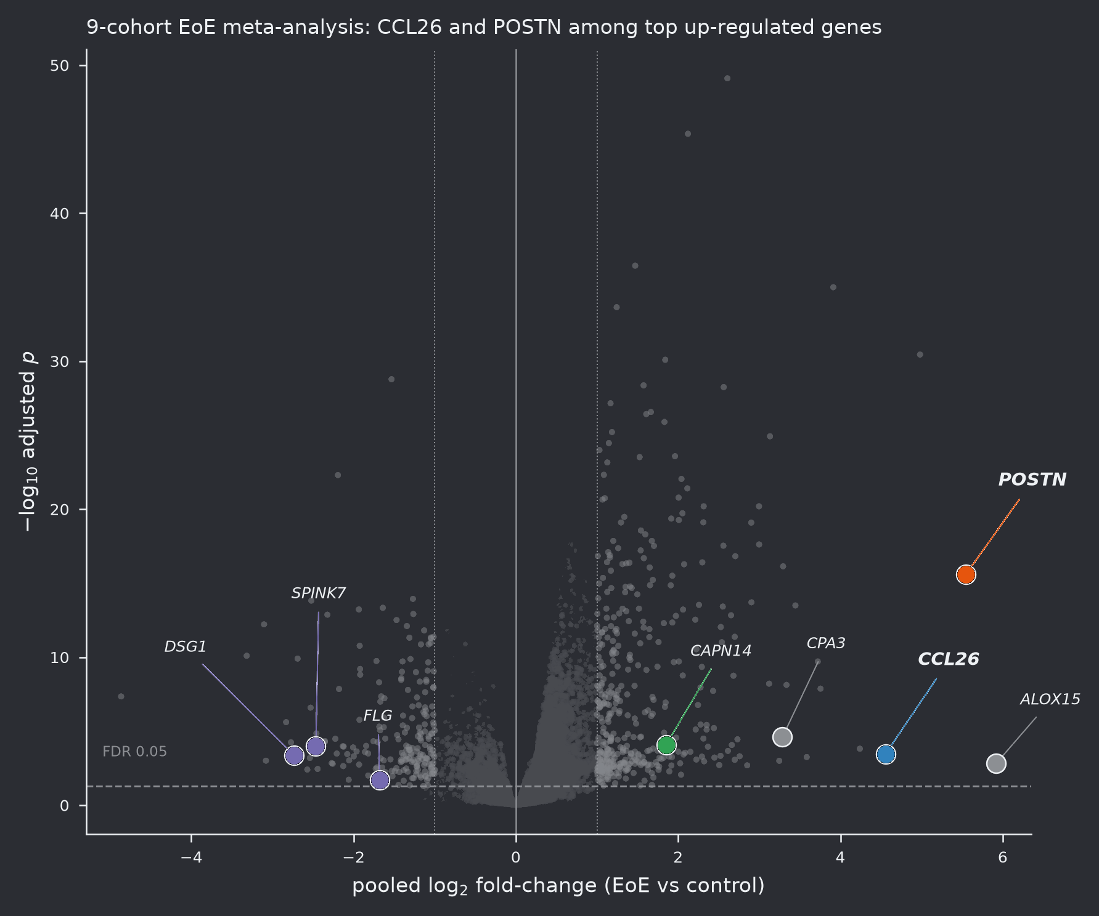
WHERE WE STARTED · CHAPTER 1
We began with the omics
Public EoE datasets — the 'existing data
and tools' the brief asks for:
• Bulk transcriptomes of esophageal biopsy
• Single-cell atlases of inflamed mucosa
• Proteomic & clinical-trial evidence
The question that started it all:
what is truly dysregulated here —
and can we act on it?
Meta-analysis volcano · pooled EoE cohorts
Notes:
We started at the very beginning: public bulk and single-cell EoE omics. I didn't generate this data — I learned to mine it, asking what's truly dysregulated, and whether any of it is druggable.

Slide 4
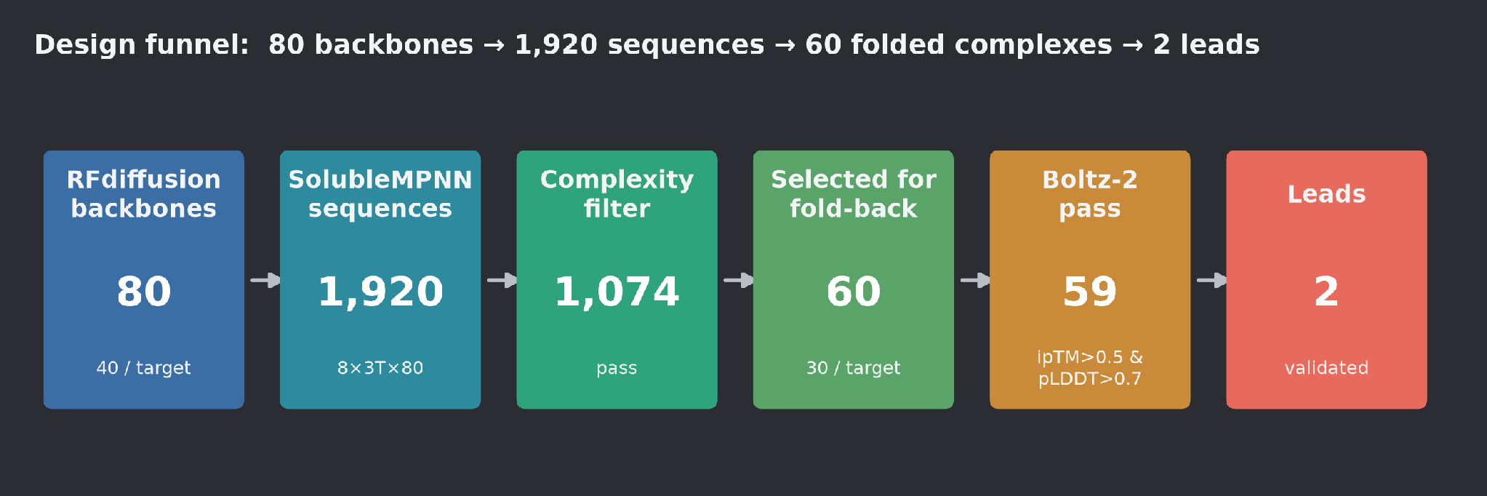
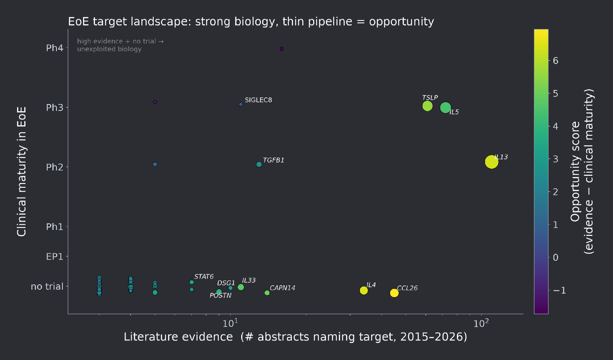
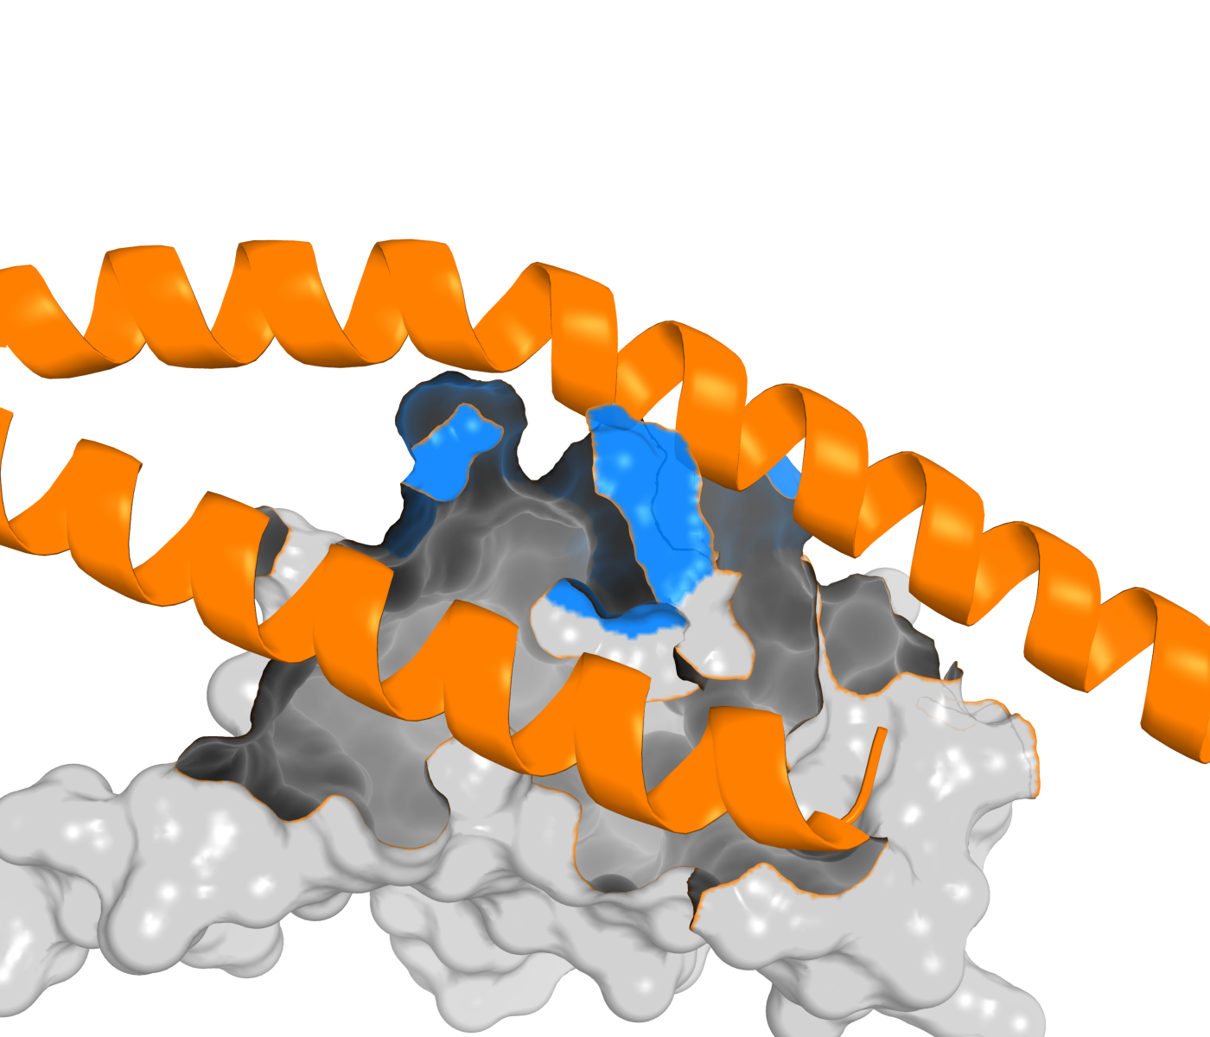
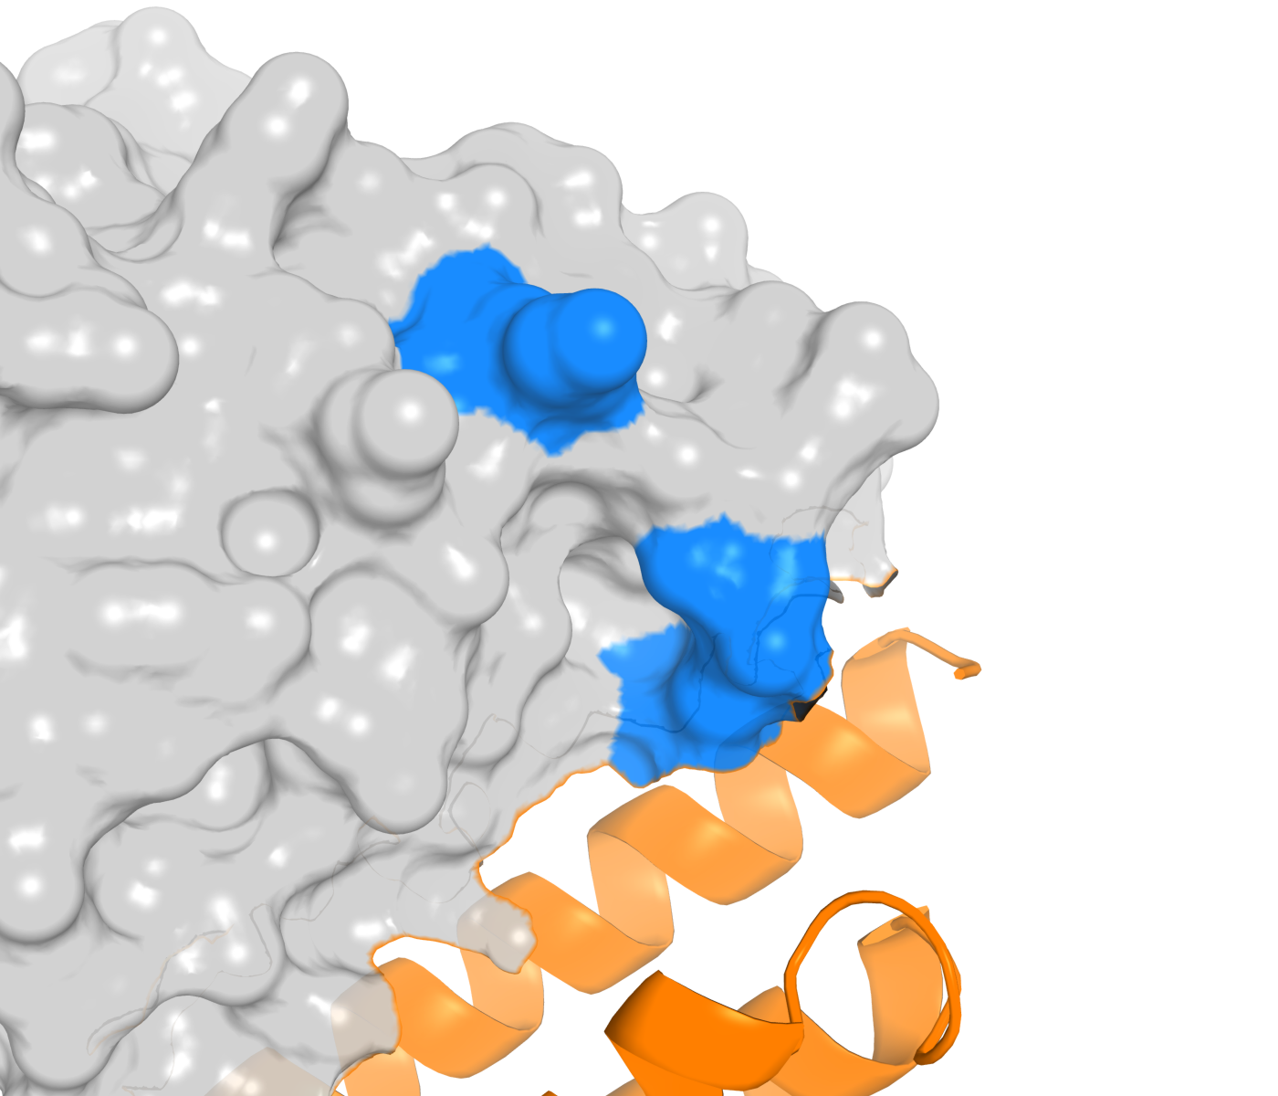
CHAPTER 2 · FROM SIGNAL TO TARGET
Differential expression → target discovery
De novo binders, docked to real EoE targets
Notes:
That became a ranked target landscape and a druggability funnel, separating known biology from unexploited gaps. CCL26 and POSTN rose to the top — and having never used a protein model, I designed de novo binders against both.

Slide 5
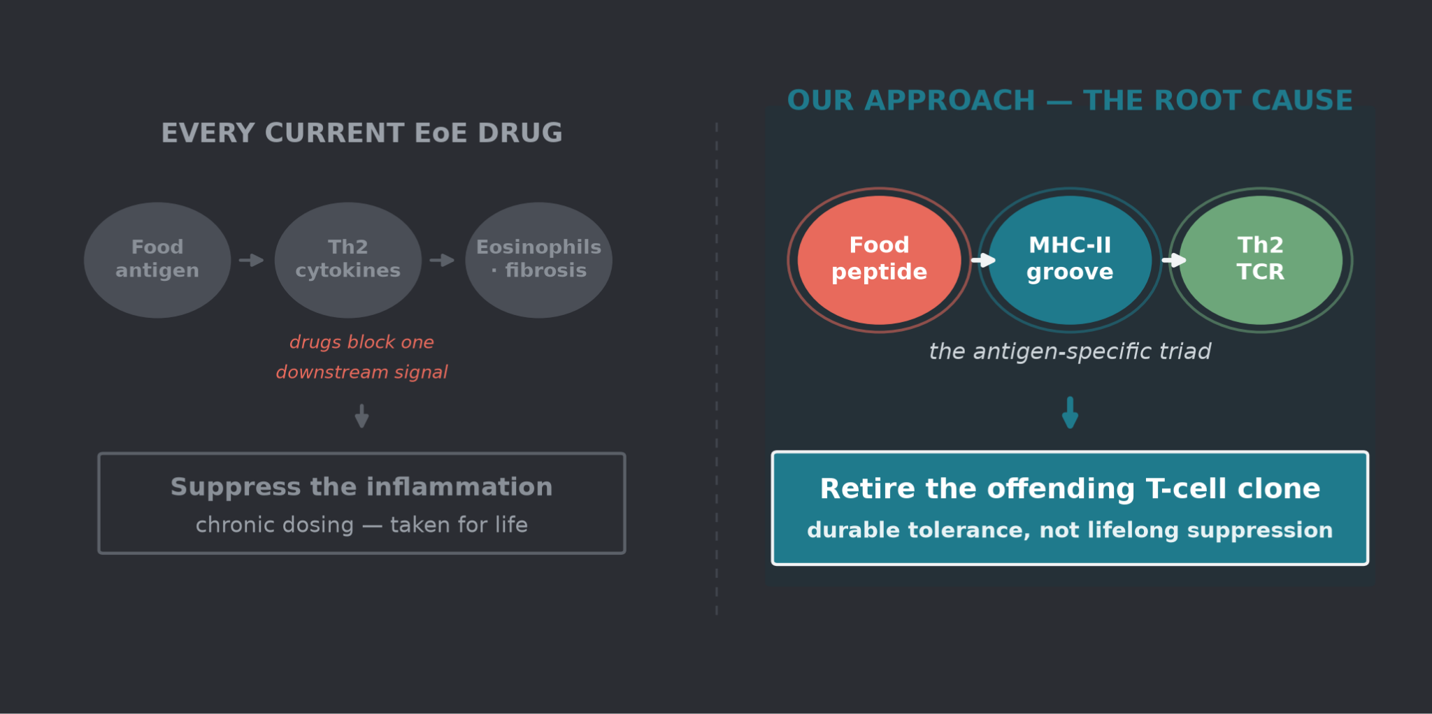
CHAPTER 3 · THE PIVOT
The Tolera Project: Target the cause
Notes:
Then the pivot — the heart of the science. Every EoE drug blocks a downstream cytokine, taken for life. But EoE is antigen-specific: a food peptide on MHC-II, seen by a pathogenic Th2 T-cell. Target that triad, and we retire the offending clone for durable tolerance — not lifelong immune suppression. This became Tolera.

Slide 6
CHAPTER 3 · THE PIVOT
Two ways to reprogram the pathogenic T cell
Beyond the personalized pMHC construct, we mined a genome-scale CD4+ T-cell Perturb-seq atlas to nominate drug targets that reprogram T-cell state.
PROGRAM A · STATE MODULATION
PROGRAM B · pMHC ADJUNCT
Dampen pathogenic Th2 output
Improve pMHC-tolerance amenability
122 selective knockdowns lower the core type-2 cytokines IL-13 / IL-5 / IL-4 — upstream drivers of the CCL26 / POSTN tissue axis — without shutting the T cell down.
Verdict: do not pursue standalone. Redundant with approved biologics (dupilumab, cendakimab); serves as a positive control (GATA3, IL4R recovered).
320 co-targets make committed effector clones more convertible to a regulatory (TR1 / iTreg) fate. Independent top hits STK11, SIK3, PRKAR1A converge on one energy-sensing kinase pathway.
Verdict: pursue with conditions. A differentiated combination adjunct to the pMHC construct — SIK3 is the tractable dual-program lead.
122
Program A dampeners
320
Program B co-targets
33 → SIK3
dual-program hits · lead
Dataset: genome-scale CD4+ T-cell Perturb-seq — labs of Alex Marson (Gladstone / UCSF) and collaborator Jonathan Pritchard (Stanford), via the CZI Virtual Cells Platform. Next: validate STK11 / SIK3 + pMHC in EoE-patient T cells.

Slide 7
CHAPTER 3 · THE PIVOT
Two paths to the clinic
The Perturb-seq mining converges on one kinase — SIK3 — that turns a single-antigen therapy into a broader combination.
PATH A · MONOTHERAPY
PATH B · COMBINATION (recommended)
pMHC-II nanoparticle, orphan
pMHC-II + SIK3 inhibitor
The antigen-specific construct as a single agent, down a rare-disease pathway.
Reach ≈70k (single HLA) · $2–5M upfront + $20–30M milestones · peak $100–200M/yr
Co-dose a transient, isoform-selective SIK3 inhibitor to prime committed clones for conversion.
Reach 140–200k (70–100% of EoE) · $5–10M upfront + $50–100M milestones · peak $400–800M/yr
Phase 1b go/no-go: 14-day EoE-patient CD4+ co-culture — the combination must raise iTreg/Tr1 conversion >2× over either agent alone, or Path B reverts to Path A.
Illustrative planning scenarios, not forecasts · SIK3: Program-B score 0.815, high cross-donor robustness (Perturb-seq)

Slide 8
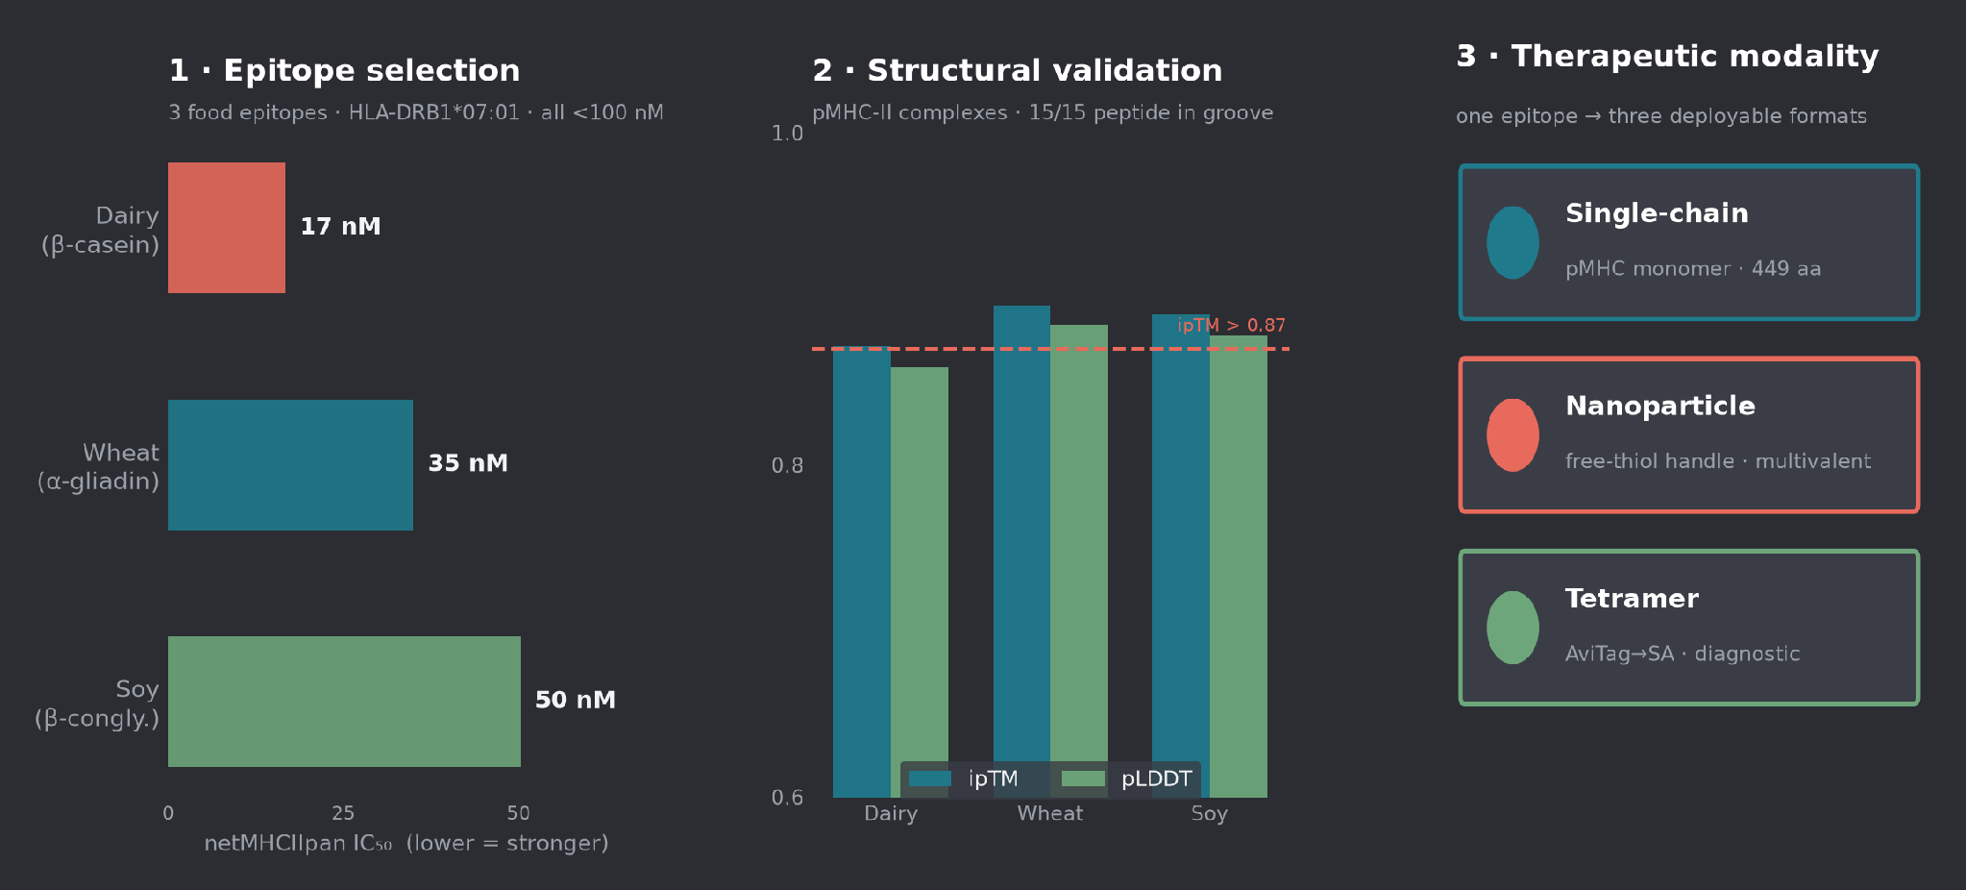
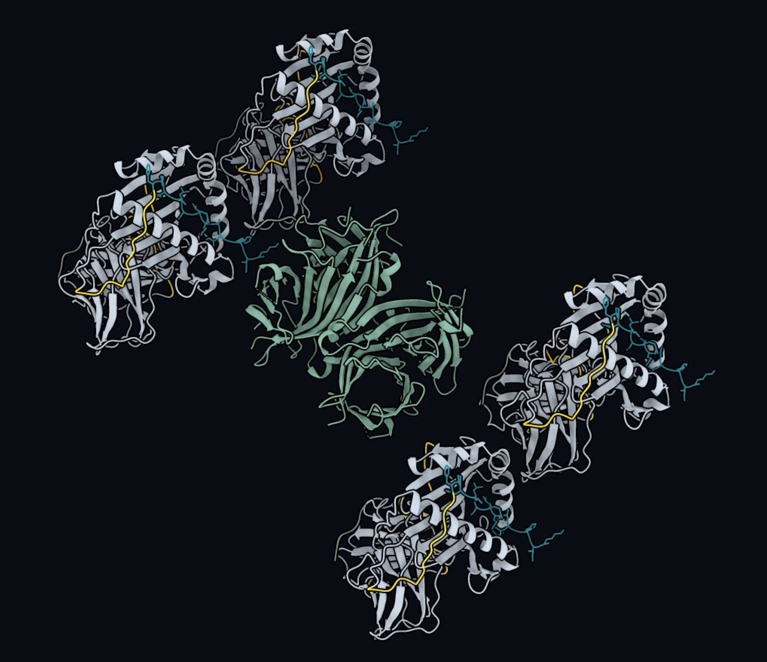
CHAPTER 4 · I HAD NEVER USED A PROTEIN MODEL
From target to designed protein
Notes:
As proof of concept, I picked dairy, wheat, and soy epitopes on HLA-DRB1*07:01 and used AI to model each peptide–MHC complex — peptide in the groove, high confidence. Then designed three formats: single-chain and nanoparticle therapeutics, and a diagnostic tetramer.

Slide 9
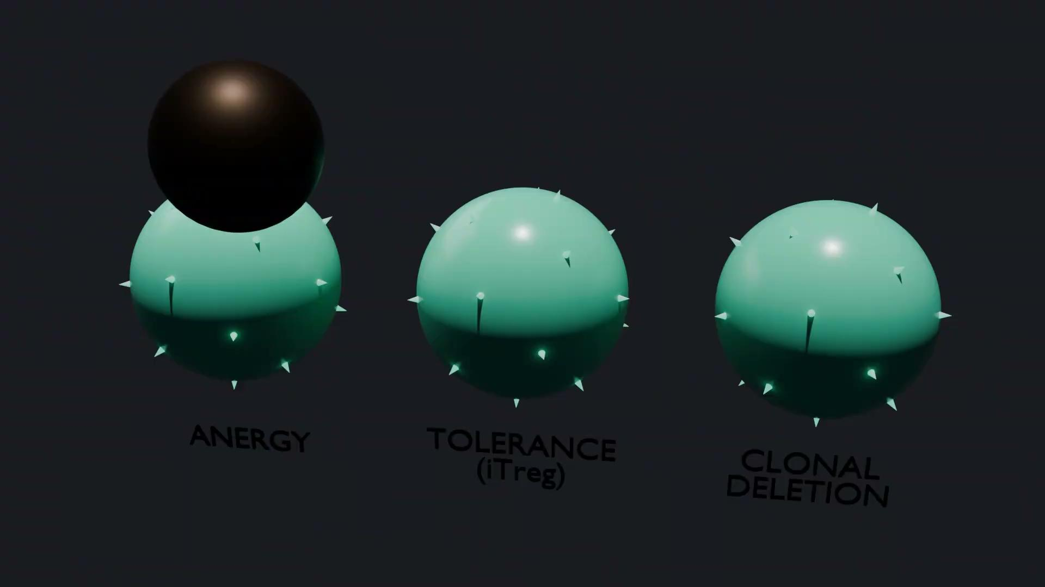
CHAPTER 5 · LEARNING BY BUILDING
I built skills and pushed them to the world
1
Created GitHub & Modal accounts
First time ever — from zero to publishing.
2
Published my first skills
Reusable pipelines anyone can run.
3
Learned ChimeraX & Blender
Rendered my own molecular videos…
4
…on Claude Science + Modal GPUs
Claude ran and rendered them for me.
github.com/ruthannepai-tech · rendered on Modal
Notes:
And I didn't just use tools — I built them. New GitHub and Modal accounts, my first published skills, ChimeraX and Blender for my own molecular videos. Then I asked: how do I scale this?

Slide 10
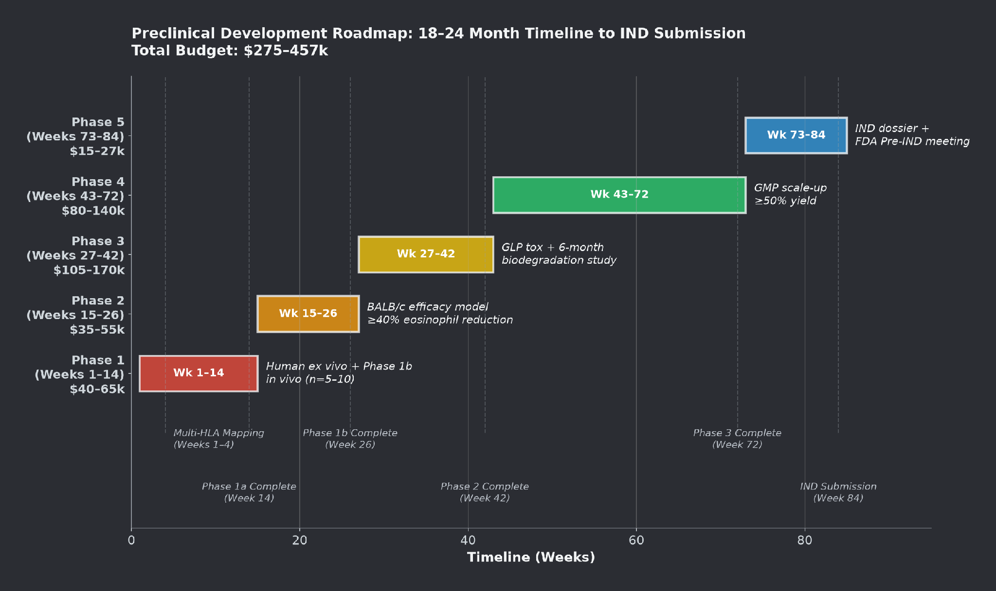
CHAPTER 6 · FROM WEEK TO ROADMAP
A full AI-to-clinic plan
Out of one week:
• 3 Peer-review–style manuscripts
with synthetic reviewer responses
• Preclinical → IND roadmap
• Regulatory & market strategy
• The Project Tolera deck
A credible line from a public
dataset to the clinic.
Notes:
I then laid out a full AI-to-clinic pipeline — preclinical roadmap, regulatory strategy, market and payer analysis. A path from a public dataset all the way to a patient.

Slide 11
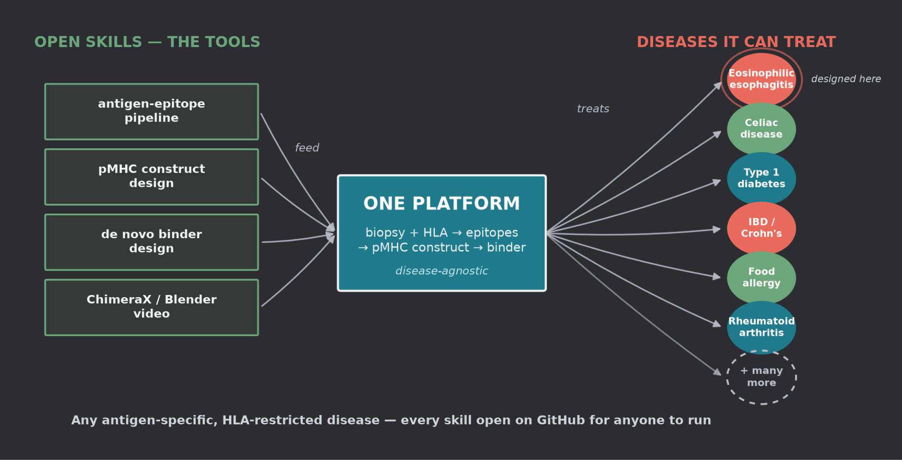
CHAPTER 7 · ONE PLATFORM, MANY DISEASES
Built to overcome disease — at scale
Notes:
EoE was the proving ground, but the platform is antigen-agnostic — it fits any antigen-specific immune disease. And because every step is an open skill, any researcher can point it at their own. Not one drug — a method.

Slide 12
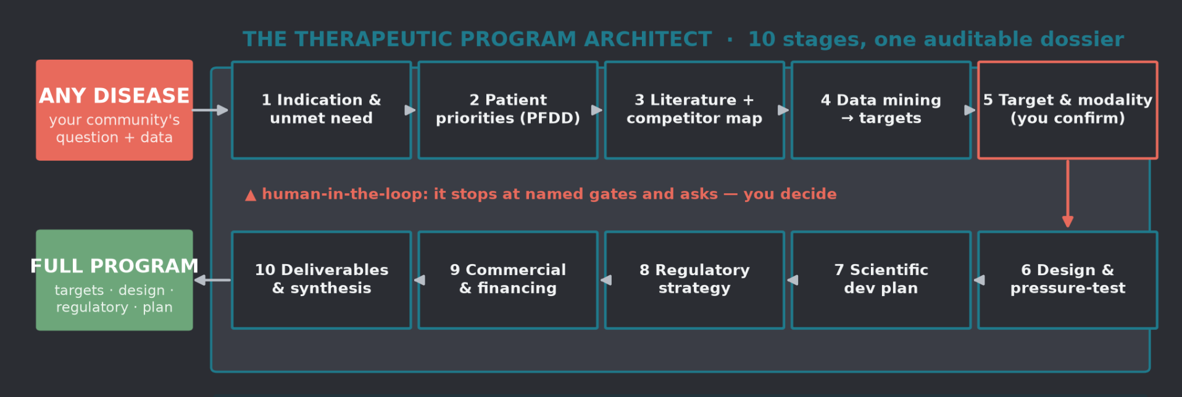
CHAPTER 8 · THE REUSABLE ENGINE
The Specialist Agent: any disease → a full drug program
Demonstrated on EoE. I packaged the whole method as an installable specialist — now anyone can point it at their disease and run. To prove that, I re-ran the whole engine on a second disease — esophageal cancer — and it produced a dual-arm GUCY2C + DKK1 target-and-binder program of its own.
Notes:
Everything I did for EoE, I packaged into one Specialist Agent — a Therapeutic Program Architect. Give it any disease, and it runs ten stages into a single auditable dossier. It's patient-centered and never silently commits — at every gate it stops and asks you to decide. Open, for anyone to run.

Slide 13
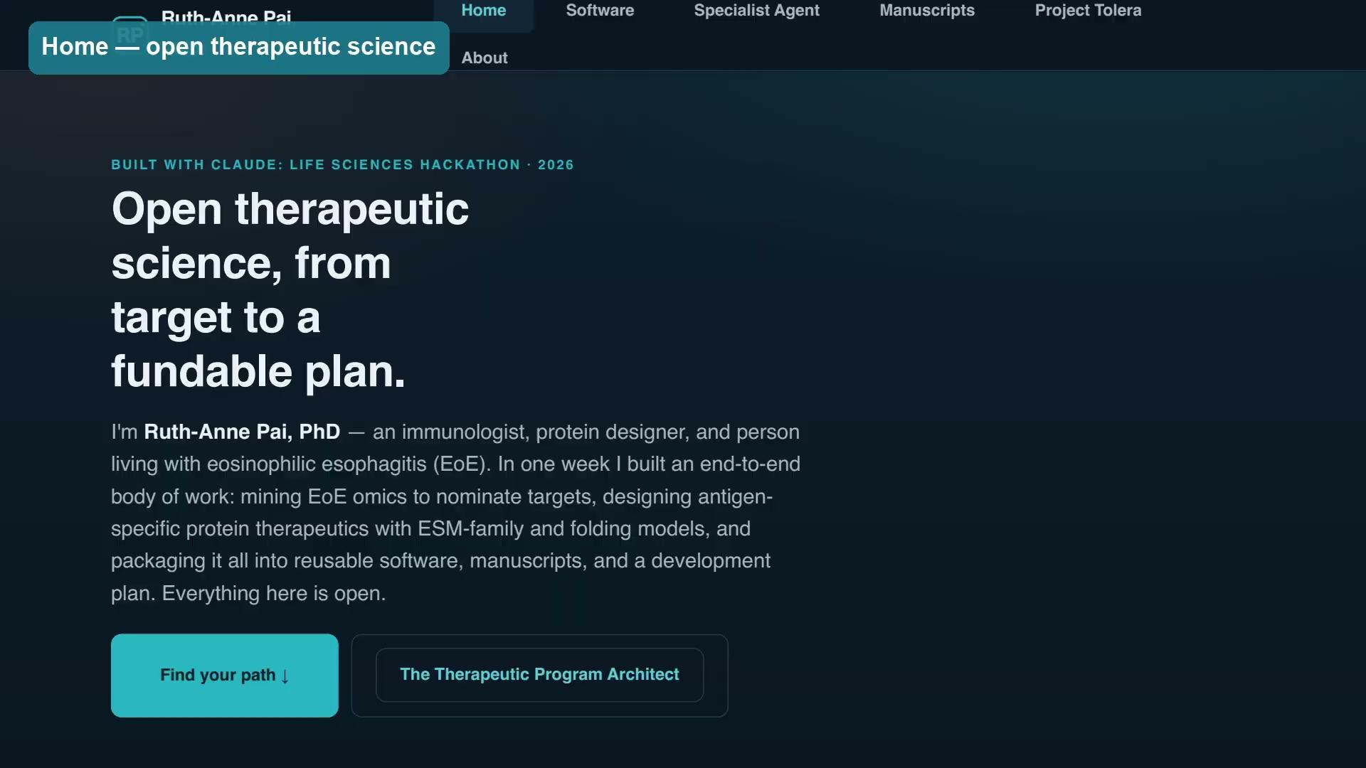
CHAPTER 9 · THE FRONT DOOR
One website — the whole project, open to anyone
ruthannepai.netlify.app
Six pages, six audiences:
• Patient orgs & advocates
• Scientists using protein models
• Biotech, investors & partners
• Claude Science developers
• Academics & data scientists
3 manuscripts 10 repos
2 diseases 0.86–0.94 ipTM
Every result, skill, and structure —
downloadable, open, reproducible.
ruthannepai.netlify.app · walkthrough video embedded — click to play
Notes:
And it all lives in one place — a website open to anyone. Nine constructs, eight repositories, two manuscripts, every structure and skill, downloadable and reproducible. The front door.

Slide 14
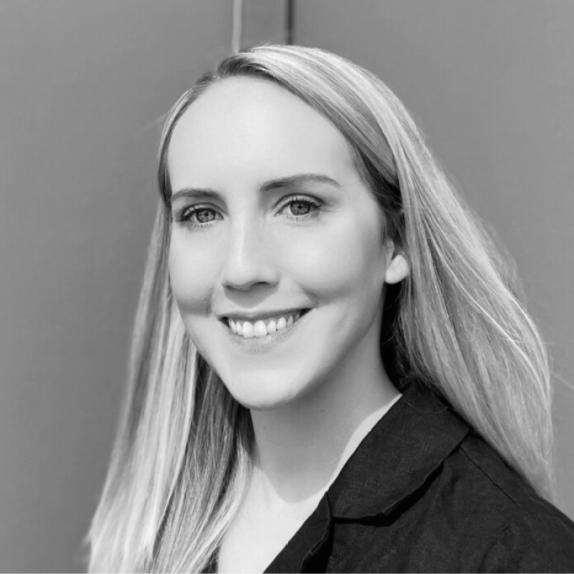
WHY THIS MATTERS
Science, democratized.
As an EoE patient, I was empowered to lean into
the science and design a therapy for my own disease.
Patient-driven, patient-centered drug development
is now genuinely possible.
500 hackers + a growing wave of AI adopters can close the gap —
and change lives.
Thank you hackathon organizers — Anthropic · Gladstone Institutes · Cerebral Valley — Ruth-Anne Pai, PhD
Notes:
I'll close where I opened: this is personal. Being empowered to design a therapy for my own disease — that's the democratization of science. Patient-driven drug development is now genuinely possible. Thank you to the organizers and developers who made this week possible.

