Slide 1
Tolera Bio
Antigen-specific tolerance, one patient at a time.
A personalized pMHC-II tolerance vaccine for eosinophilic esophagitis.
One course, not a lifetime of symptom suppression.
Series Seed · $8M · seeking lead investor | Ruth-Anne Pai, PhD — Founder & CEO (immunologist; living with EoE)

Slide 2
THE PROBLEM
A disease you manage every meal, for life
EoE is a chronic, food-driven immune disease — ~167,500 people in the US, and rising.
• Diagnosis takes years and repeated sedated endoscopies
• PPIs, steroids, elimination diets, dupilumab — all effective for some, none curative
• Stop treatment and inflammation returns; uncontrolled disease progresses to irreversible fibrostenosis
• The daily burden — chewing every bite, avoiding restaurants, the fear of choking — never shows up in a biopsy
The insight everyone missed
EoE is fundamentally antigen-specific — a food peptide, presented on an MHC-II molecule, to a pathogenic T-cell clone.
Yet every approved and pipeline therapy blocks a downstream cytokine or cell, and must be taken indefinitely.
None touches the antigen-specific cause.
Tolera Bio · 2

Slide 3
WHY NOW
Three things are true for the first time
The biology is validated
The regulatory path exists
The design already computes
The first EoE food-reactive TCR and its pMHC-II triad are characterized. The disease's antigen-specific cause is now addressable.
Tzield (2022) proved the FDA will approve a disease-modifying immune therapy. Neoantigen vaccines proved per-patient biologics clear CMC.
A 9-construct pMHC-II panel folds at ipTM 0.87–0.90, 15/15 in-groove. This is not slide-ware — it is built.
Tolera Bio · 3

Slide 4
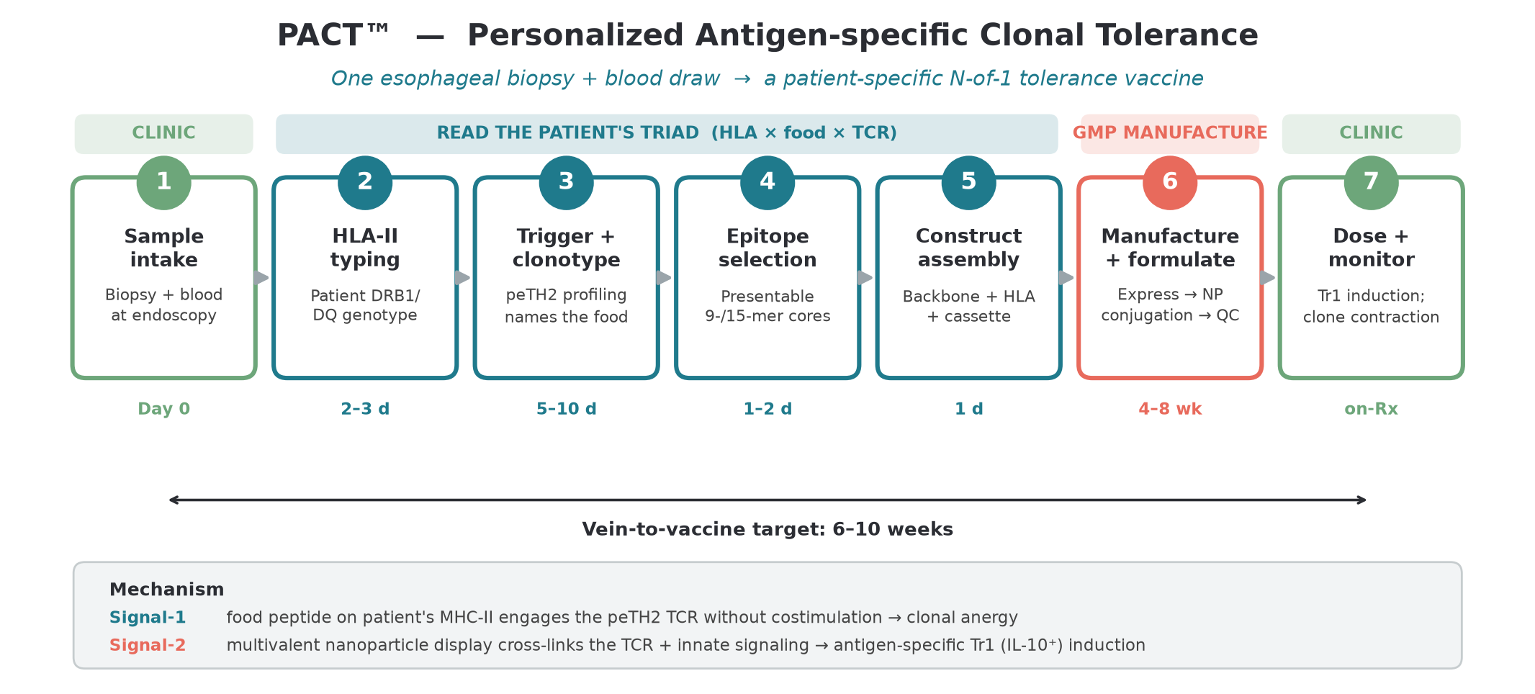
THE SOLUTION
Retire the clone. Don't suppress the system.
From one biopsy + blood draw, we identify the patient's HLA type and causal food-reactive clone and manufacture an N-of-1 vaccine that re-educates only that clone — Signal-1 anergy + multivalent nanoparticle Tr1/IL-10 induction.
Tolera Bio · 4

Slide 5
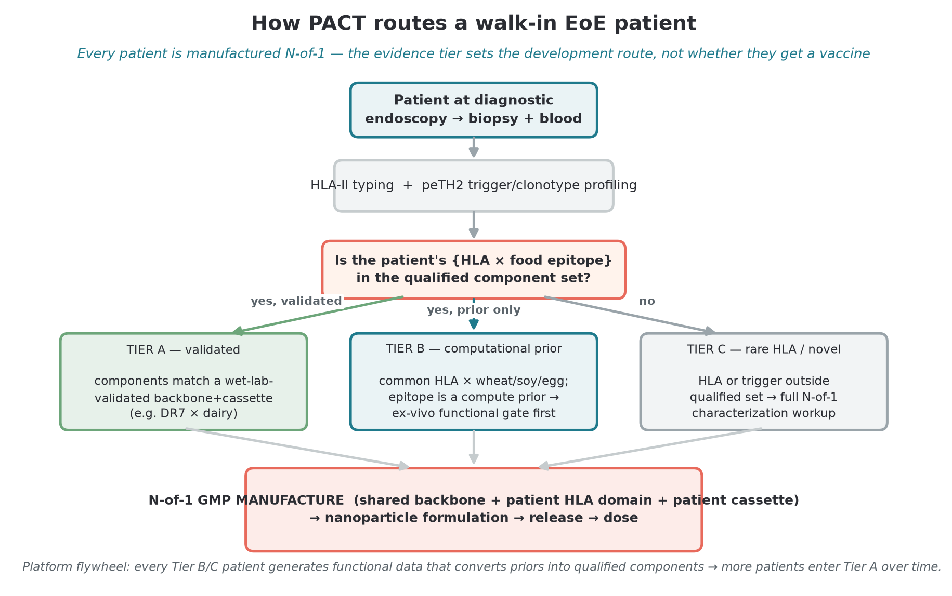
PLATFORM — PACT™
One backbone, a swappable cassette per patient
Personalized therapy is only investable if manufacturing is tractable.
PACT™ uses a shared, GPU-validated MHC-II backbone with a swappable peptide cassette — only the peptide changes per patient.
The expensive, regulated components are standardized and validated once.
• Vein-to-vaccine target: 6–10 weeks
• The process is exported, not an inventory — it travels internationally
• The same engine extends to celiac and other food/auto-antigen disease
Tolera Bio · 5

Slide 6
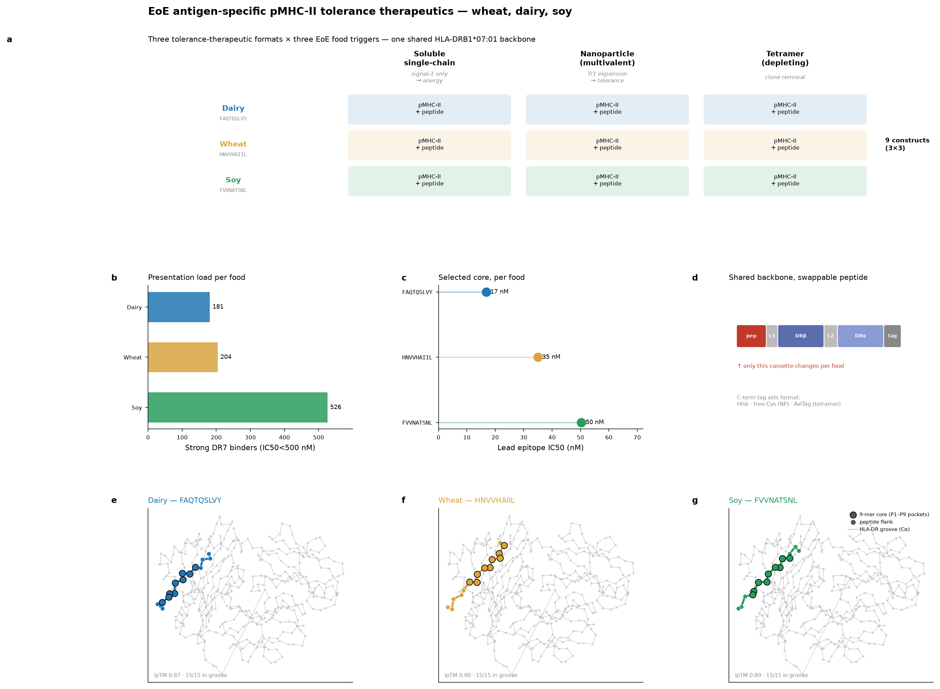
SCIENTIFIC VALIDATION
The design is built and computes
9-construct panel
dairy · wheat · soy
ipTM 0.87–0.90
15/15 peptides in-groove
Dairy anchor (β-casein aa59–78, HLA-DRB1*07:01): tetramer-validated in the literature*
Wheat + soy: computational priors — wet-lab validation is a funded Seed milestone
*attribution carried from founding brief; flagged for diligence verification
Tolera Bio · 6

Slide 7
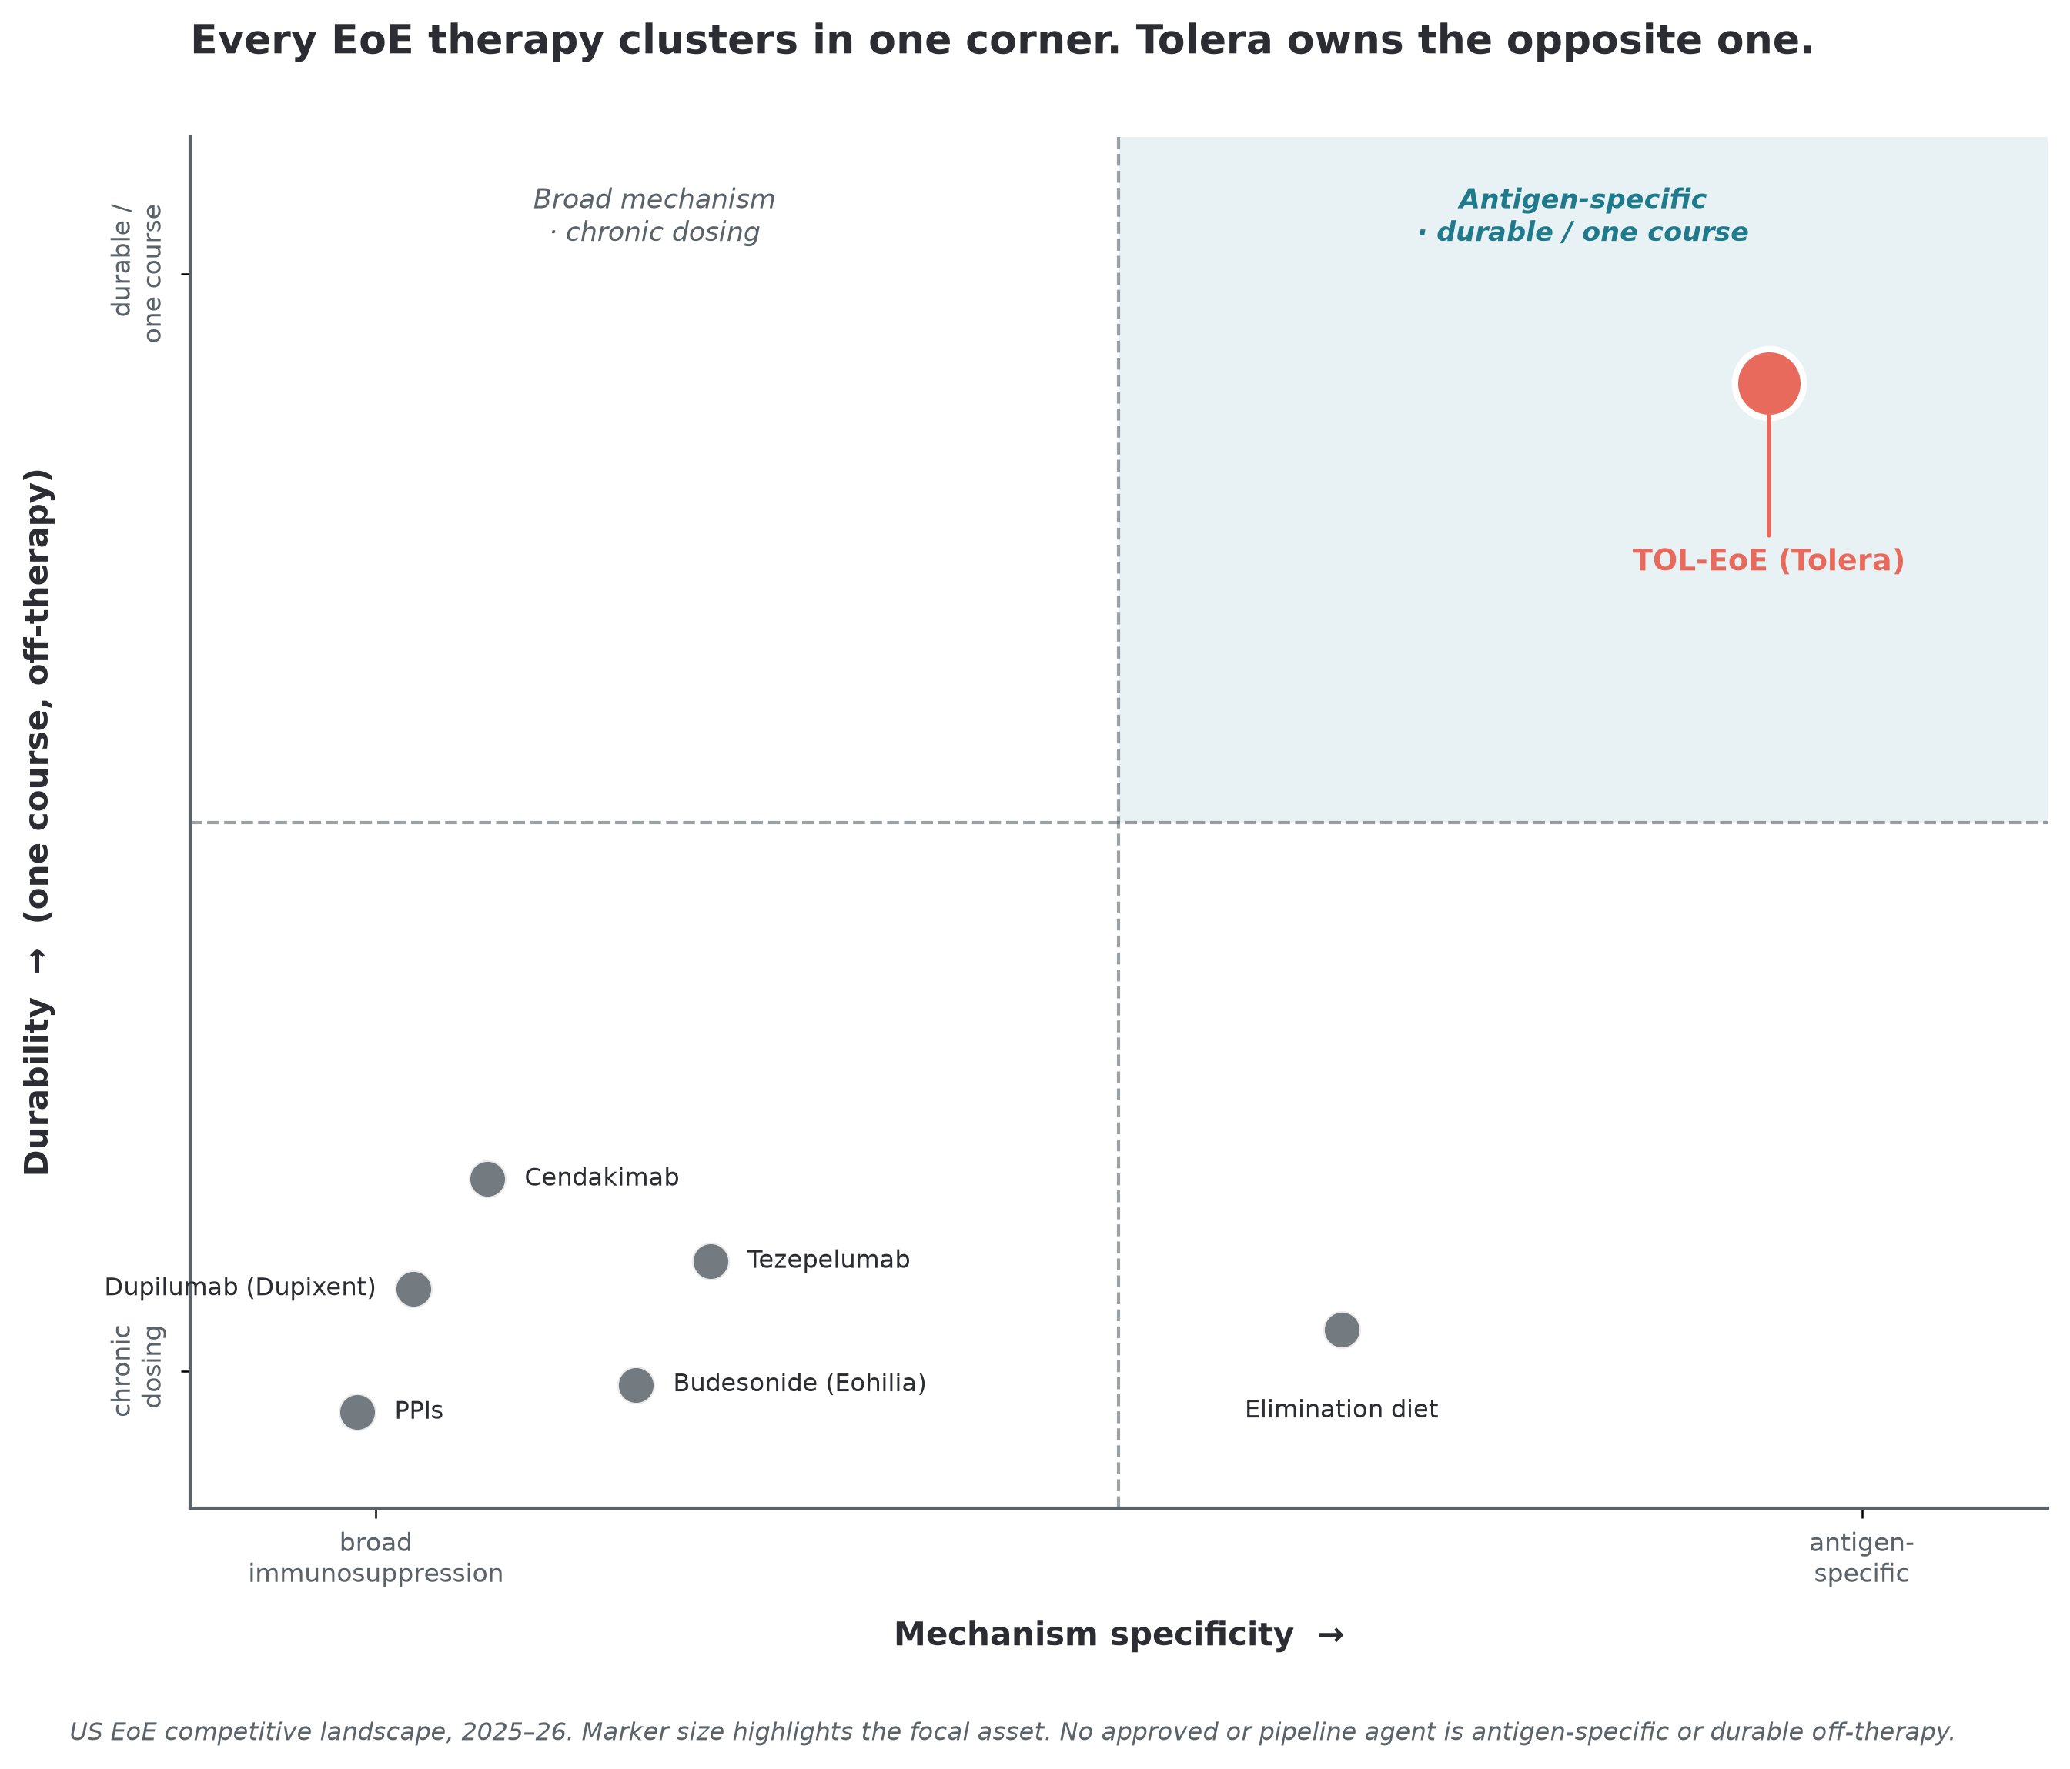
COMPETITIVE WHITESPACE
Everyone clusters in one corner. We own the other.
Every approved and pipeline EoE therapy is a broad-mechanism, chronic-dosing symptom suppressor.
Tolera is the only antigen-specific, one-course entrant.
The differentiation is categorical, not incremental — and a recent pipeline agent was dropped for EoE after missing the endoscopic endpoint despite a mechanistic effect. Mechanism alone doesn't win.
Tolera Bio · 7

Slide 8
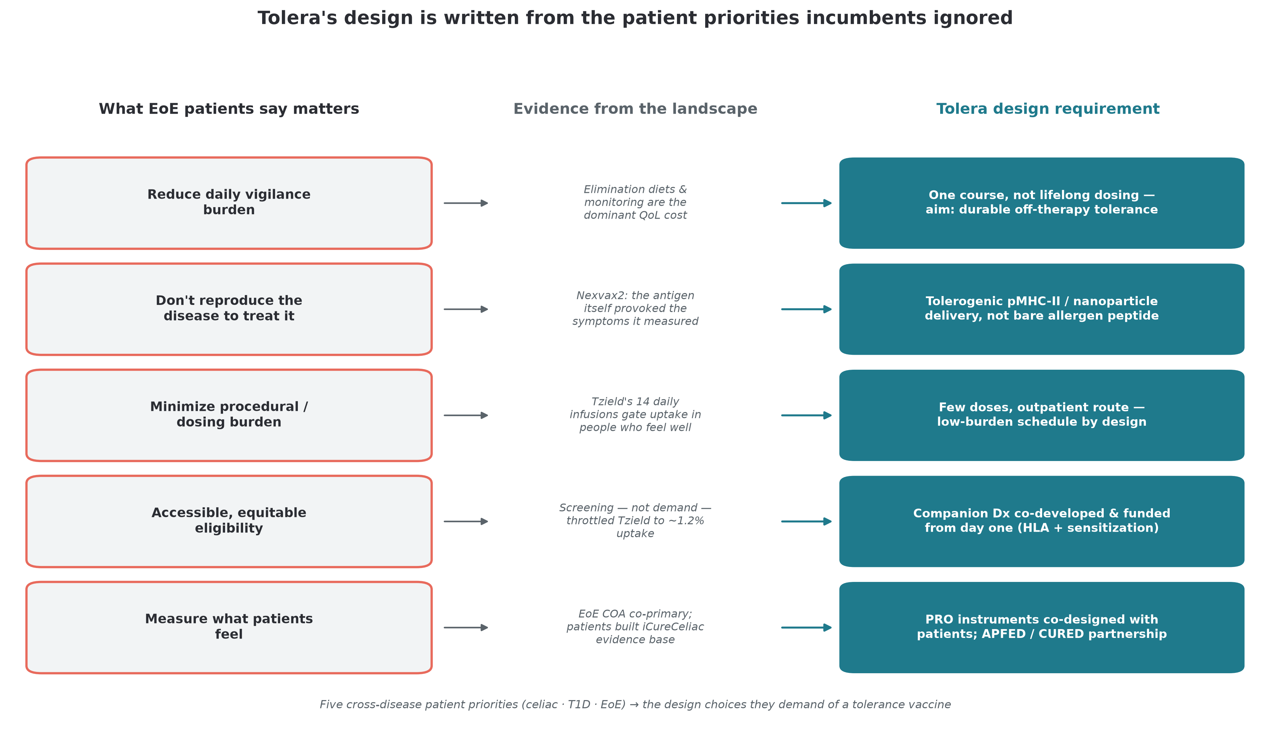
OUR UNFAIR ADVANTAGE
The first program to put patient voice first
Across T1D, celiac, and MS, formal patient input arrived too late to shape trial design. EoE has no dedicated PFDD and no pMHC program — so Tolera can invert the field's sequence.
Tolera Bio · 8

Slide 9
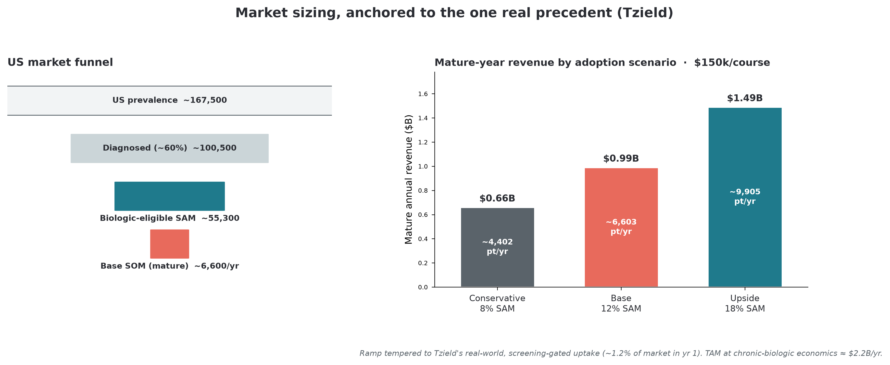
MARKET
~$2.2B TAM, anchored to the one real precedent
US funnel
167,500 → 100,500 → 55,300 SAM
Base case (12% of SAM):
~6,600 patients/yr
~$1.0B mature revenue
Range: $0.66B / $0.99B / $1.49B
Tempered from a single 15% point to Tzield's real, screening-gated ramp.
Tolera Bio · 9

Slide 10
BUSINESS MODEL
Two revenue lines from one biopsy
Therapeutic — TOL-EoE
Companion diagnostic
Platform optionality
Personalized one-course tolerance vaccine. Value-based priced at ~$150k — ~23% below Tzield's actual $194k/course.
Blood-based food-trigger + clonotype assay. Patient-selection gate AND remission monitor. Revenue earlier and independent of the therapeutic.
PACT extends to celiac and other food/auto-antigen disease; qualified backbones/cassettes are out-licensable.
Tolera Bio · 10

Slide 11
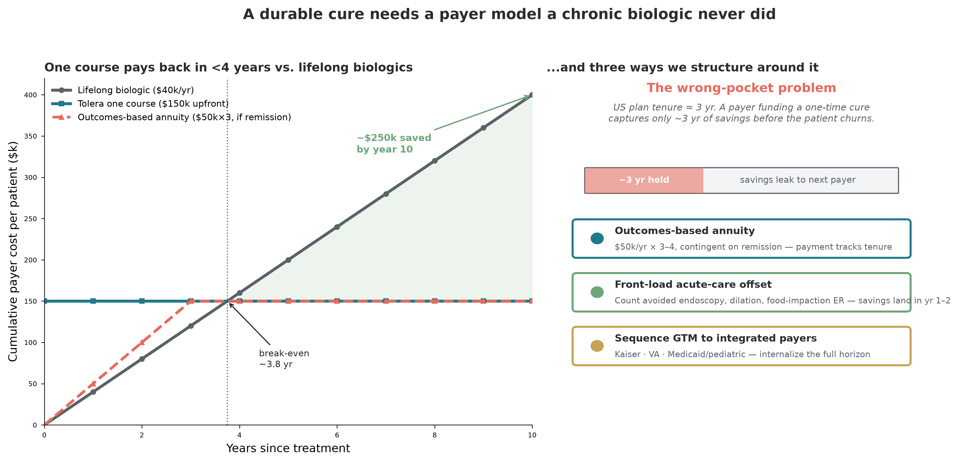
MARKET ACCESS
A durable cure needs a payer model chronic drugs never did
We name the wrong-pocket problem and carry three contracting models — outcomes-based annuity, one-time + warranty, front-loaded offset — matched per payer channel.
Tolera Bio · 11

Slide 12
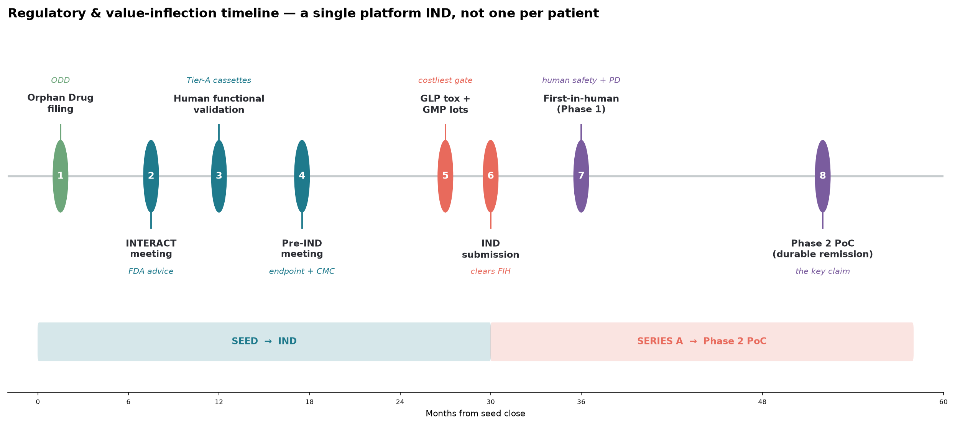
REGULATORY STRATEGY
A platform IND on a proven precedent
One platform IND — not one per patient — on the individualized-product framework.
ODD → Fast Track → Breakthrough → test RMAT
EoE co-primary (histology + dysphagia COA) is FDA-validated.
We will seek histologic remission as an Accelerated-Approval surrogate — borrowing Tzield's disease-modification logic.
Companion Dx co-reviewed, timeline in parallel.
Tolera Bio · 12

Slide 13
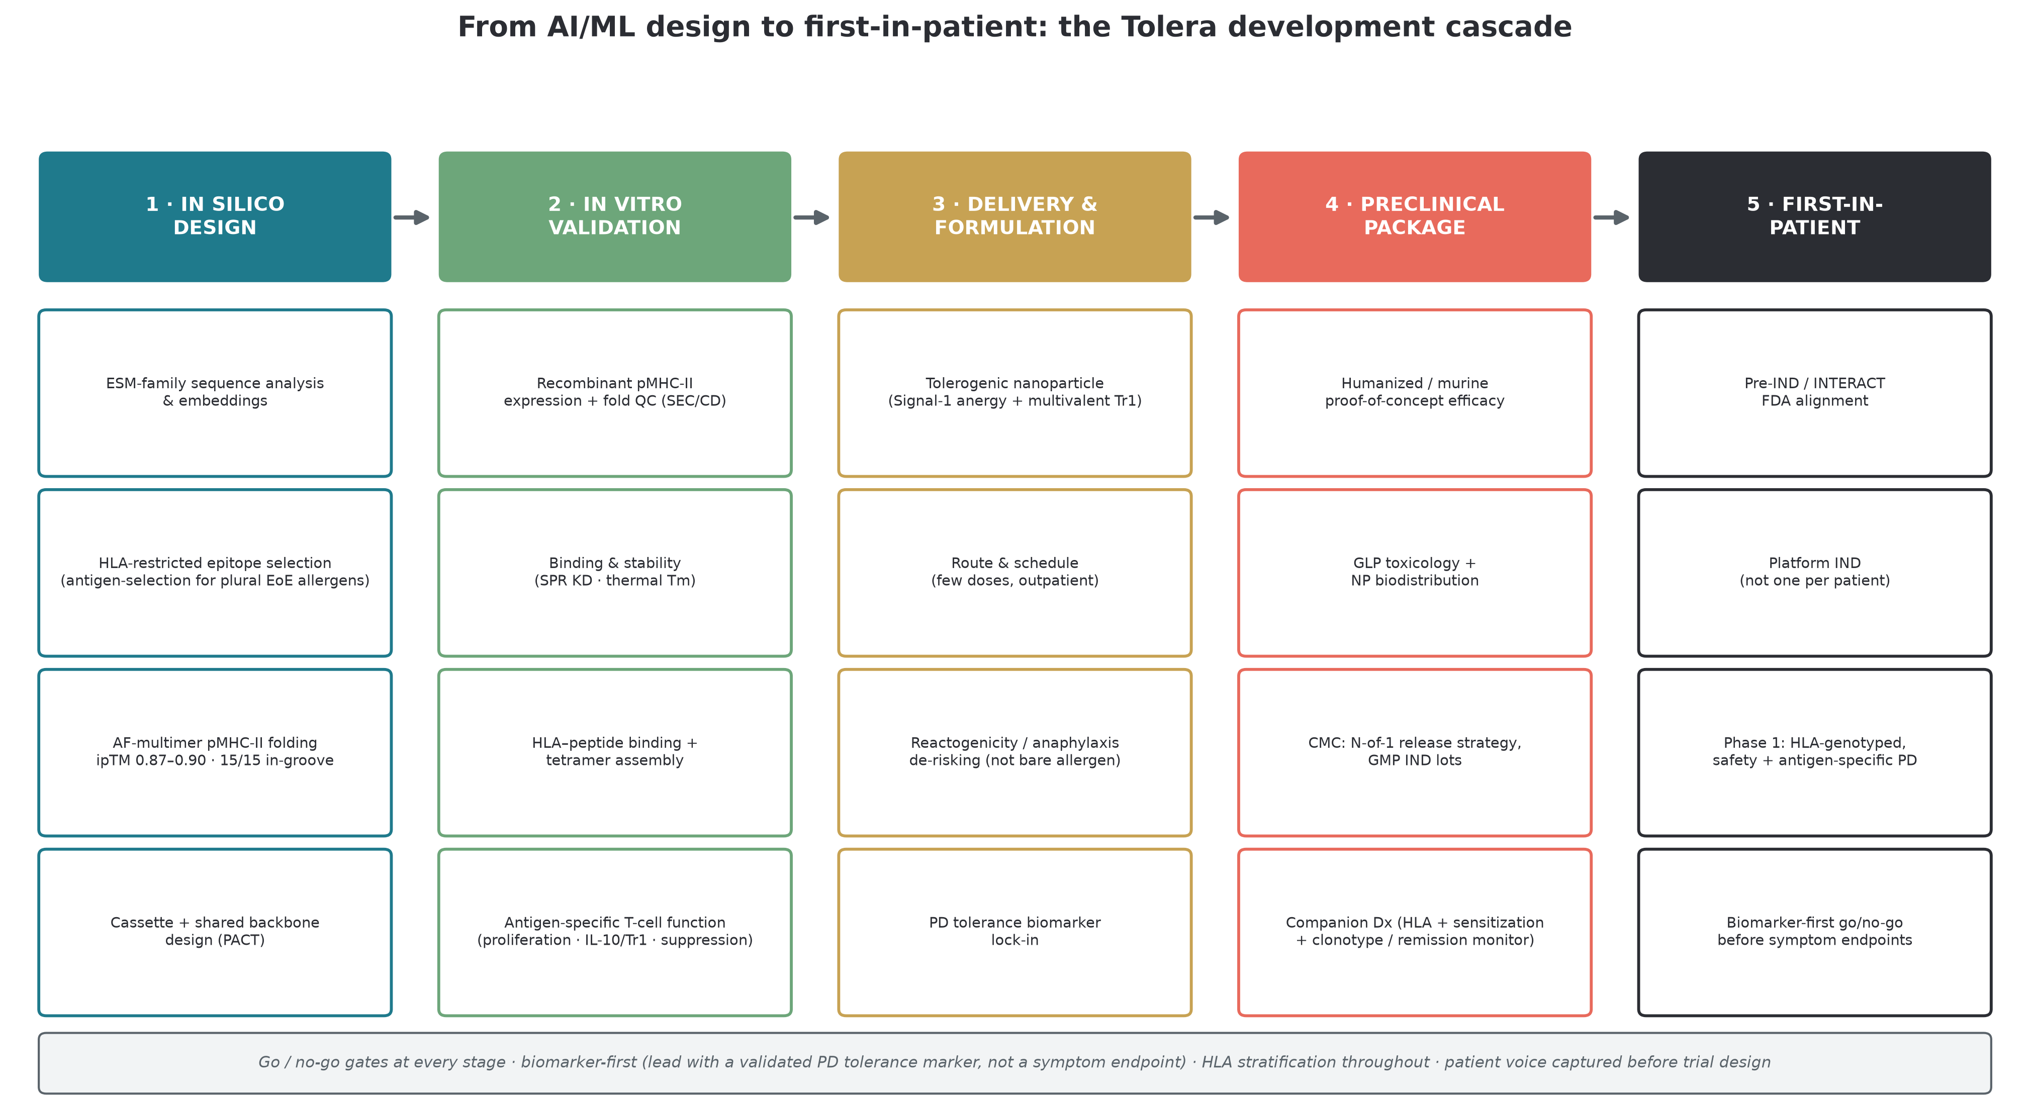
DEVELOPMENT PLAN
From AI/ML design to first-in-patient
Biomarker-first · tolerogenic delivery (not bare allergen) · HLA-stratified · early-disease endpoint · co-built screening — the winners' playbook.
Tolera Bio · 13

Slide 14
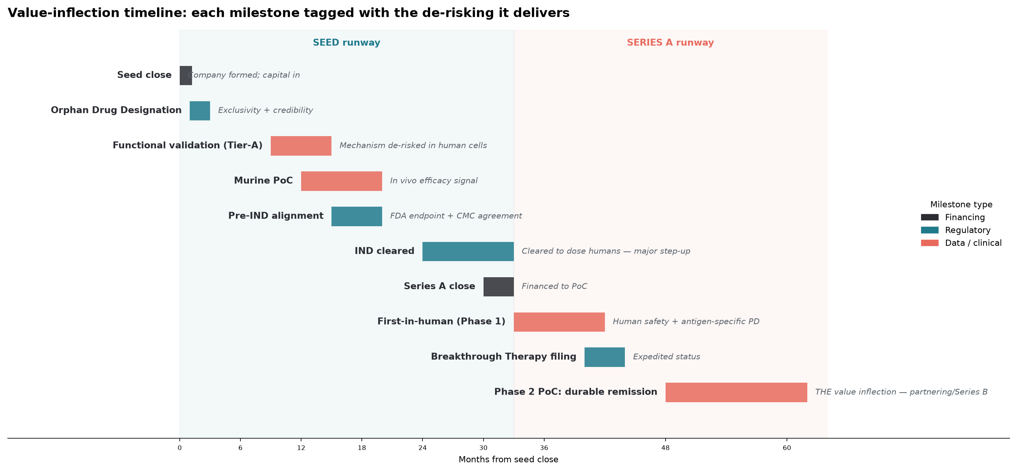
MILESTONES
Capital-efficient path to value inflection
Tolera Bio · 14

Slide 15
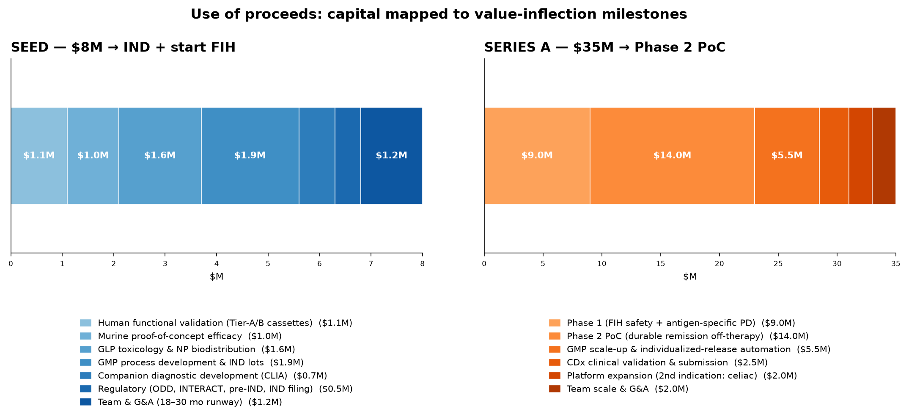
THE ASK
$8M Seed to a cleared IND + first-in-human
$8M Seed → cleared IND + FIH dosing (18–30 mo)
$35M Series A → Phase 2 durable-remission PoC (~$43M cumulative)
The exit comp: Tzield, a first-in-class tolerance asset, drew a $2.9B Sanofi acquisition on a single indication — at a price above ours.
Tolera Bio · 15

Slide 16
Why us
A patient-scientist founder who designed the platform and lives the disease — a durable advantage in trial design, recruitment, endpoint selection, and community trust.
Antigen-specific tolerance, one patient at a time.
Tolera Biosciences, Inc. · Series Seed · $8M · seeking lead investor

