Slide 1
Project Tolera
Antigen-specific tolerance, one patient at a time.
A citizen-scientist's roadmap for a personalized pMHC-II tolerance vaccine in eosinophilic esophagitis — from AI/ML design to first-in-patient.
Ruth-Anne Pai, PhD
PhD Scientist & Advisor | Bridging Science and Advocacy · person living with EoE
advising@ruthannepai.com · ruthannepai.com · linkedin.com/in/ruth-anne-pai
Developed during the “Built with Claude: Life Sciences Hackathon,” July 2026

Slide 2
THE PROBLEM
A disease you manage every meal, for life
EoE is a chronic, food-driven immune disease — ~167,500 people in the US, and rising.
• Diagnosis takes years and repeated sedated endoscopies
• PPIs, steroids, elimination diets, dupilumab — all effective for some, none curative
• Stop treatment and inflammation returns; uncontrolled disease progresses to irreversible fibrostenosis
• The daily burden — chewing every bite, avoiding restaurants, the fear of choking — never shows up in a biopsy
The insight everyone missed
EoE is fundamentally antigen-specific — a food peptide, presented on an MHC-II molecule, to a pathogenic T-cell clone.
Yet every approved and pipeline therapy blocks a downstream cytokine or cell, and must be taken indefinitely.
None touches the antigen-specific cause.
Project Tolera · 2

Slide 3
WHY NOW
Three things are true for the first time
The biology is validated
The regulatory path exists
The design already computes
The first EoE food-reactive TCR and its pMHC-II triad are characterized. The disease's antigen-specific cause is now addressable.
Tzield (2022) proved the FDA will approve a disease-modifying immune therapy. Neoantigen vaccines proved per-patient biologics clear CMC.
A 9-construct pMHC-II panel folds at ipTM 0.87–0.90, 15/15 in-groove — built by one citizen-scientist in a week.
Project Tolera · 3

Slide 4
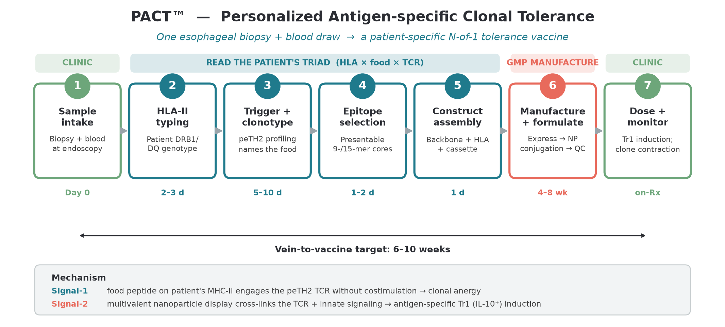
THE APPROACH
Retire the clone. Don't suppress the system.
From one biopsy + blood draw, the workflow identifies the patient's HLA type and causal food-reactive clone and manufactures an N-of-1 vaccine that re-educates only that clone — Signal-1 anergy + multivalent nanoparticle Tr1/IL-10 induction.
Project Tolera · 4

Slide 5
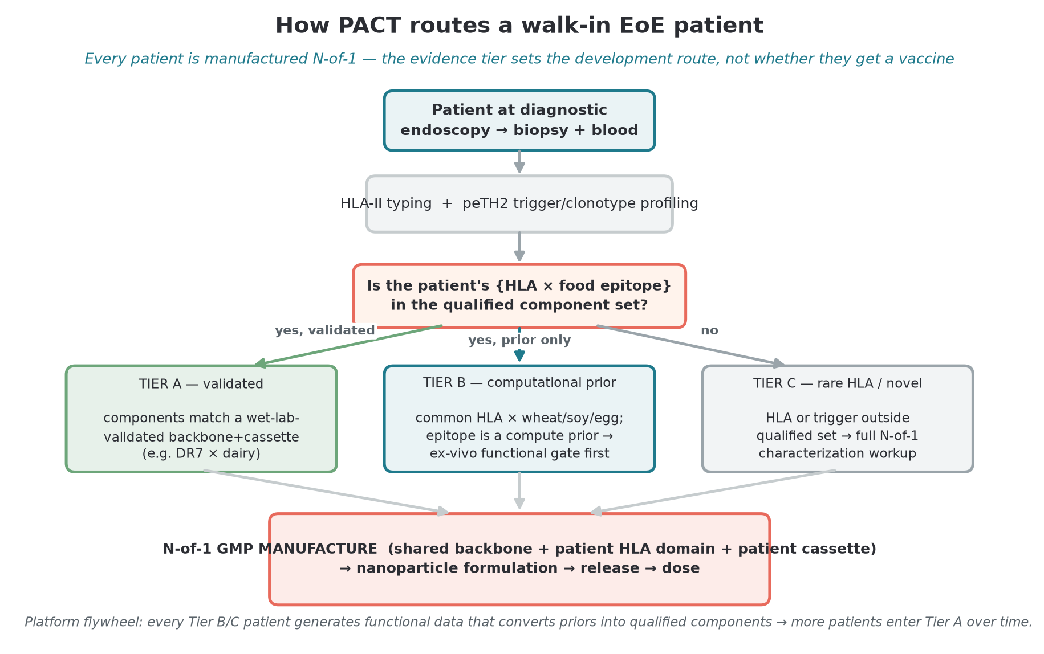
PLATFORM — PACT™
One backbone, a swappable cassette per patient
Personalized therapy is only viable if manufacturing is tractable.
PACT™ uses a shared, GPU-validated MHC-II backbone with a swappable peptide cassette — only the peptide changes per patient.
The expensive, regulated components are standardized and validated once.
• Vein-to-vaccine target: 6–10 weeks
• The process is exported, not an inventory — it travels internationally
• The same engine extends to celiac and other food/auto-antigen disease
Project Tolera · 5

Slide 6
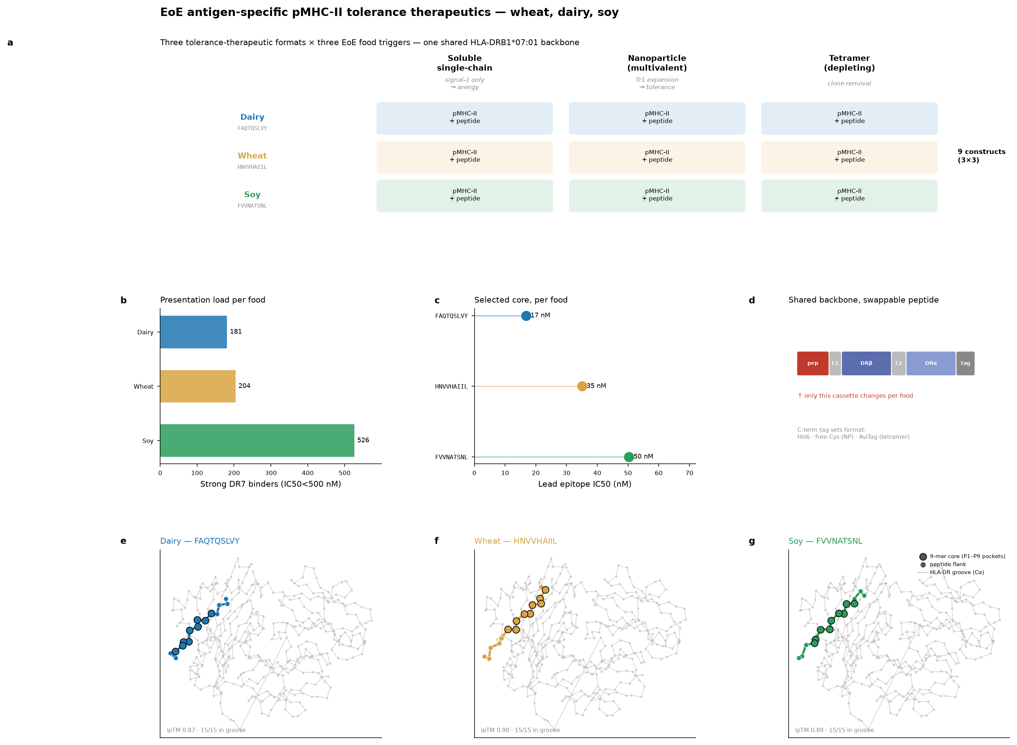
SCIENTIFIC VALIDATION
The design is built and computes
9-construct panel
dairy · wheat · soy
ipTM 0.87–0.90
15/15 peptides in-groove
Dairy anchor (β-casein aa59–78, HLA-DRB1*07:01): supported by a reported tetramer-validated epitope*
Wheat + soy: computational priors — wet-lab validation is a near-term milestone
*attribution carried from founding brief; flagged for independent verification
Project Tolera · 6

Slide 7
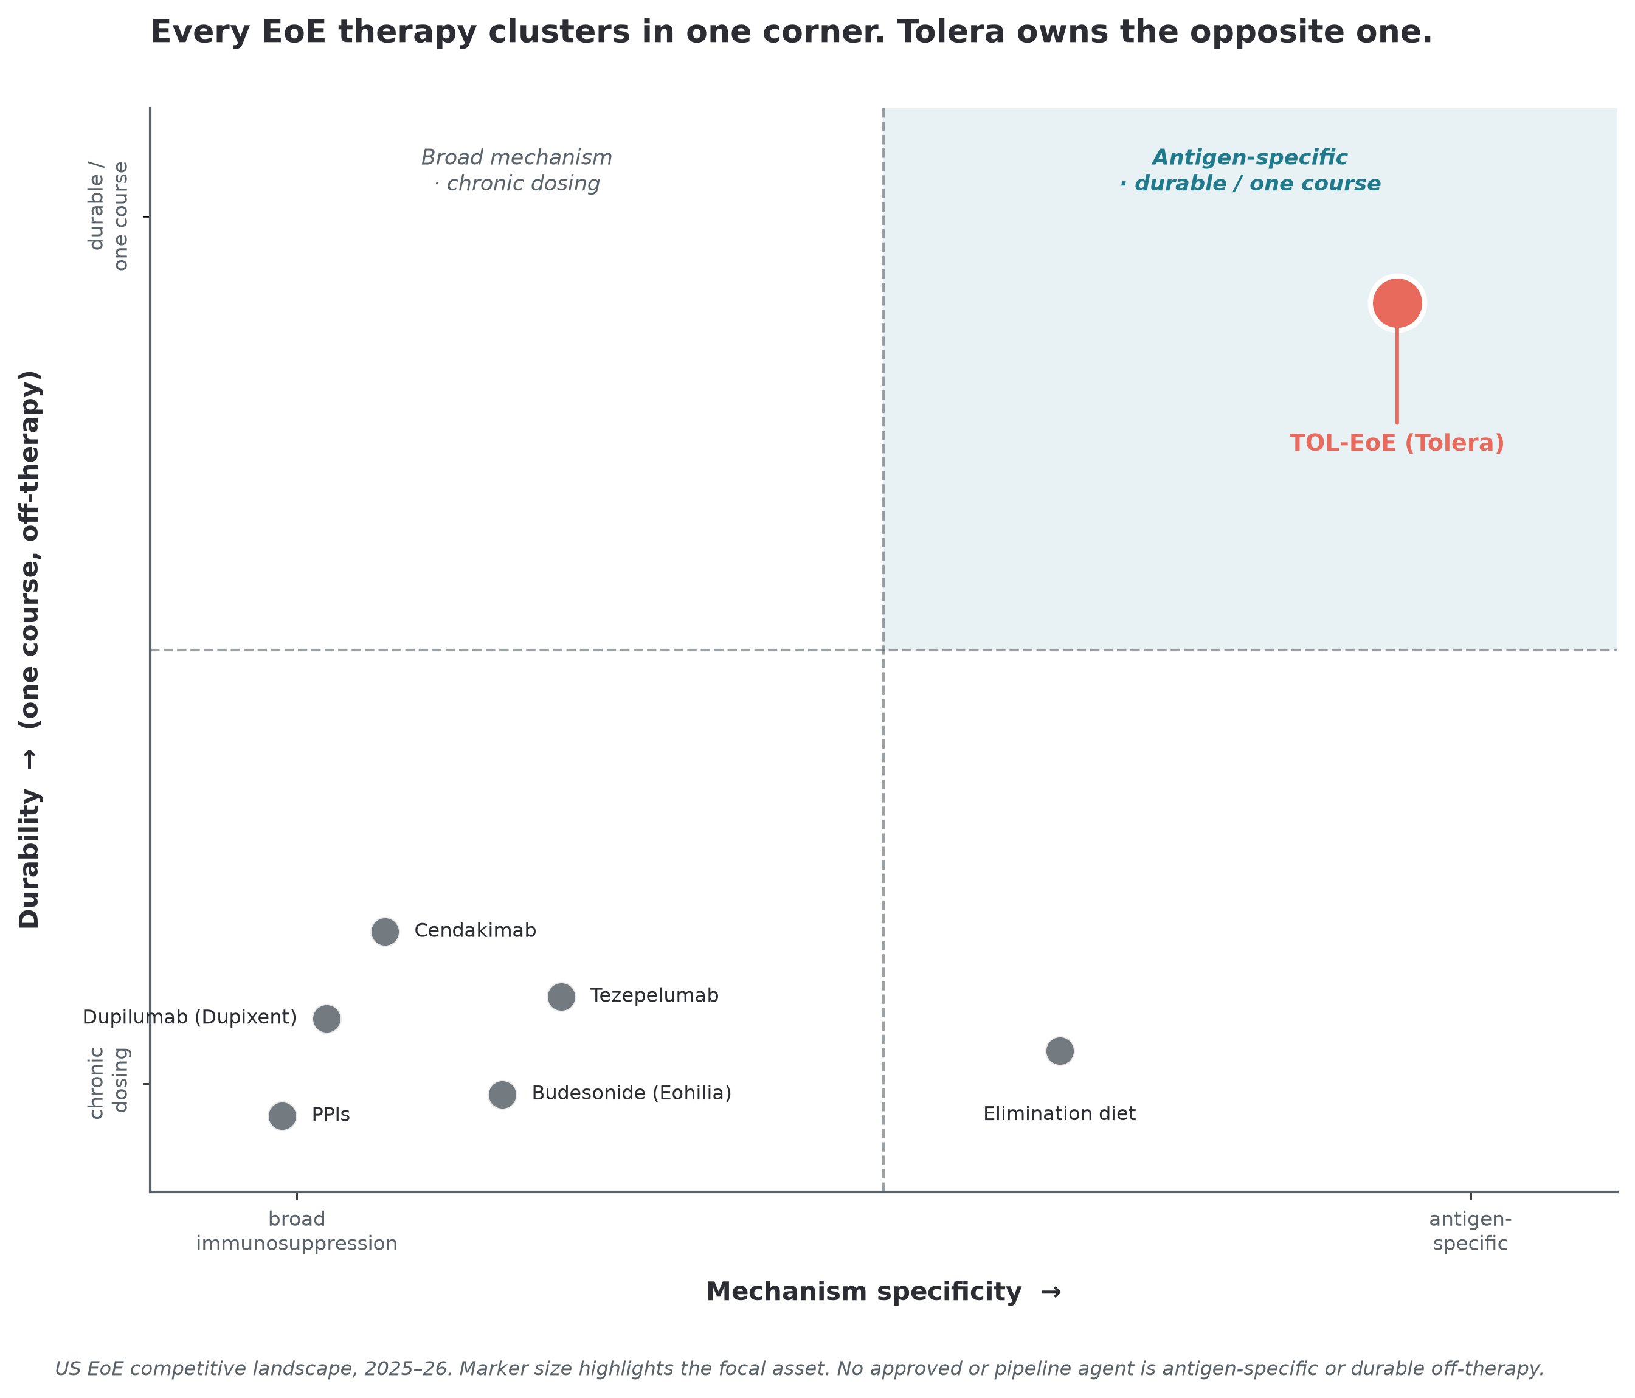
COMPETITIVE WHITESPACE
Everyone clusters in one corner. This owns the other.
Every approved and pipeline EoE therapy is a broad-mechanism, chronic-dosing symptom suppressor.
Project Tolera is the only antigen-specific, one-course approach.
The differentiation is categorical, not incremental — and a recent pipeline agent was dropped for EoE after missing the endoscopic endpoint despite a mechanistic effect. Mechanism alone doesn't win.
Project Tolera · 7

Slide 8
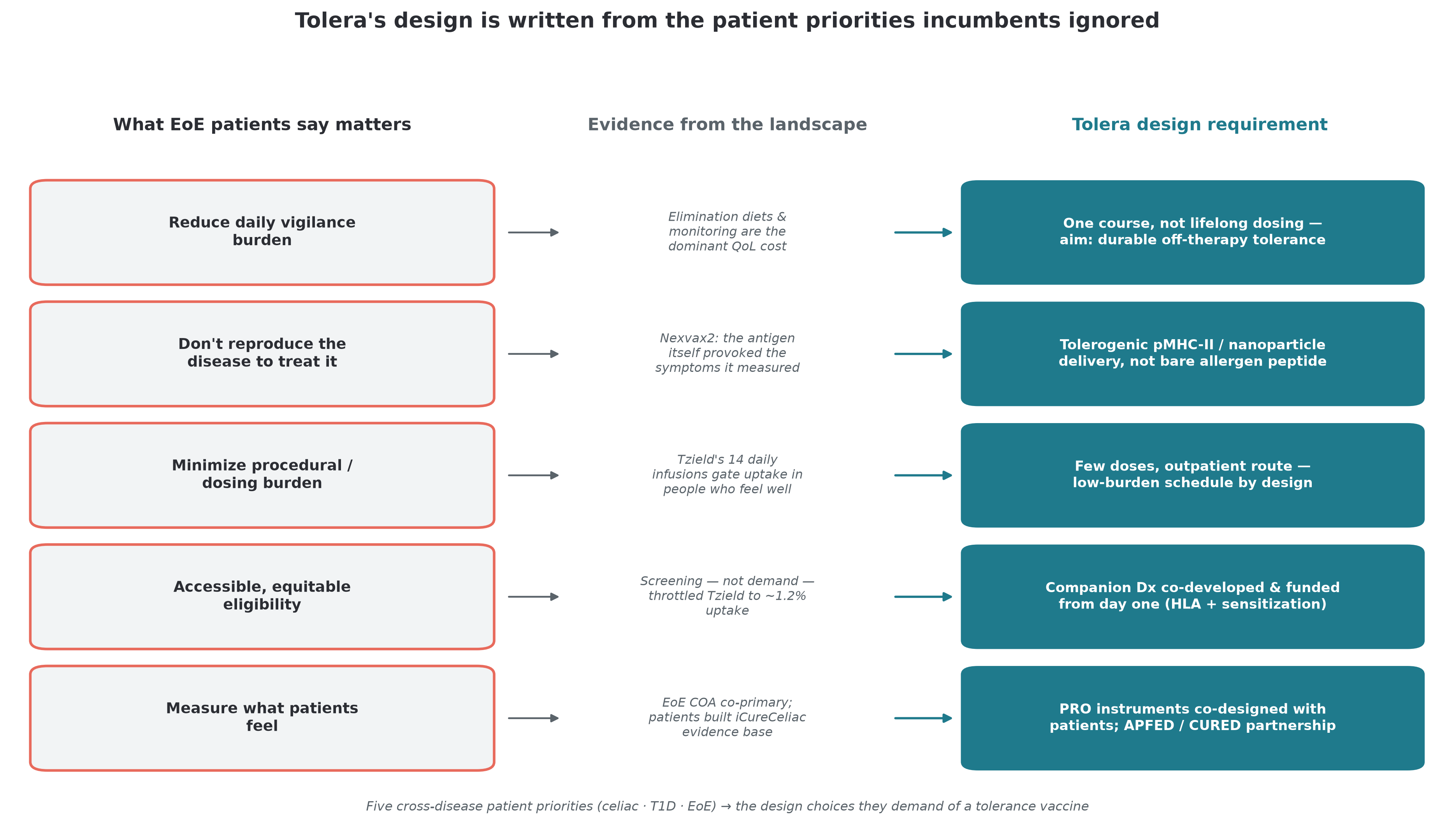
THE DIFFERENTIATOR
The first program to put patient voice first
Across T1D, celiac, and MS, formal patient input arrived too late to shape trial design. EoE has no dedicated PFDD and no pMHC program — so this roadmap can invert the field's sequence.
Project Tolera · 8

Slide 9
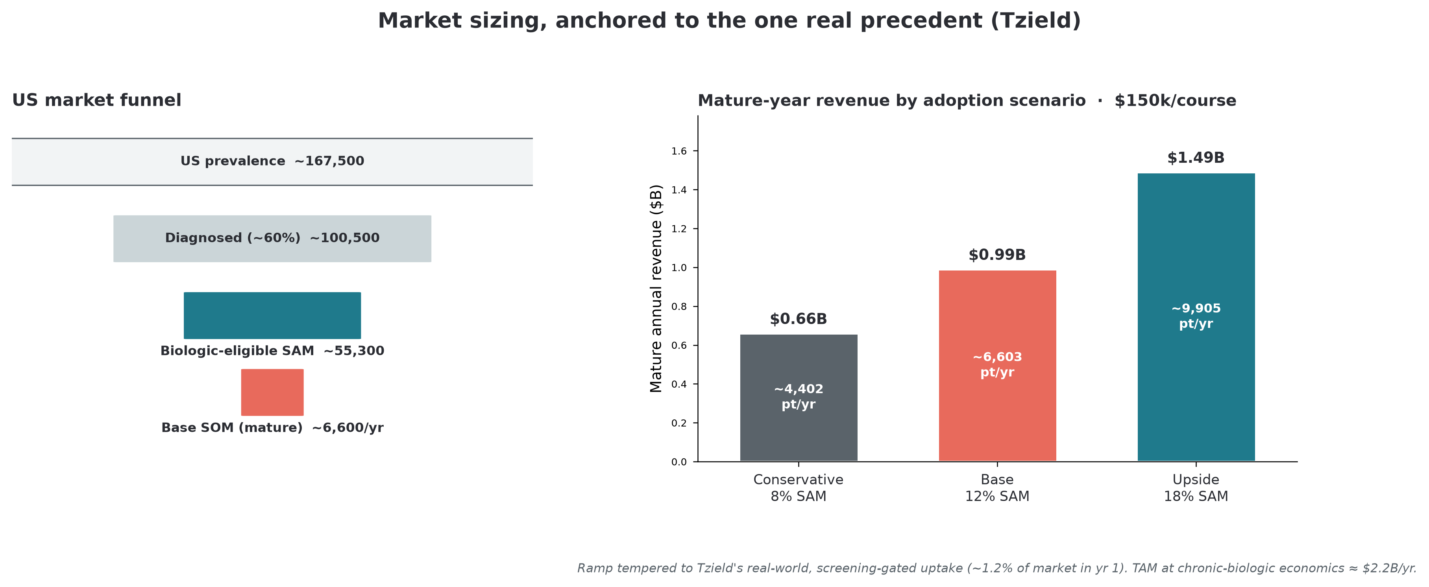
MARKET
~$2.2B TAM, anchored to the one real precedent
US funnel
167,500 → 100,500 → 55,300 SAM
Base case (12% of SAM):
~6,600 patients/yr
~$1.0B mature revenue
Range: $0.66B / $0.99B / $1.49B
Tempered from a single 15% point to Tzield's real, screening-gated ramp.
Project Tolera · 9

Slide 10
VALUE MODEL
Two value lines from one biopsy
Therapeutic — TOL-EoE
Companion diagnostic
Platform optionality
Personalized one-course tolerance vaccine. Value-based modeled at ~$150k — ~23% below Tzield's actual $194k/course.
Blood-based food-trigger + clonotype assay. Patient-selection gate AND remission monitor. Value earlier and independent of the therapeutic.
PACT extends to celiac and other food/auto-antigen disease; qualified backbones/cassettes are out-licensable.
Project Tolera · 10

Slide 11
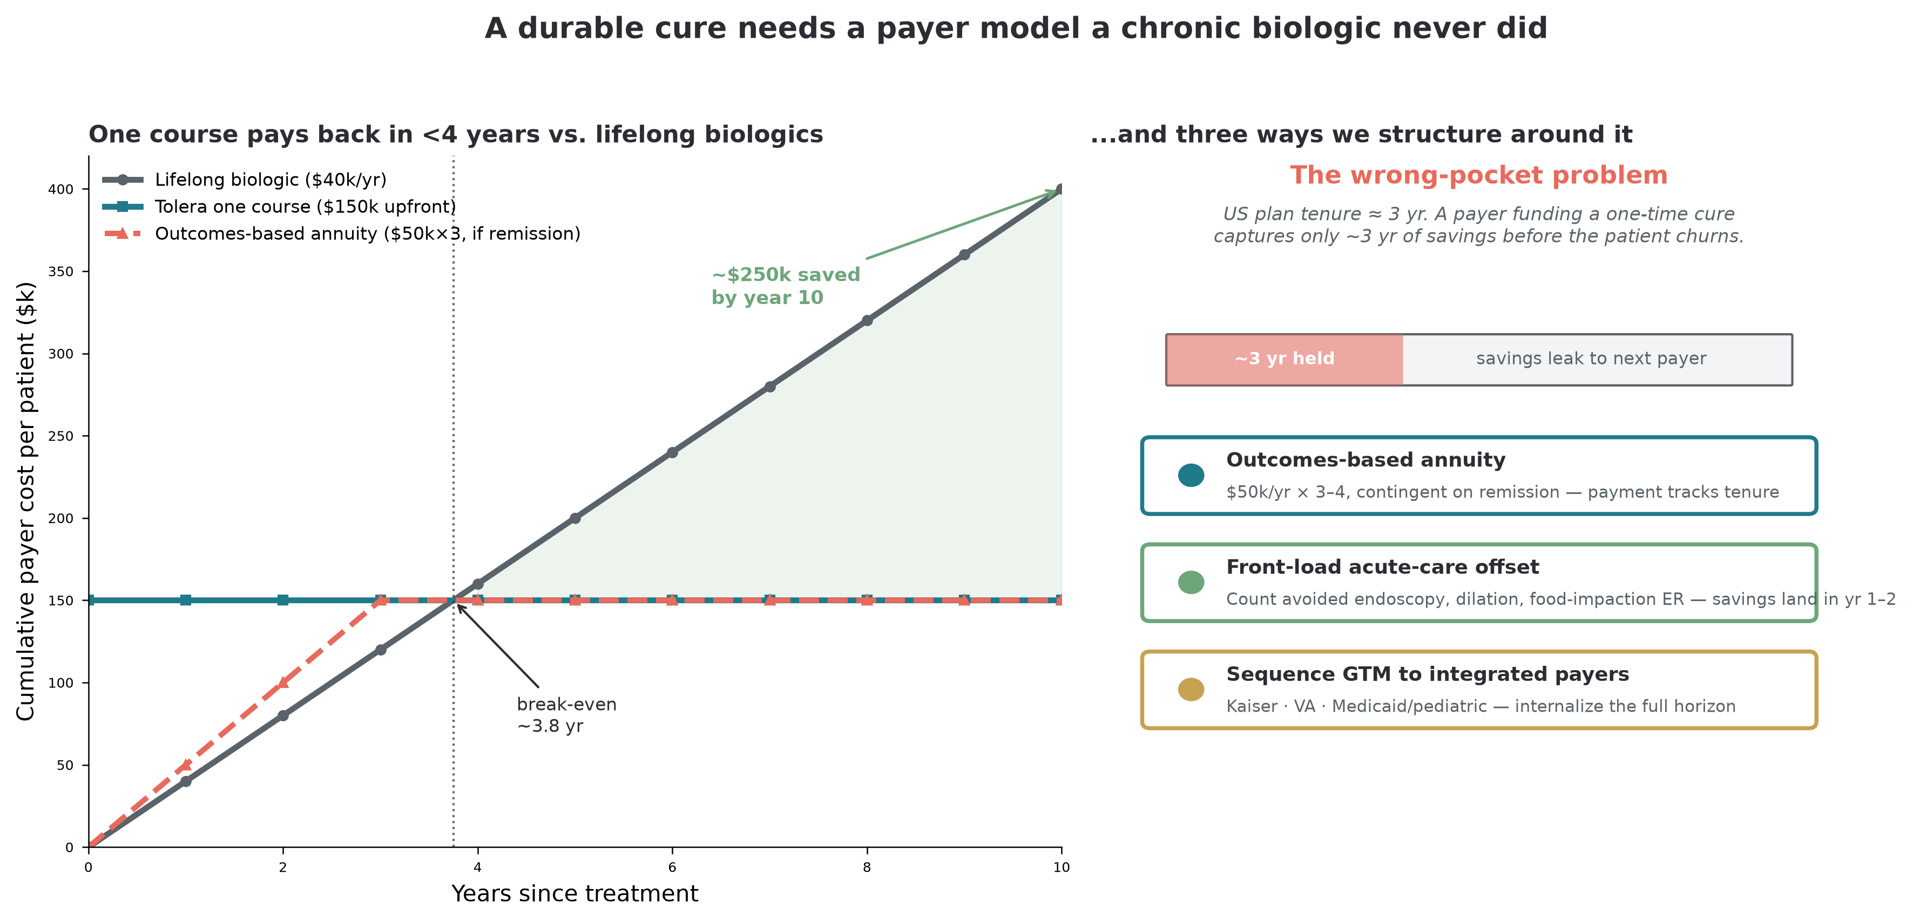
MARKET ACCESS
A durable cure needs a payer model chronic drugs never did
The roadmap names the wrong-pocket problem and scopes three contracting models — outcomes-based annuity, one-time + warranty, front-loaded offset — matched per payer channel.
Project Tolera · 11

Slide 12
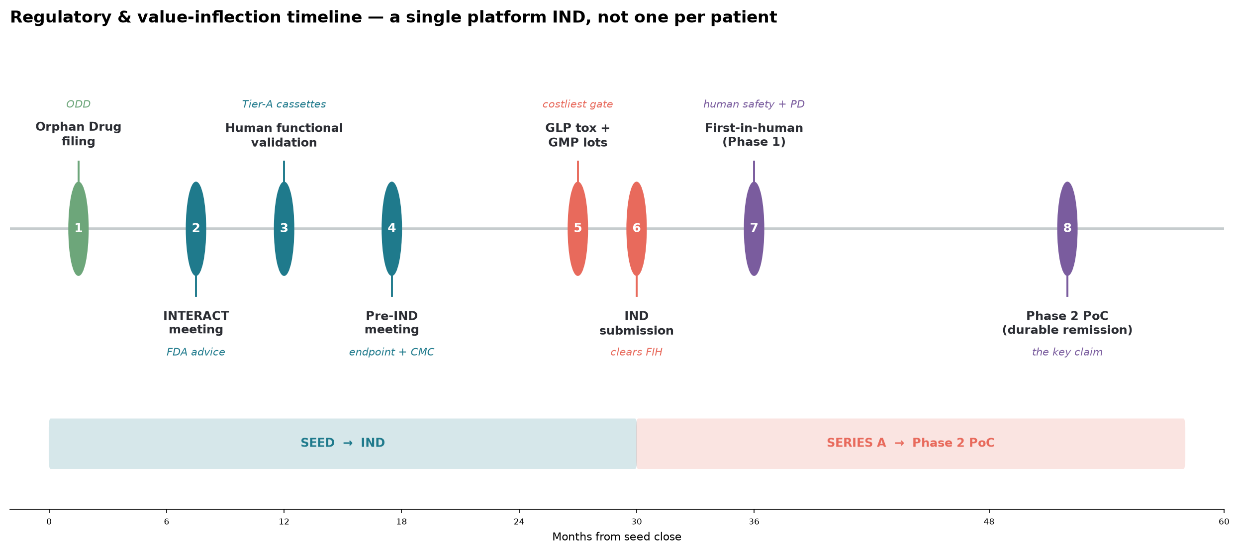
REGULATORY STRATEGY
A platform IND on a proven precedent
One platform IND — not one per patient — on the individualized-product framework.
ODD → Fast Track → Breakthrough → test RMAT
EoE co-primary (histology + dysphagia COA) is FDA-validated.
Histologic remission is proposed as an Accelerated-Approval surrogate — borrowing Tzield's disease-modification logic.
Companion Dx co-reviewed, timeline in parallel.
Project Tolera · 12

Slide 13
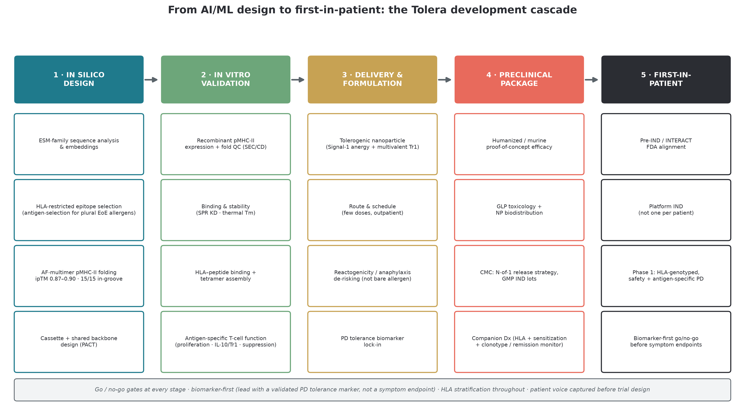
DEVELOPMENT PLAN
From AI/ML design to first-in-patient
Biomarker-first · tolerogenic delivery (not bare allergen) · HLA-stratified · early-disease endpoint · co-built screening — the winners' playbook.
Project Tolera · 13

Slide 14
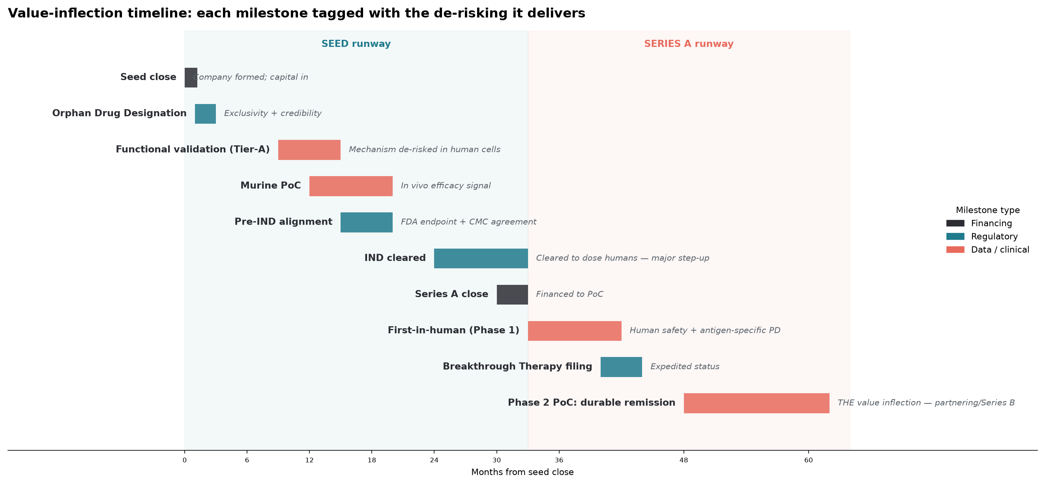
MILESTONES
A capital-efficient path to the key inflection
Project Tolera · 14

Slide 15
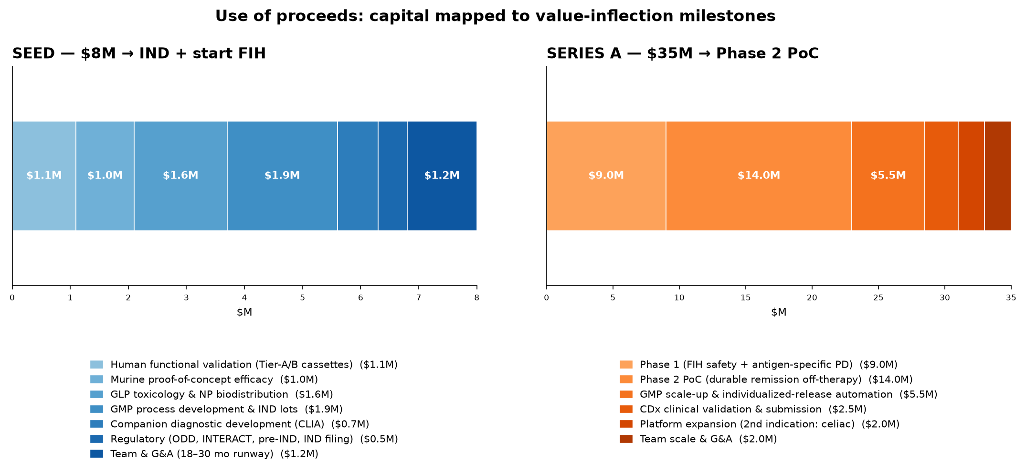
WHAT IT WOULD TAKE
Scoped to IND + first-in-human
~$8M → cleared IND + FIH dosing (18–30 mo)
~$35M → Phase 2 durable-remission PoC (~$43M cumulative)
These figures scope the work — a brief for any biotech partner or funder who wants to take it forward.
The precedent for the value at stake: Tzield, a first-in-class tolerance asset, drew a $2.9B Sanofi acquisition on a single indication.
Project Tolera · 15

Slide 16
Where this goes next
A personalized pMHC-II tolerance vaccine for EoE is scientifically credible today, commercially rational, and — critically — designable by a citizen-scientist with the right tools in a single week.
If this roadmap is useful to you — as a researcher, clinician, advocate, funder, or biotech partner — reach out.
Antigen-specific tolerance, one patient at a time.
Ruth-Anne Pai, PhD · PhD Scientist & Advisor | Bridging Science and Advocacy · person living with EoE
advising@ruthannepai.com · ruthannepai.com · linkedin.com/in/ruth-anne-pai
Developed during the “Built with Claude: Life Sciences Hackathon,” July 2026

