Slide 1
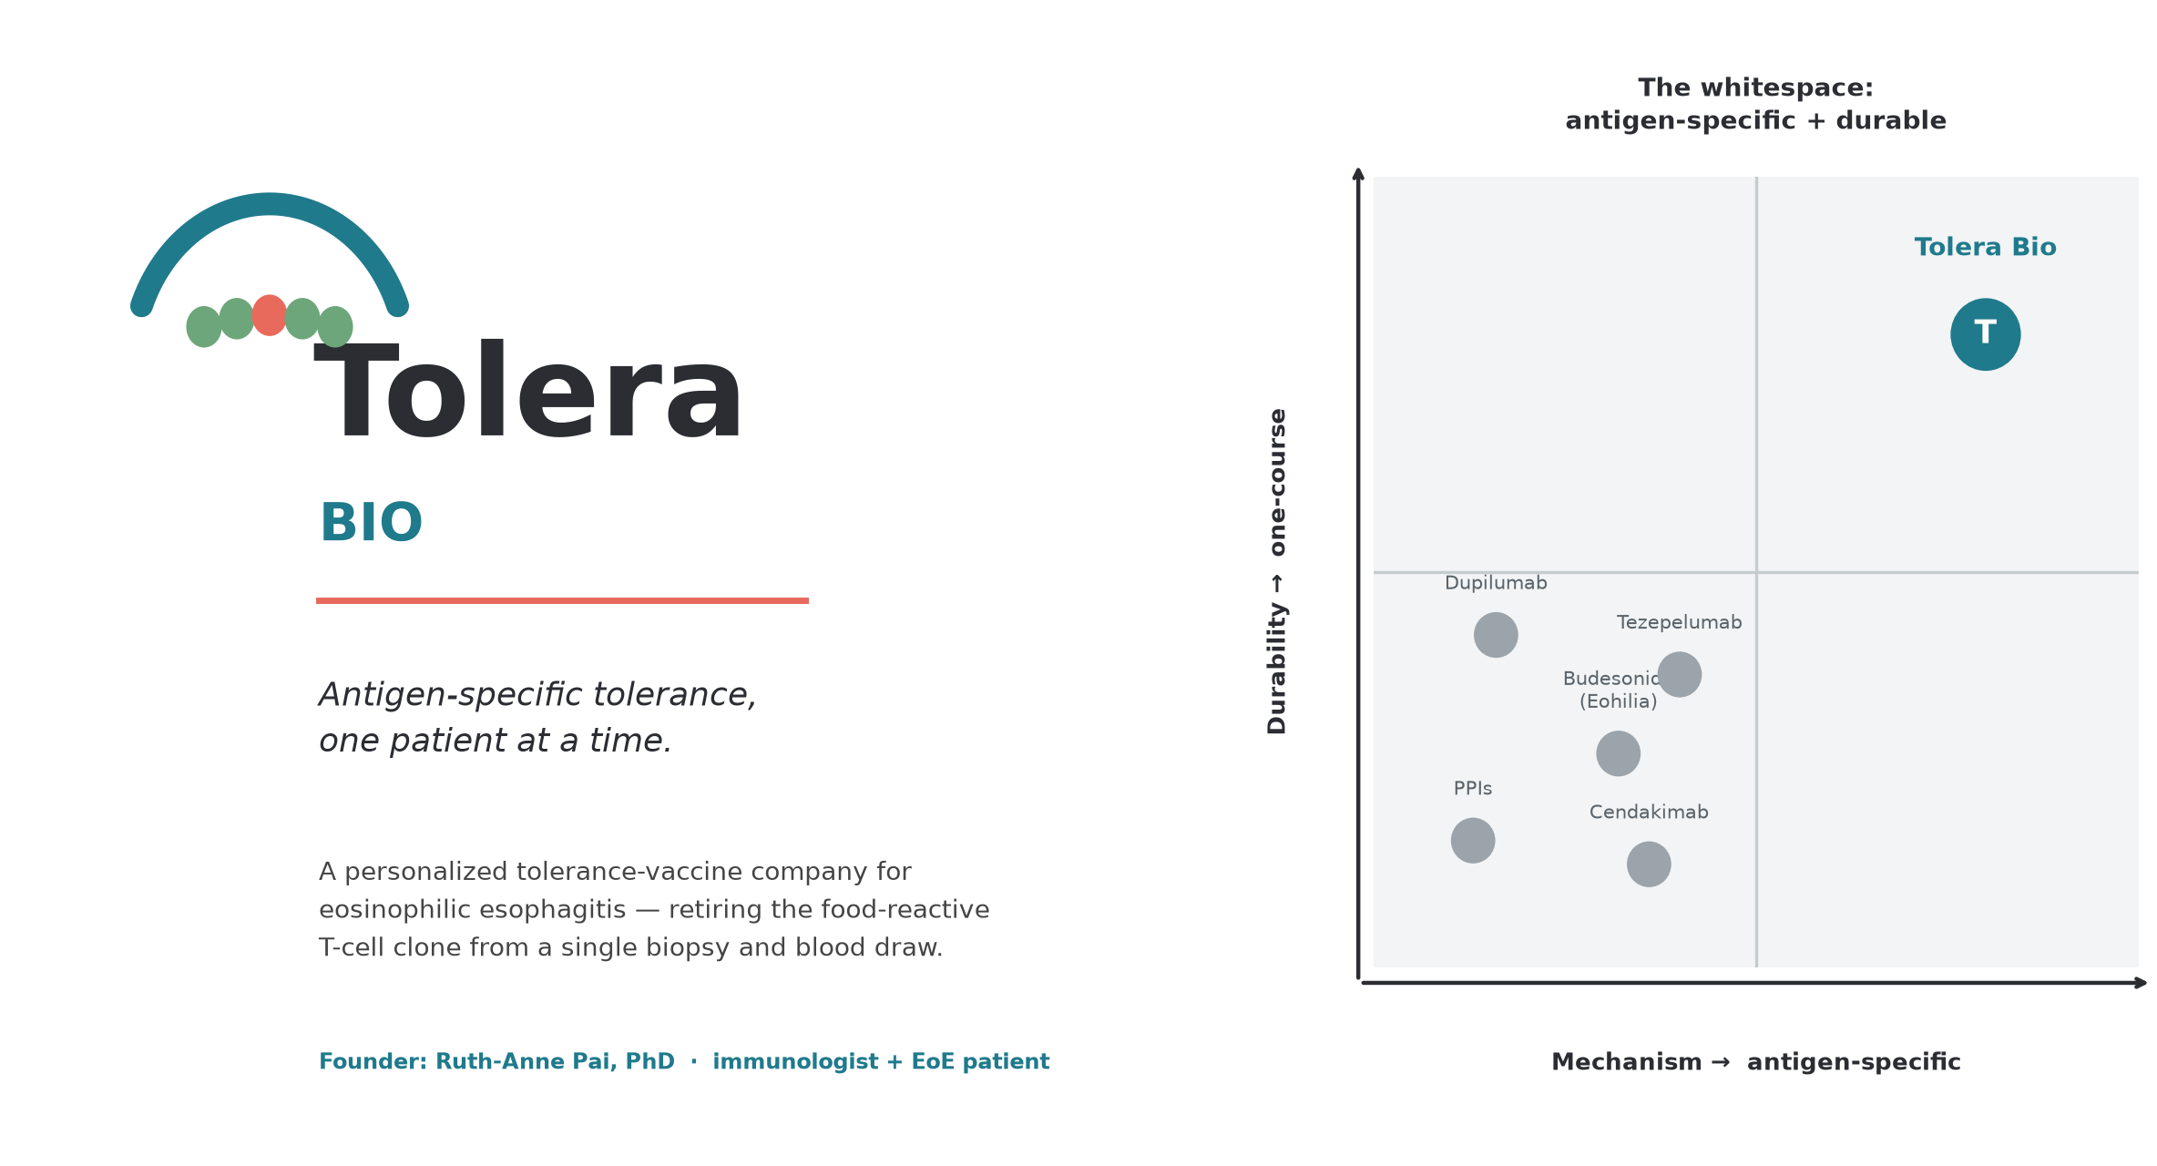
Series Seed · $8M · Personalized antigen-specific tolerance for eosinophilic esophagitis
Tolera /ˈtoʊ.lɛr.ə/ · “TOE-lair-uh”
Ruth-Anne Pai, PhD — Founder & CEO · immunologist and person living with EoE
Tolera Bio · Confidential
1

Slide 2
THE PROBLEM
EoE is antigen-specific. Every therapy treating it is not.
• Eosinophilic esophagitis (EoE): chronic, food-driven immune disease of the esophagus — dysphagia, food impaction, strictures.
• ~1 in 2,000 people; ~167,500 in the US and rising.
• Driven by a defined triad: a food peptide, presented on an MHC-II molecule, to a pathogenic effector-Th2 (peTH2) T-cell clone.
• Yet every approved and pipeline therapy blocks a downstream cytokine or cell — and must be taken indefinitely:
  – Dupilumab, cendakimab, tezepelumab — chronic biologics
  – Budesonide (Eohilia), PPIs — chronic symptom control
  – Elimination diets — restrictive, poor quality of life, relapse on reintroduction
• No approved therapy is antigen-specific. None induces durable tolerance.
The lived reality
“At diagnosis, a patient is handed a lifetime of steroids, injections, or a shrinking list of foods they're allowed to eat — managing symptoms, never resolving the cause.
We are building the company that changes that answer.”
— Founder, living with EoE
Tolera Bio · Confidential
2

Slide 3
THE SOLUTION
A personalized vaccine that retires the disease-driving T-cell clone
• From a single biopsy + blood draw at diagnosis, Tolera manufactures a patient-specific pMHC-II tolerance vaccine that silences only the food-reactive clone — leaving the rest of the immune system intact.
Antigen-specific
Durable
Personalized N-of-1
Targets the patient's own food peptide on their own MHC-II — not broad immunosuppression.
Induces tolerance (anergy + Tr1/IL-10 regulation) — designed as one course, not lifelong dosing.
Each vaccine is built for one patient's HLA + trigger — the neoantigen-vaccine model, for food antigens.
Precedent: teplizumab (Tzield) validated disease-modifying tolerance in autoimmunity; individualized neoantigen vaccines validated per-patient manufacturing.
Tolera Bio · Confidential
3

Slide 4
INFLECTION
Why now
Regulatory precedent exists
Tzield (2022) proved the FDA approves antigen-directed, disease-modifying immune therapy; neoantigen vaccines proved individualized CMC is tractable.
The biology is pinned down
Dilollo/Spergel/Hill (2025) functionally validated the first EoE food-antigen TCR (eoeTCR-4): β-casein, HLA-DRB1*07:01, tetramer-confirmed.
The design already computes
A 9-construct pMHC-II panel is designed and GPU-validated (ipTM ≥ 0.87) on a shared, swappable-cassette backbone.
AI protein design collapsed timelines
Structure prediction + epitope selection make N-of-1 design a compute step, not a research project.
Tolera Bio · Confidential
4

Slide 5
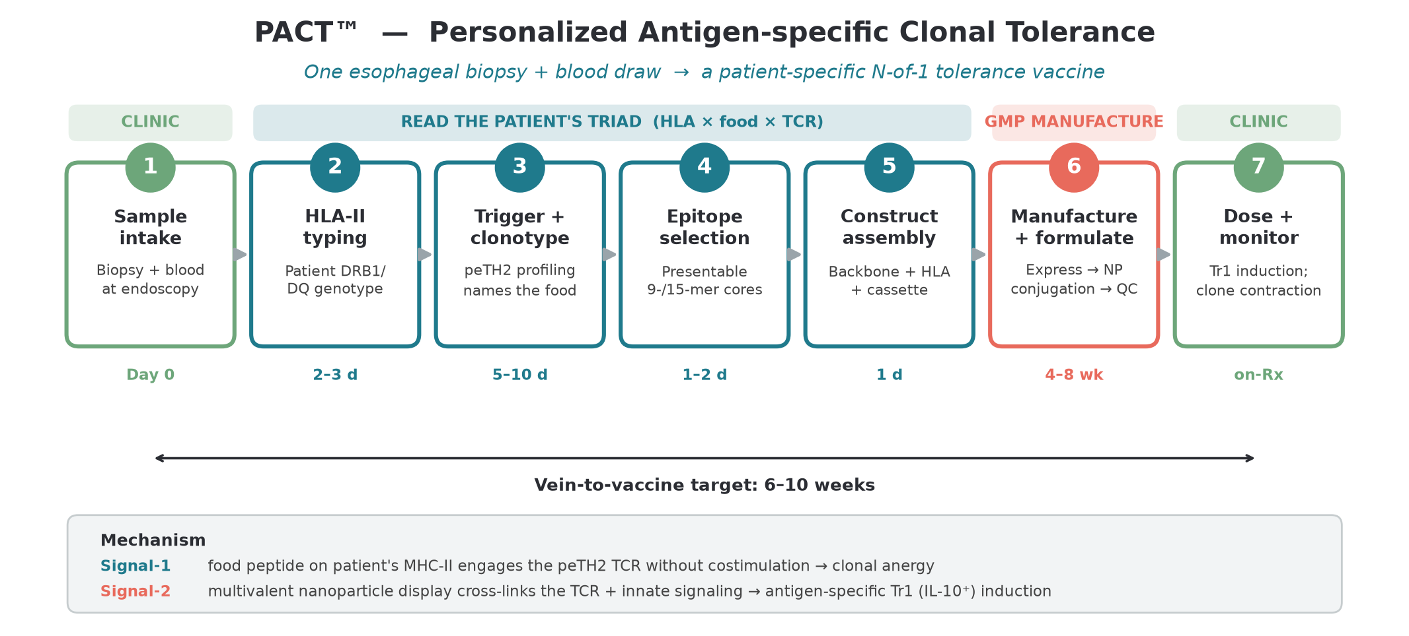
THE PLATFORM
PACT™ — from clinic to vaccine in one workflow
Tolera Bio · Confidential
5

Slide 6
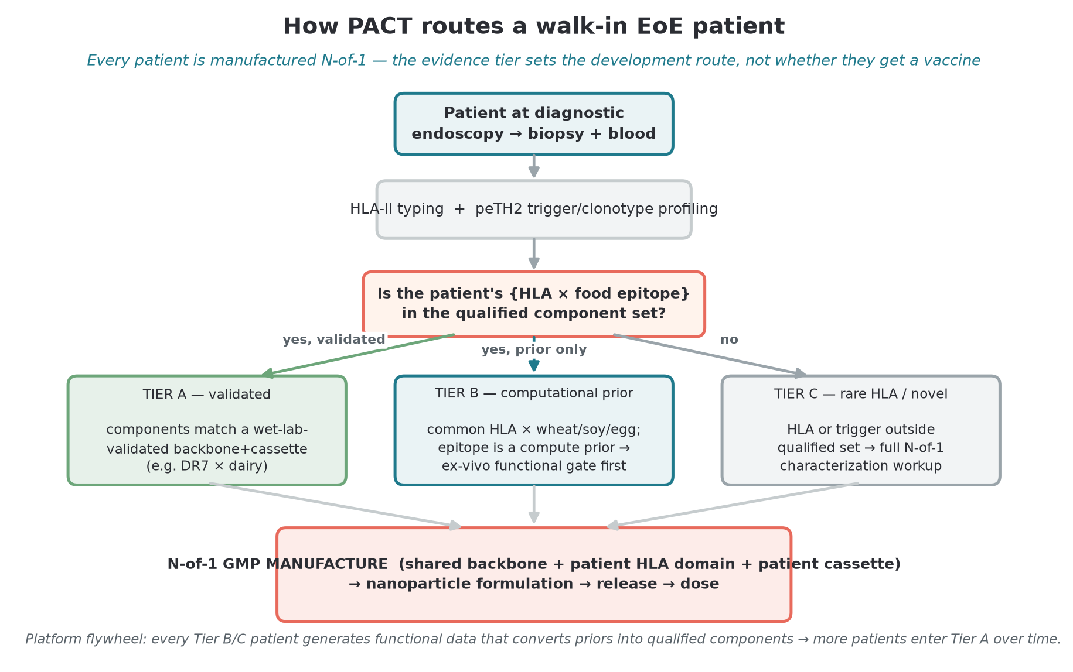
PERSONALIZATION
Every walk-in patient gets a vaccine; the evidence tier sets the route
Tolera Bio · Confidential
6

Slide 7
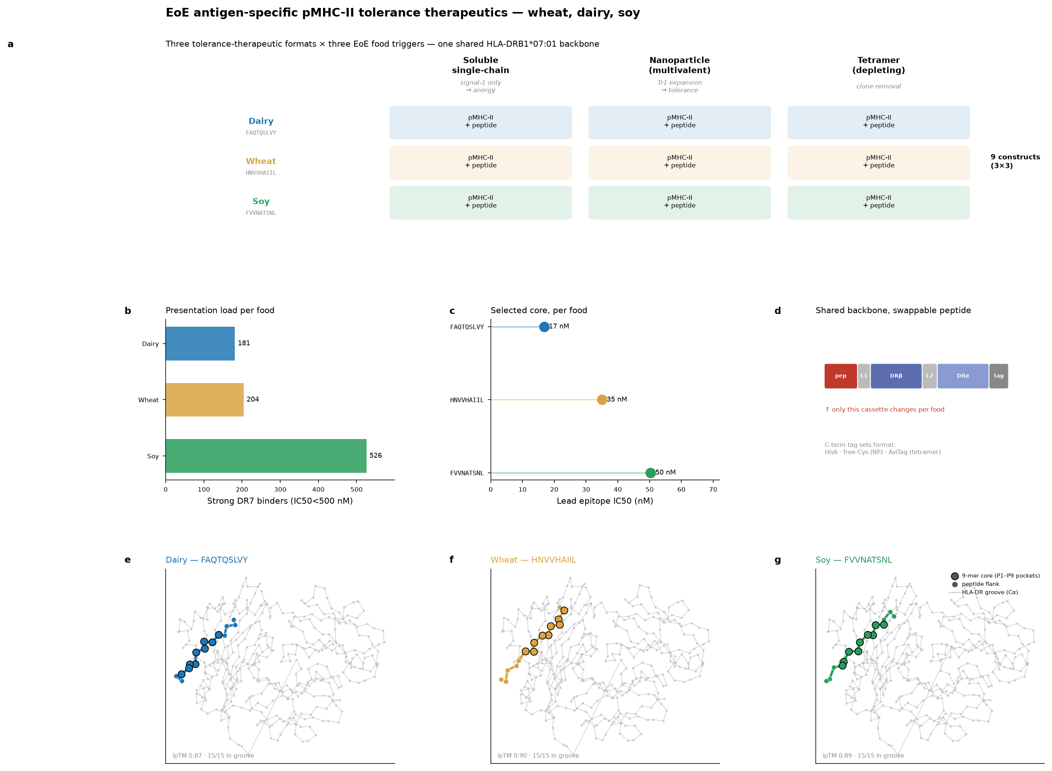
VALIDATION DATA
The science is designed and GPU-validated
What's validated
• Dairy anchor is tetramer-validated (β-casein aa59–78, DR7)
• All 3 complexes fold at ipTM 0.87–0.90, 15/15 peptide in groove
• One shared DR7 backbone; only the peptide cassette swaps
• Wheat & soy are computational priors — wet-lab validation is a funded milestone
Tolera Bio · Confidential
7

Slide 8
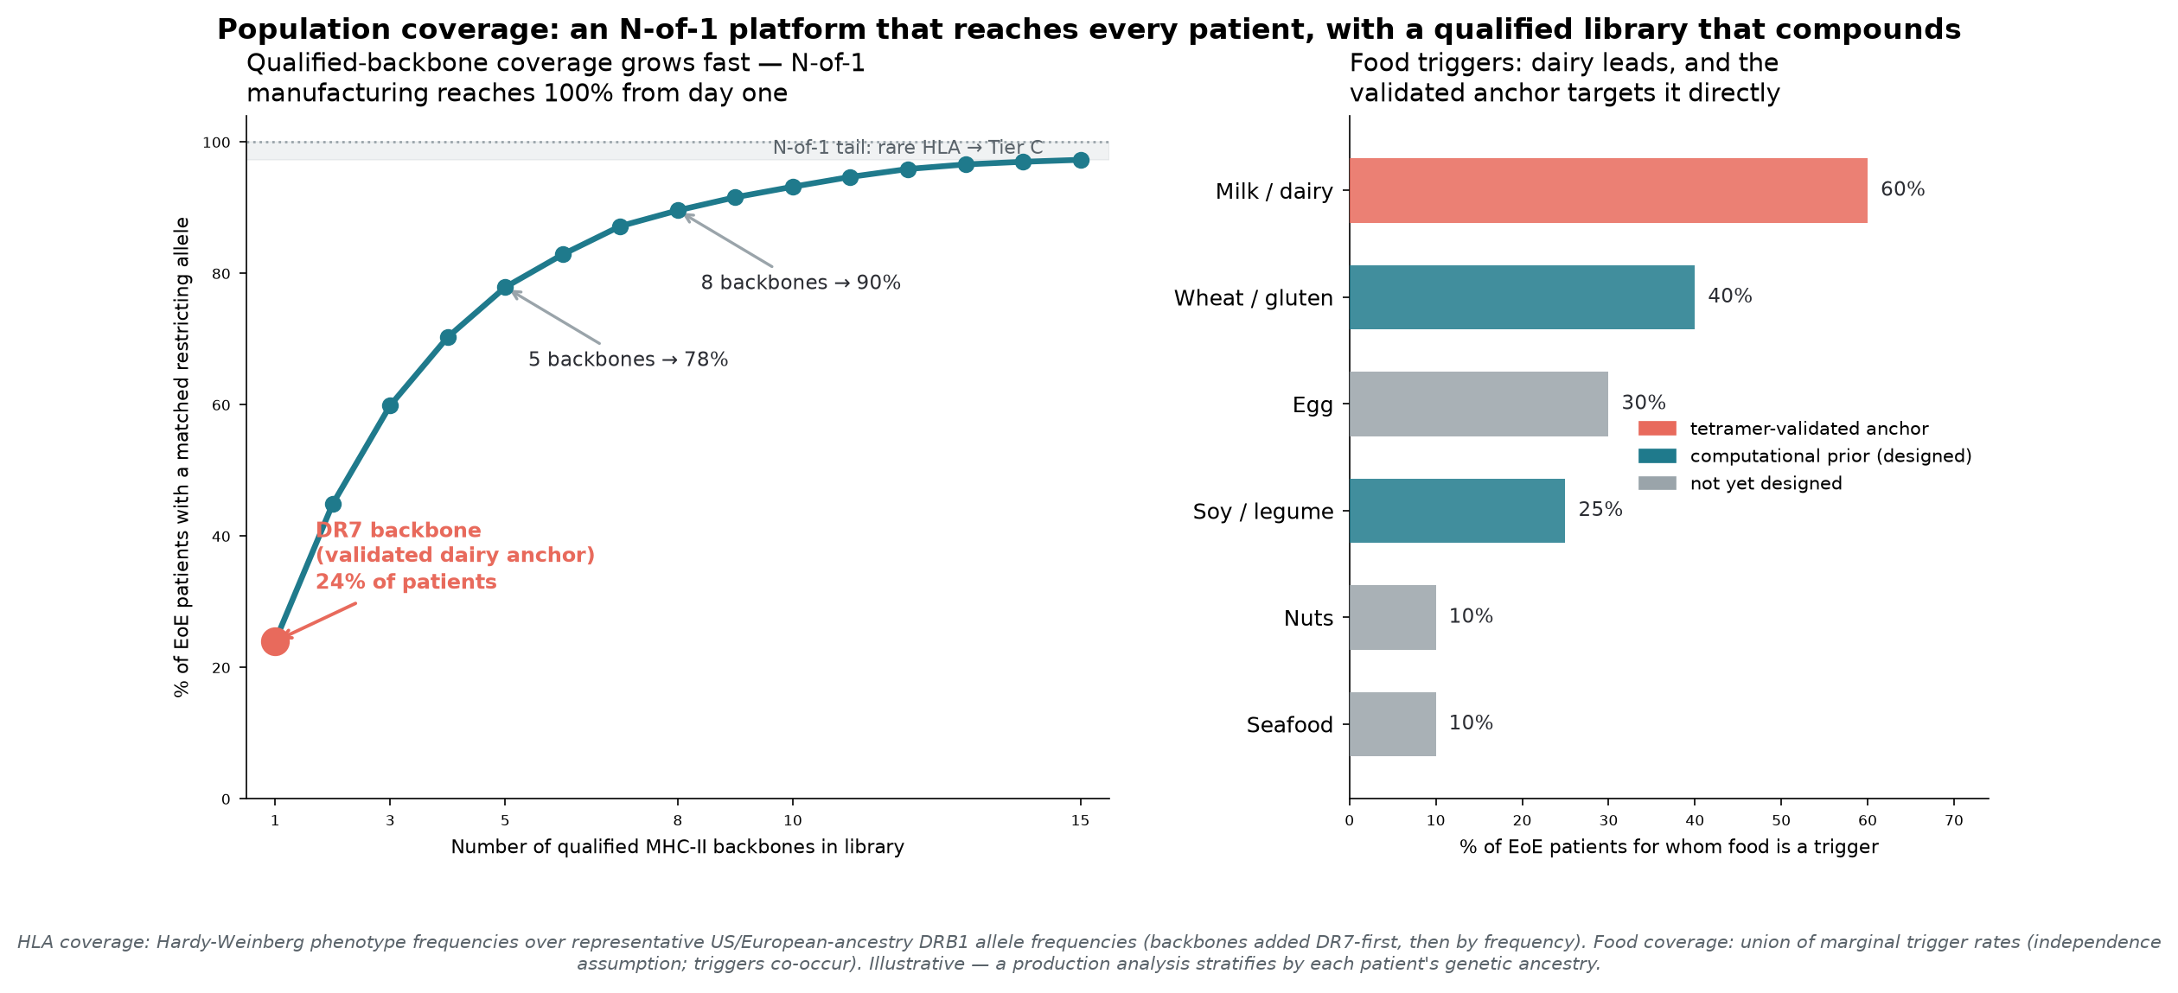
POPULATION COVERAGE
Coverage: N-of-1 reaches every patient; the library compounds
Tolera Bio · Confidential
8

Slide 9
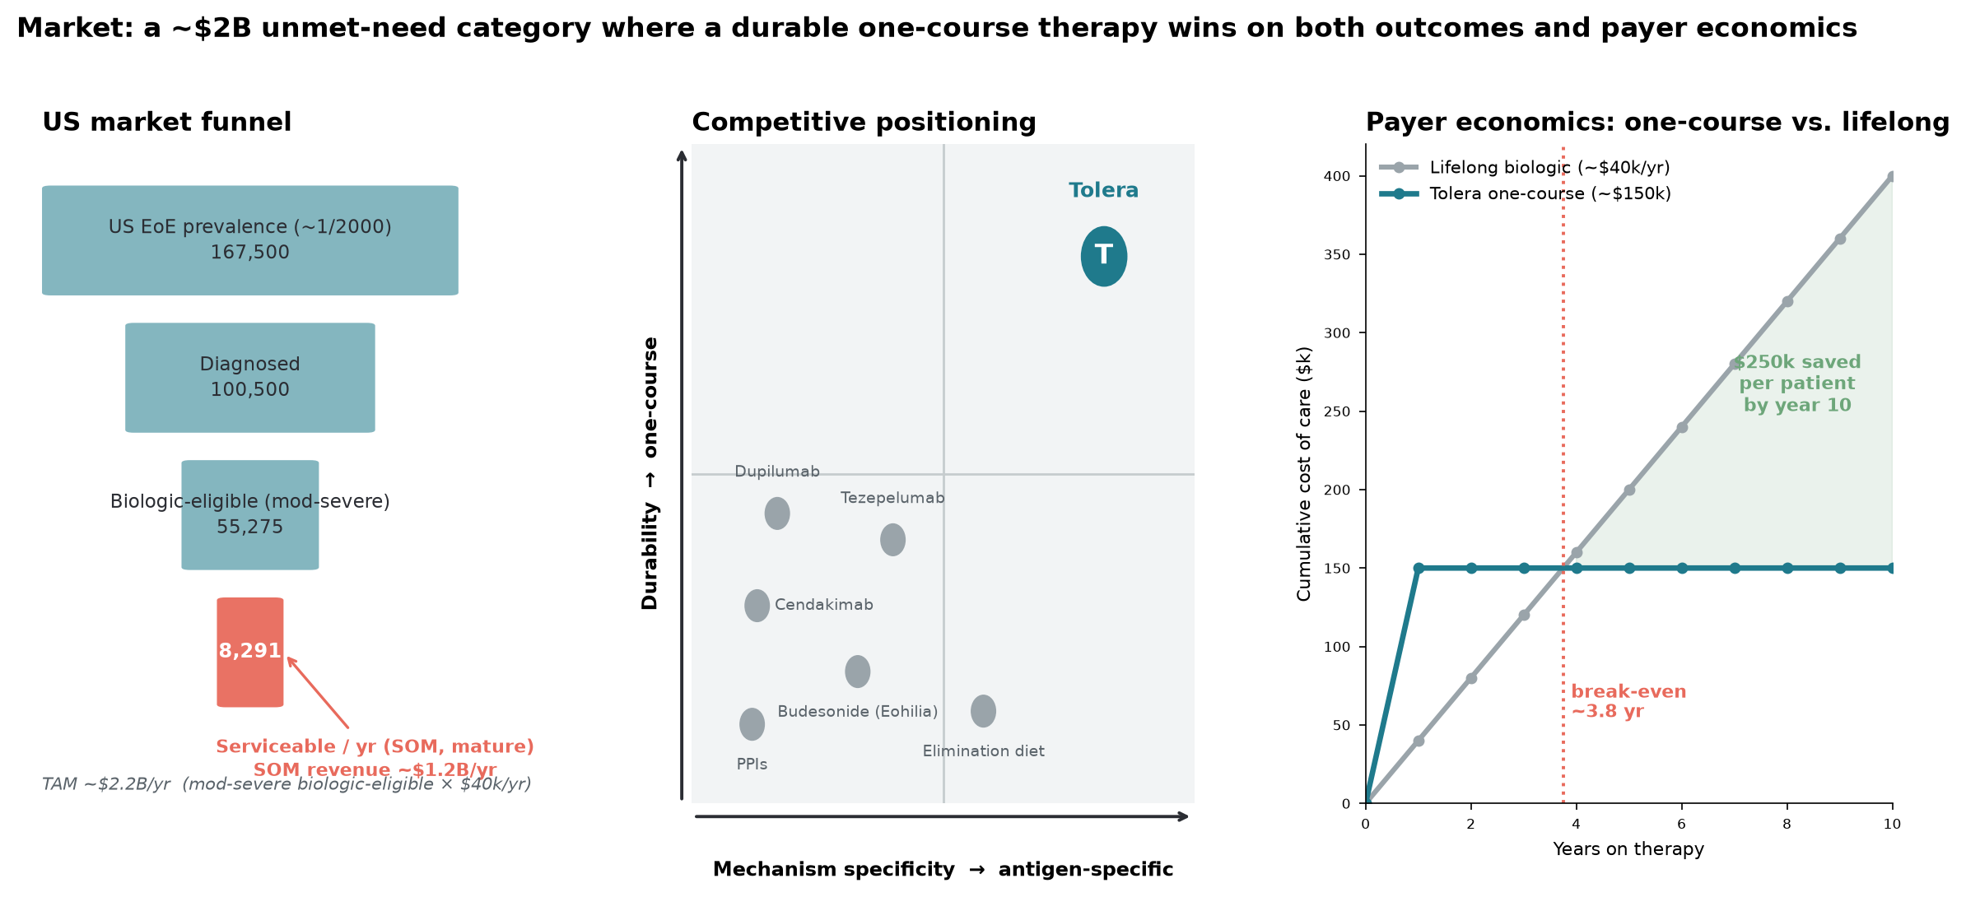
MARKET
A ~$2B unmet-need market with no antigen-specific competitor
Tolera Bio · Confidential
9

Slide 10
COMPETITIVE LANDSCAPE
Competition: everyone else suppresses; we tolerize
Agent | Mechanism | Dosing | Antigen-specific? | Durable?
Dupilumab (Sanofi/Regeneron) | anti-IL-4Rα | chronic | No | No
Cendakimab (BMS) | anti-IL-13 | chronic | No | No
Tezepelumab (AZ/Amgen) | anti-TSLP | chronic | No | No
Budesonide / Eohilia (Takeda) | topical steroid | chronic | No | No
Elimination diet | antigen avoidance | lifelong | directed, not therapeutic | No
TOL-EoE (Tolera Bio) | antigen-specific pMHC-II tolerance | one course | Yes | Design goal: yes
The field is well-capitalized (validating the market) — but a recent pipeline agent was discontinued for EoE after failing to move endoscopic scores. Mechanism alone doesn't win; durable, antigen-specific disease modification is the open category.
Tolera Bio · Confidential
10

Slide 11
BUSINESS MODEL
Business model: therapeutic + companion diagnostic
Personalized tolerance vaccine (TOL-EoE)
One-course, value-based price ~$150k — priced against the ~$40k/yr lifelong biologic it displaces. Pays back in <4 years; saves payers ~$250k/patient over a decade.
Companion diagnostic (blood assay)
Names the causal food + clonotype from a blood draw. Patient-selection gate, standalone reimbursable test, AND the remission monitor that makes outcomes-based contracting work.
Platform optionality (PACT)
Same engine extends to celiac and other food/auto-antigen disease — a pipeline-in-a-product, plus backbone/cassette out-licensing.
Tolera Bio · Confidential
11

Slide 12
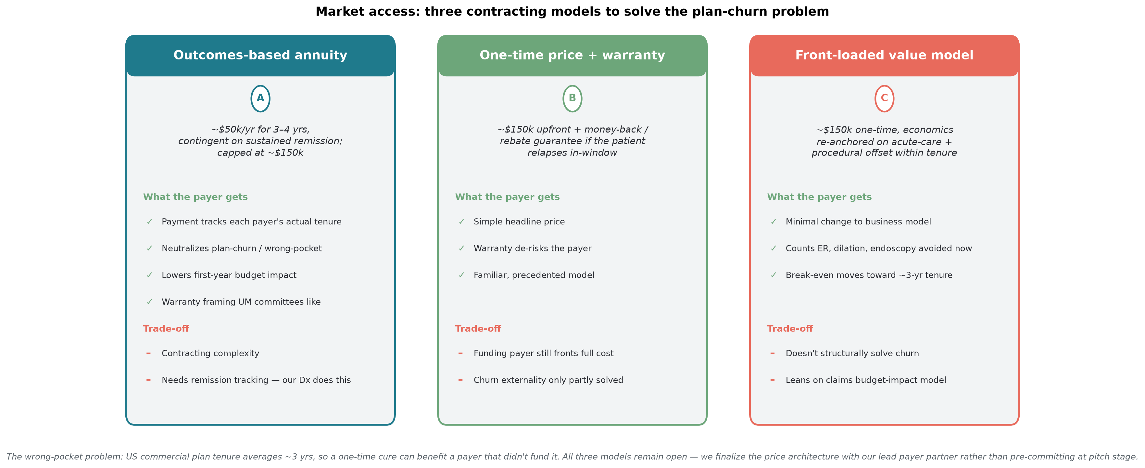
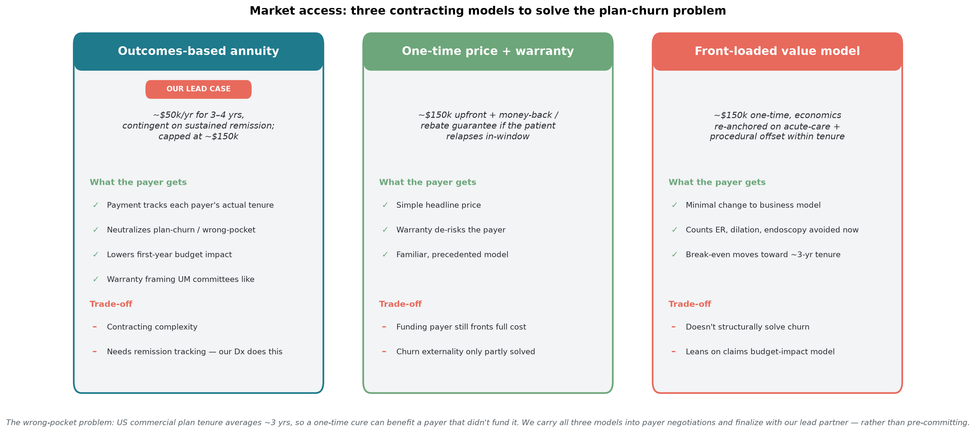
MARKET ACCESS
Why payers cover it: solving the plan-churn problem
The wrong-pocket problem: US commercial plan tenure averages ~3 yrs, so a one-time cure can benefit a payer that didn't fund it. Three contracting models address this — an outcomes-based annuity, a one-time price with an outcomes warranty, and a front-loaded value model. We keep all three open and finalize the price architecture with our lead payer partner, matched to each channel (capitated / commercial / Medicaid).
Tolera Bio · Confidential
12

Slide 13
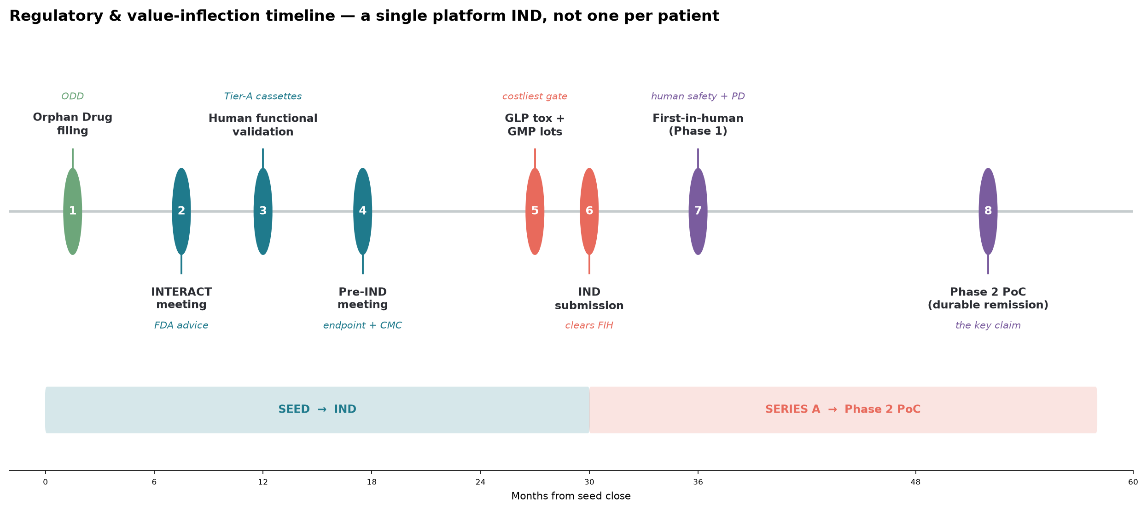
REGULATORY STRATEGY
Regulatory: one platform IND, not one per patient
• Individualized-product framework (à la neoantigen vaccines): qualify the platform + selection algorithm once; release each patient's product against it.
• Orphan Drug (US <200k) → Fast Track → Breakthrough → test RMAT eligibility. Endpoints already validated: histologic remission, EREFS, DSQ.
• Companion diagnostic co-developed under FDA CDx framework. FTO note: the food-trigger assay concept is patented (Hill/Spergel) — license or design-around.
Tolera Bio · Confidential
13

Slide 14
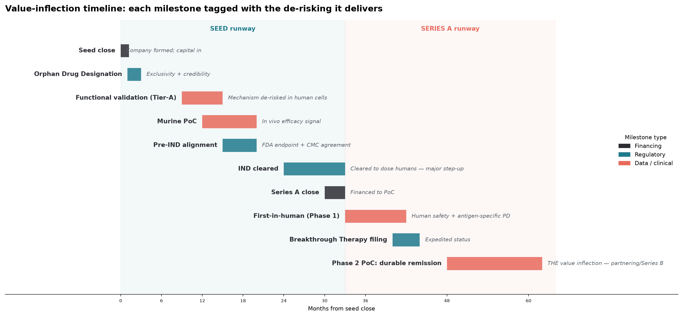
ROADMAP
Value-inflection milestones
Tolera Bio · Confidential
14

Slide 15
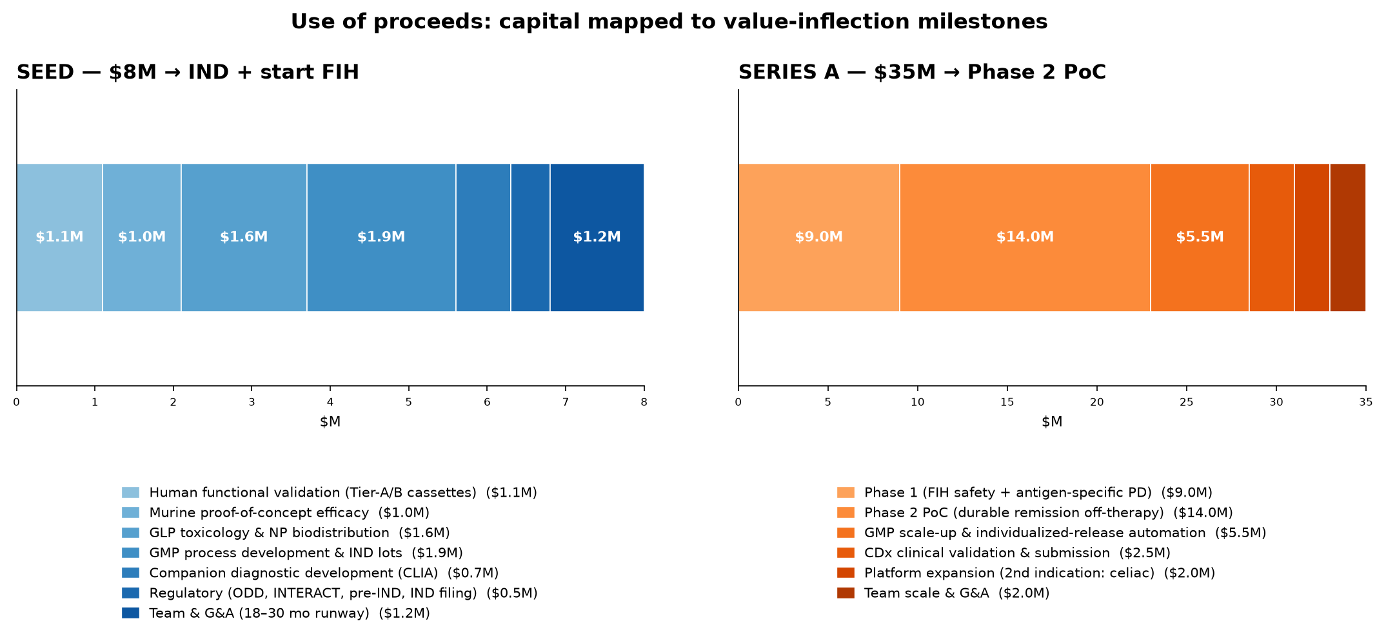
THE ASK
The ask: $8M Seed → cleared IND + first-in-human
$8M Seed buys the single largest de-risking step available now: computational designs → human-validated, IND-enabling data + first-in-human dosing, plus a revenue-generating companion diagnostic. A $35M Series A then funds through the Phase 2 durable-remission proof-of-concept.
Tolera Bio · Confidential
15

Slide 16
TEAM
Team & founding advantage
Ruth-Anne Pai, PhD
Building out (seed hires)
Founder & CEO
• VP / Head of CMC — individualized biologic manufacturing & release
• Head of Translational Immunology — functional validation, Tr1 assays
• Regulatory lead — CBER individualized-product & CDx experience
• Head of Market Access — durable-therapy / outcomes-based contracting
• Clinical advisors — EoE KOLs (GI + allergy/immunology); SAB — pMHC/tolerance veterans
• Immunologist; designed and computationally validated the full pMHC-II platform.
• Lives with EoE — the patient-scientist advantage in trial design, recruitment, endpoints, and community trust.
• Drove the work from literature to GPU-validated constructs to preclinical roadmap.
Tolera Bio · Confidential
16

Slide 17
VISION
Make durable, antigen-specific tolerance the standard of care for food-driven immune disease.
• Start with EoE: turn a lifetime of suppression into a one-course, personalized vaccine.
• Extend PACT to celiac and other food/auto-antigen disease — the same engine, new cassettes.
• Build the company that a patient at diagnosis is sent to — the one I wish existed for me.
Tolera Bio · Confidential
17

Slide 18
Contact & disclosures
Ruth-Anne Pai, PhD — Founder & CEO, Tolera Bio
Series Seed · $8M · seeking lead investor
Tolera /ˈtoʊ.lɛr.ə/ · “TOE-lair-uh”
Disclosures & disclaimer
This deck describes a preclinical-stage design platform. The dairy epitope (β-casein aa59–78, HLA-DRB1*07:01) is tetramer-validated in the literature; all other epitope binding values are computational priors pending wet-lab validation. Fold-quality metrics (ipTM/pLDDT) are from GPU structure prediction, not experimental structures.
Market, financial, coverage, and payer/pricing figures are planning assumptions grounded in public data and stated explicitly in the accompanying analyses; they are not guidance or projections of returns. Contracting models are illustrative and subject to payer negotiation. Regulatory pathways require formal FDA interaction and are not commitments.
The food-trigger T-cell-assay concept is patented (Hill/Spergel); commercial use requires licensing or design-around. Nothing herein is medical advice.
Tolera Bio · Confidential
18

