Slide 1
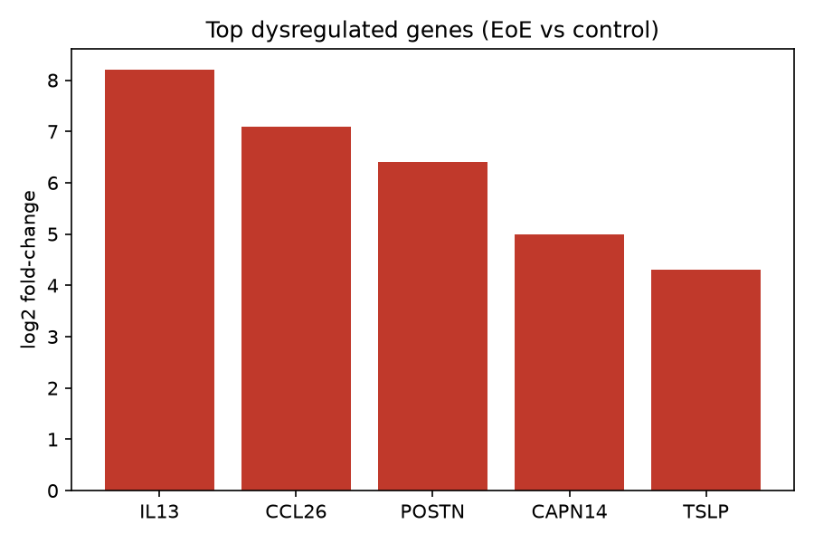
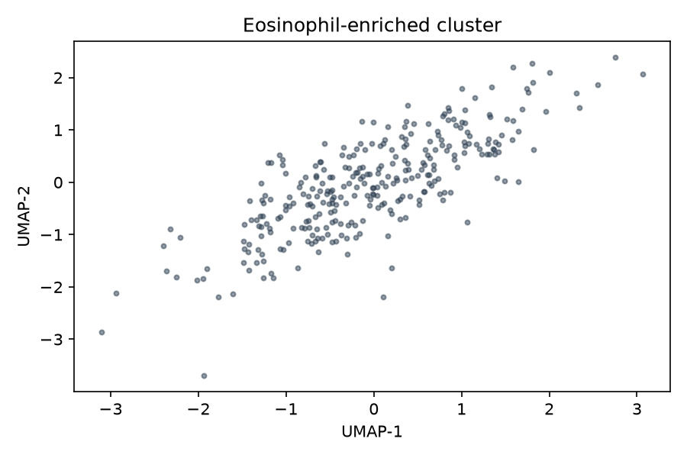

Novel Therapeutic Targets in Eosinophilic Esophagitis
A. Researcher, B. Scientist, C. Lead
Department of Allergy & Immunology · Built with Claude Life Sciences Hackathon 2025
Top Dysregulated Genes
Background
Conclusions
EoE is a chronic, food-antigen-driven type 2 inflammatory disease of the esophagus.
Current therapies (PPIs, topical steroids, dupilumab) leave a real treatment gap.
We mined public omics datasets to surface unexploited, esophagus-relevant targets.
• IL13 / CCL26 axis dominates the transcriptional signature
• CAPN14 is an esophagus-specific candidate
• Three targets prioritized for protein-design follow-up
Eosinophil Cell State
A distinct eosinophil-enriched cluster expands in active disease.
Methods
• Transcriptomic + single-cell EoE cohorts vs controls
• Differential expression + pathway enrichment
• ESM embeddings for sequence-based target triage
• PPI-network prioritization of candidates
Next Steps
Design and validate binders against the top candidate in esophageal organoid models; assess pMHC/TCR relevance.
Contact: researcher@example.org | github.com/example/eoe-targets
Notes:
[Background · 30s] EoE is a type-2 esophageal disease with a treatment gap despite dupilumab.
[Methods · 20s] We combined bulk + single-cell omics with ESM-based triage.
[Results · 40s] The IL13/CCL26 axis dominates; CAPN14 stands out as esophagus-specific.
[Ask · 15s] We're prioritizing three targets for protein design — happy to discuss collaborations.

