Slide 1
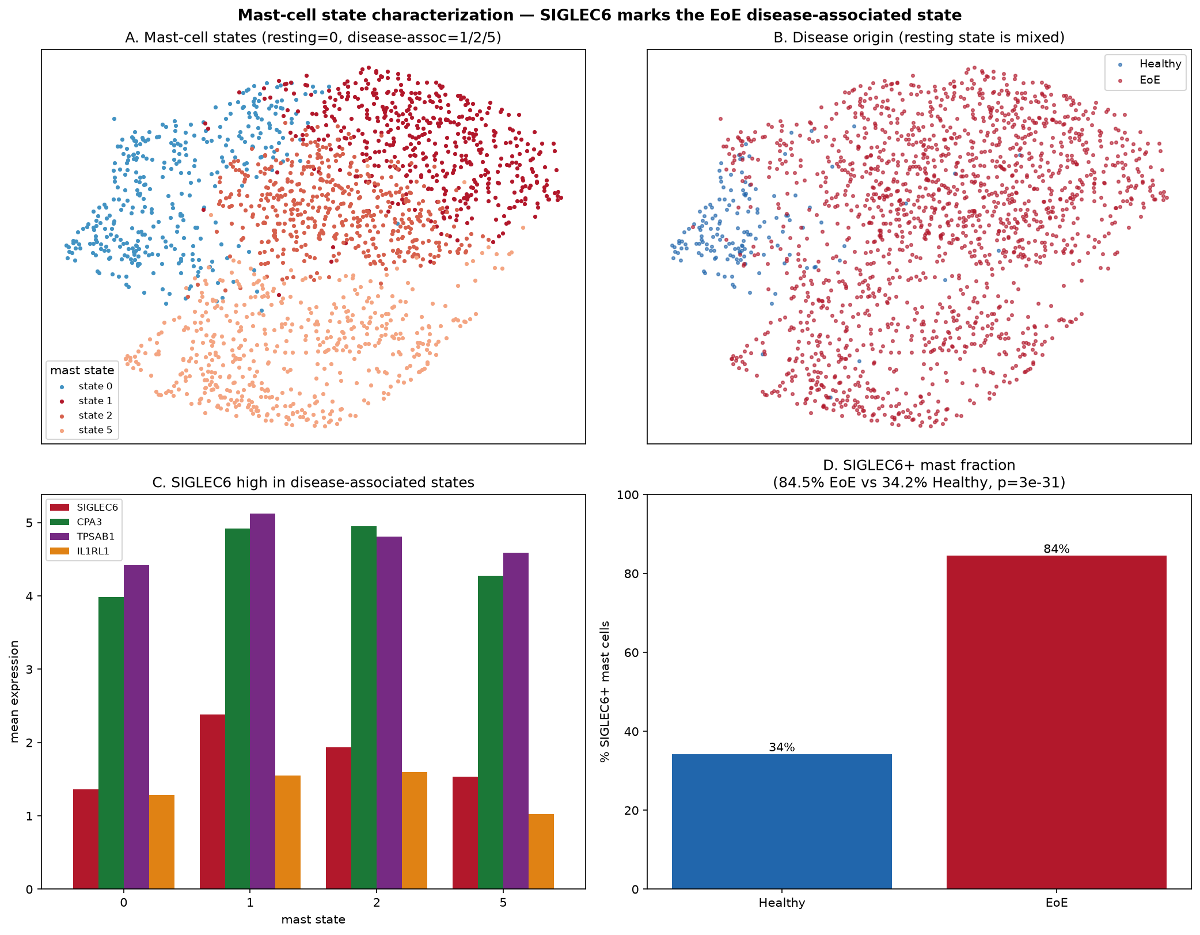
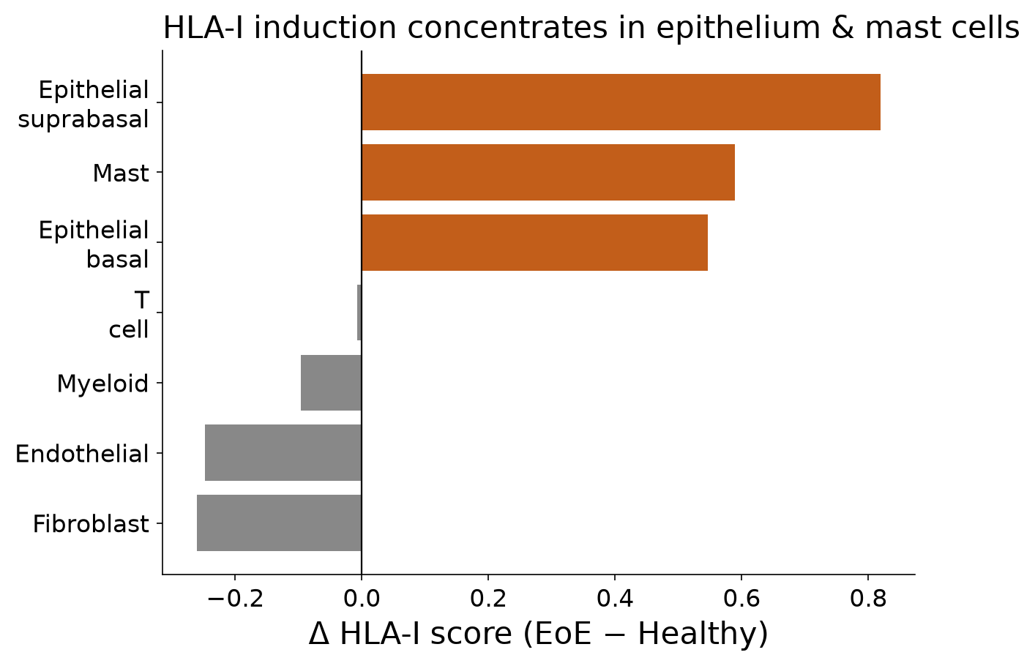
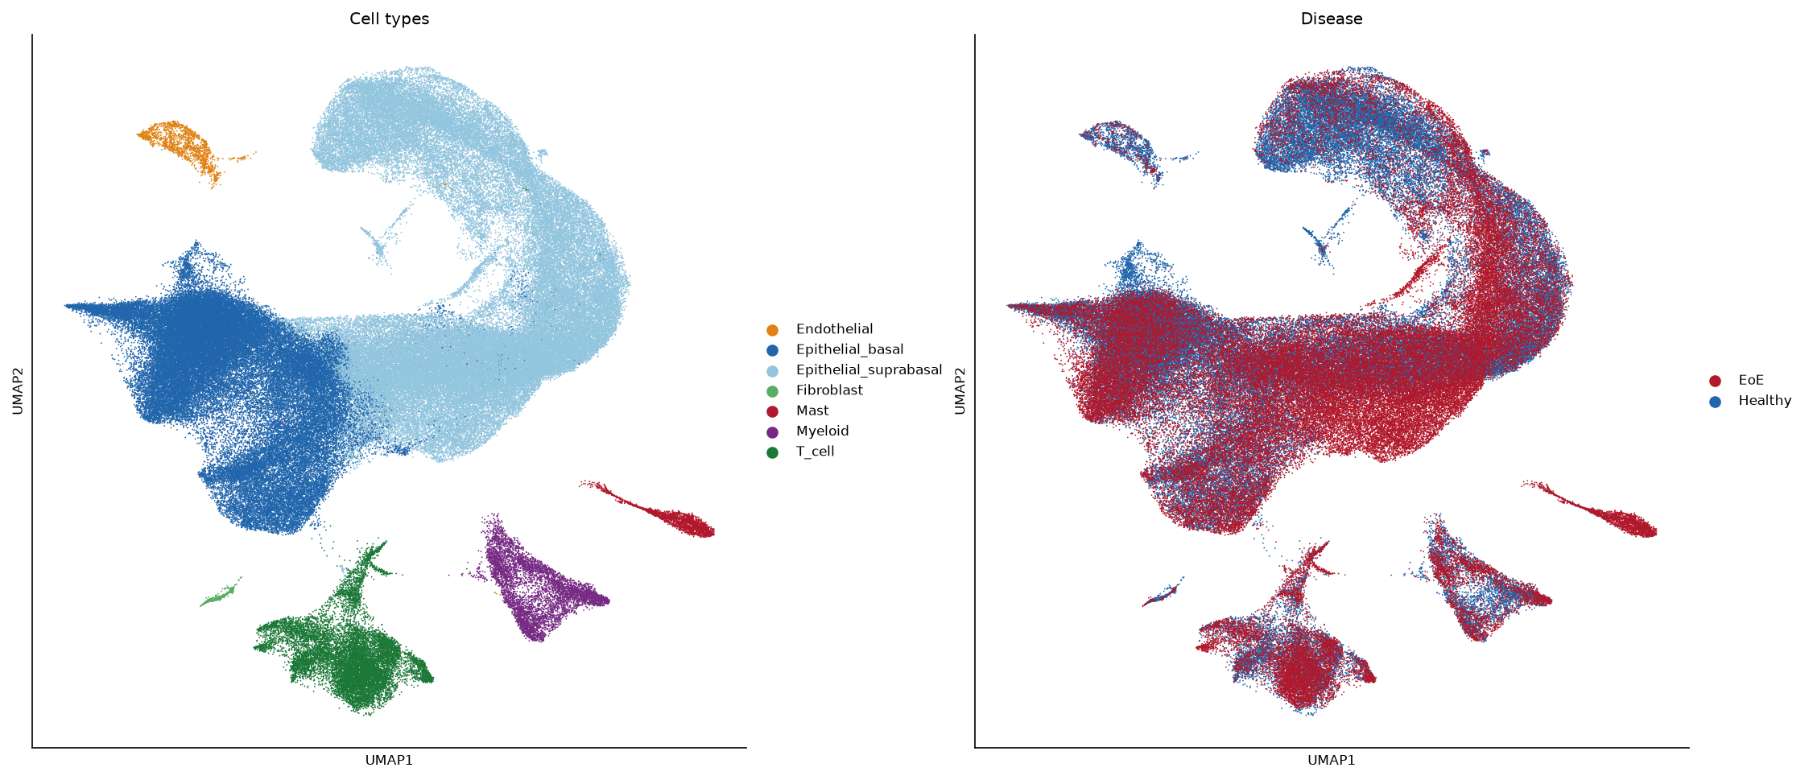
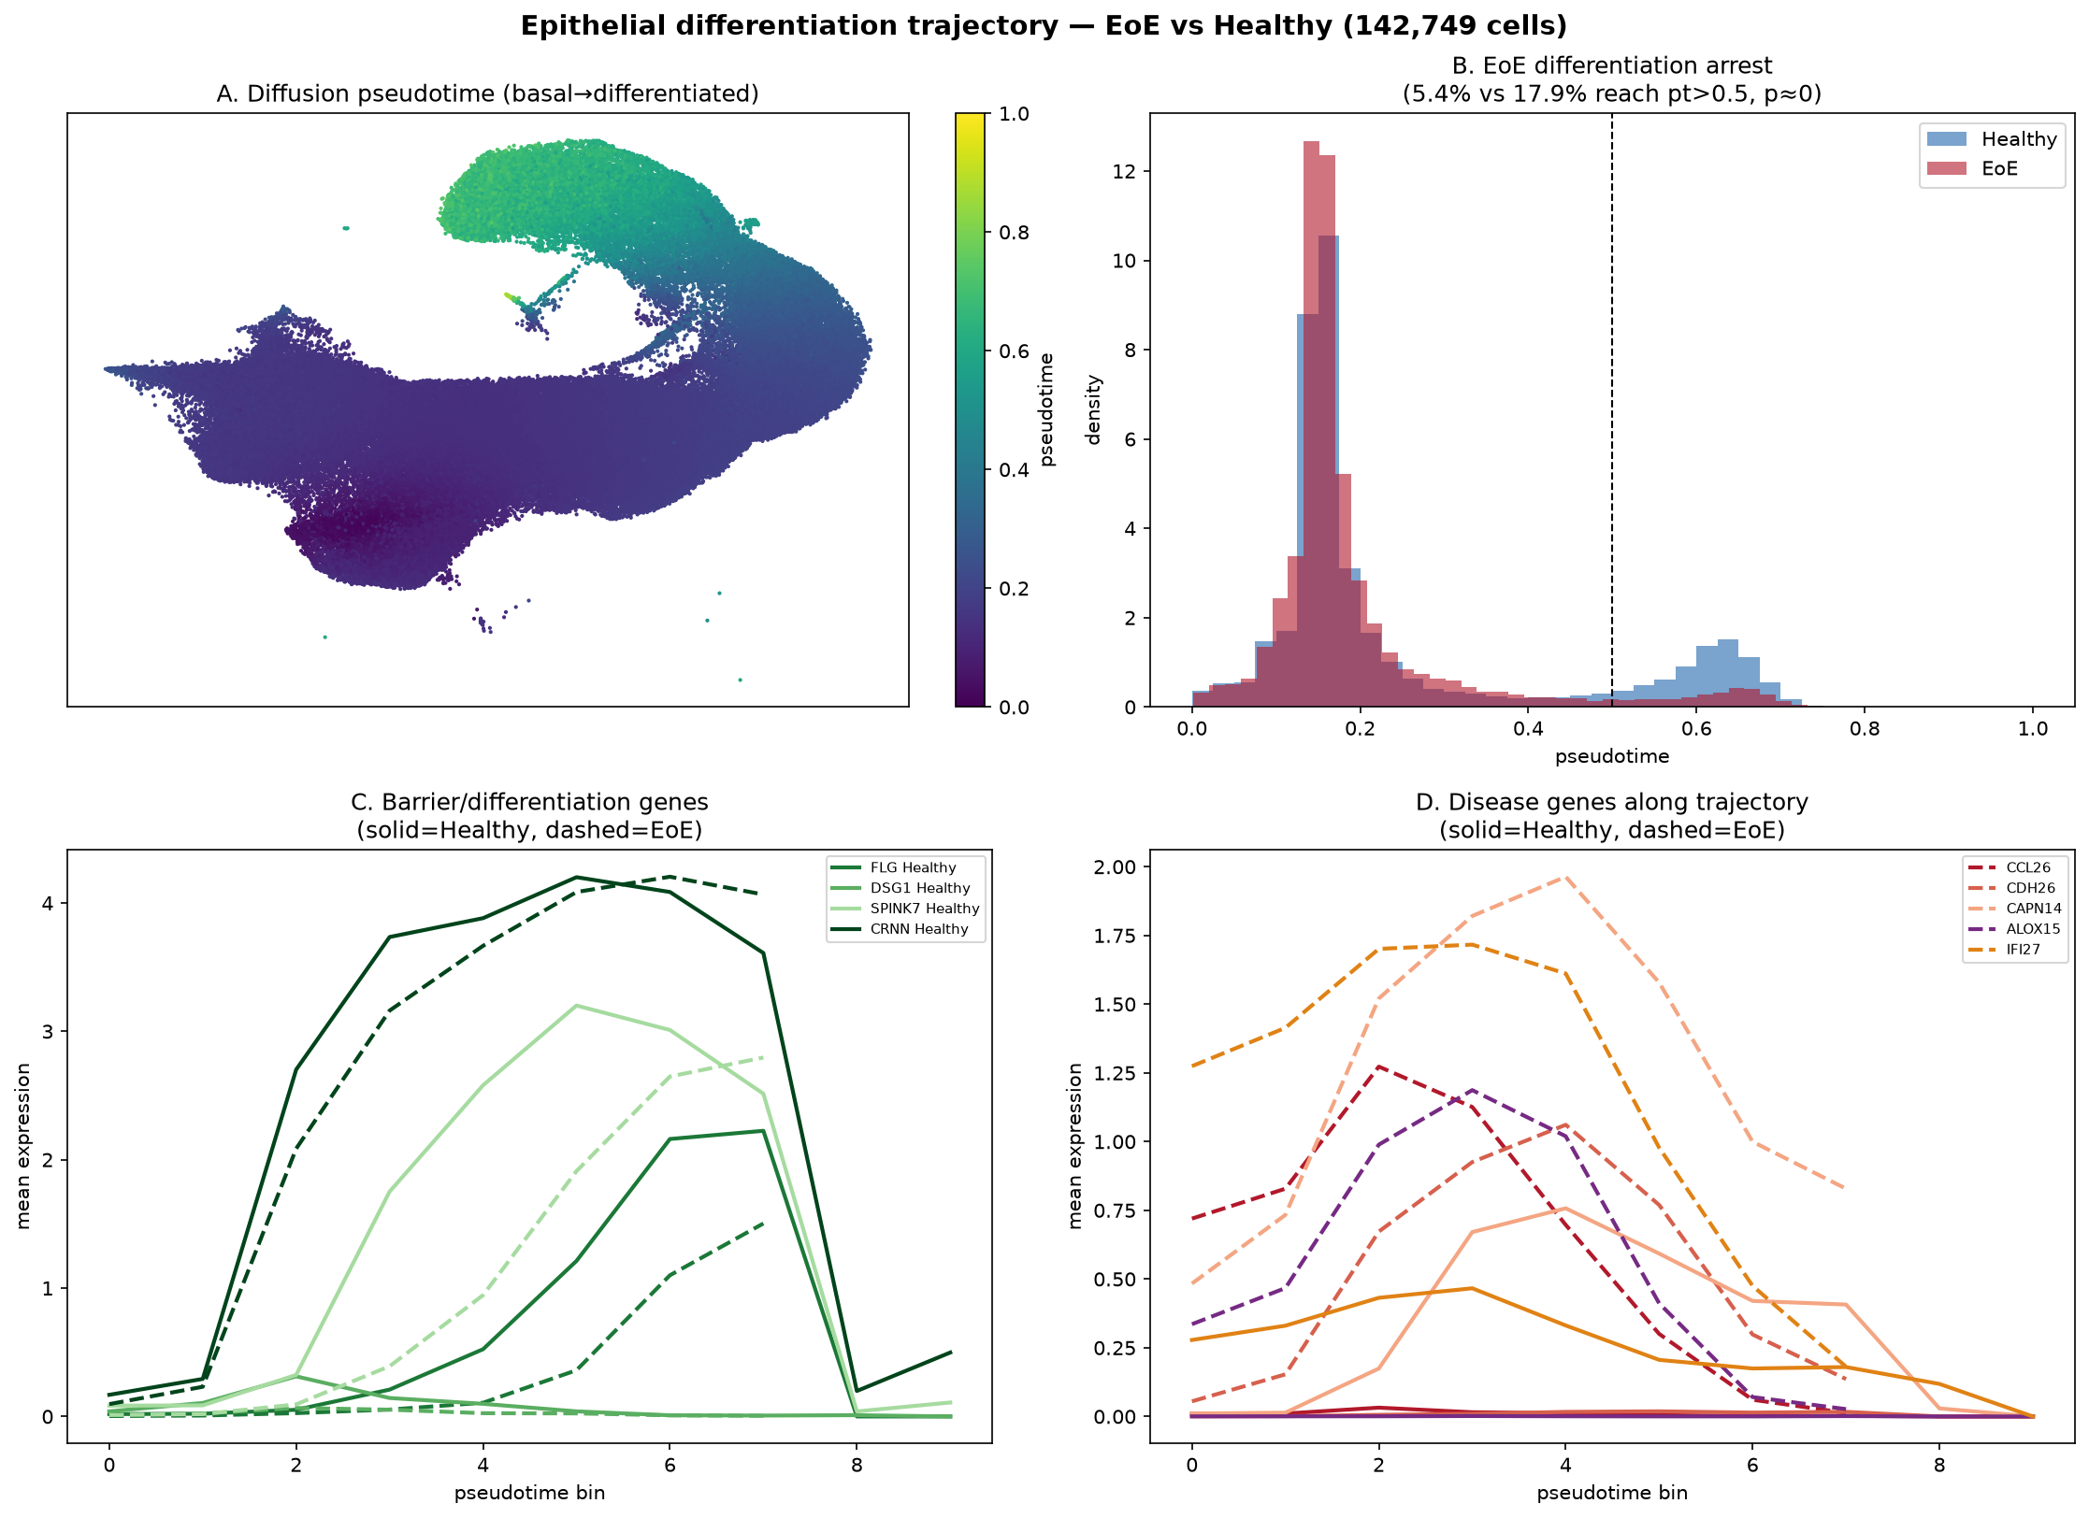
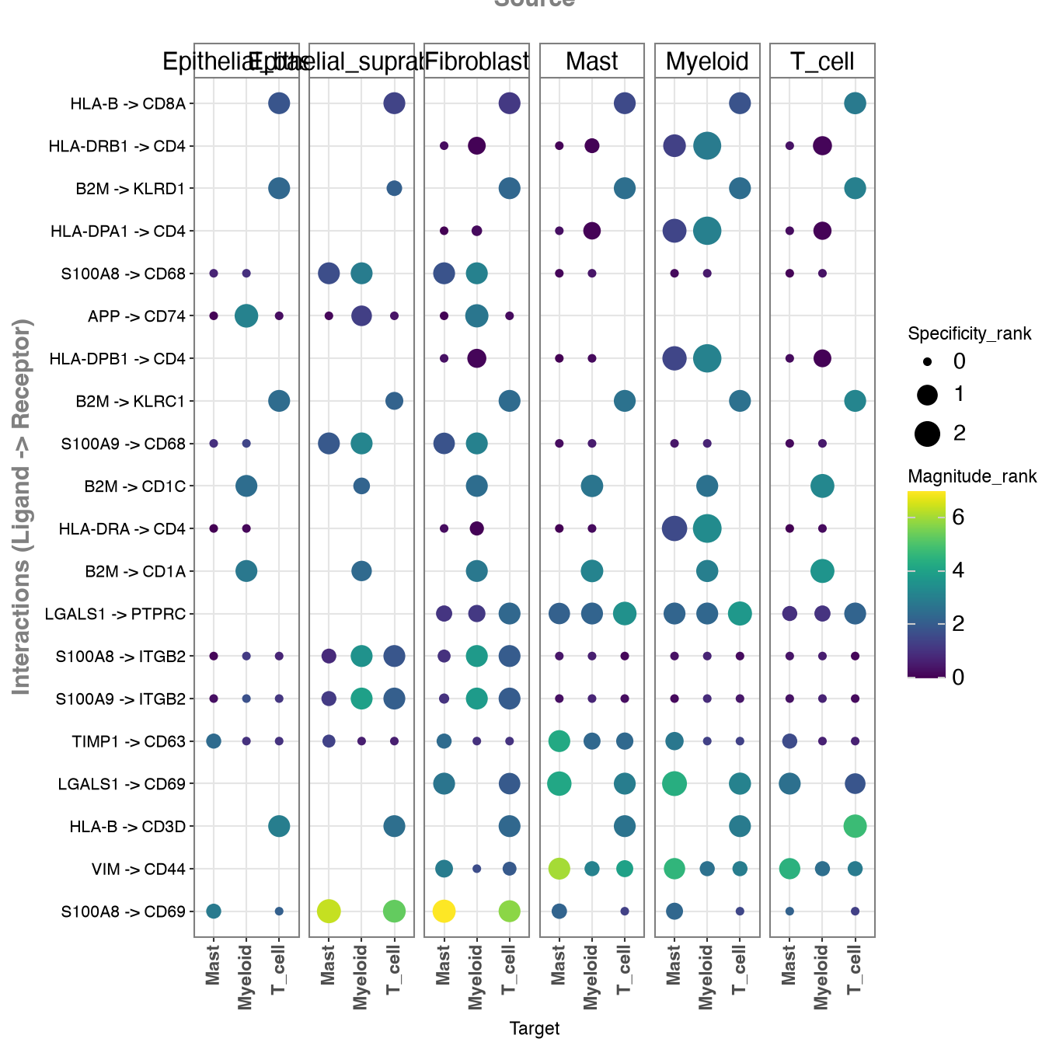
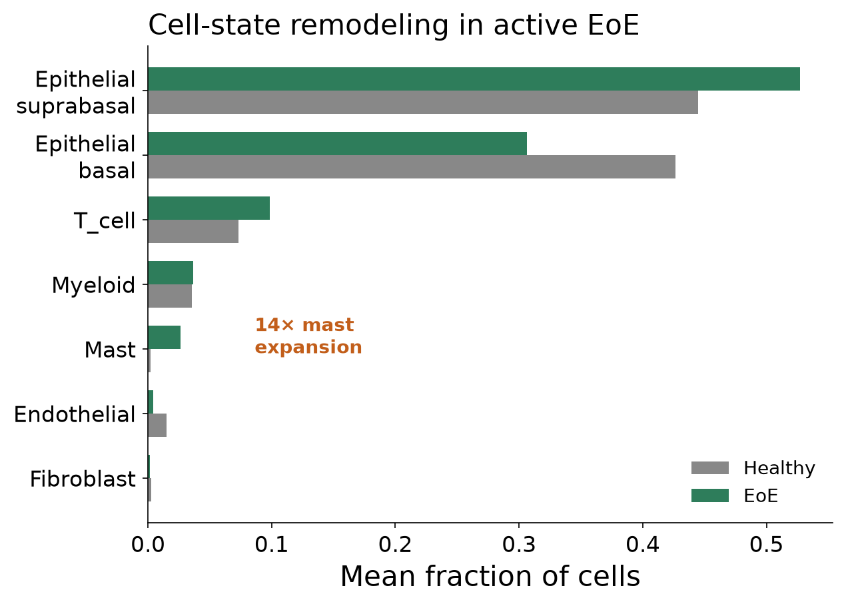

Single-Cell Cell-State Remodeling in Eosinophilic Esophagitis
Active EoE reshapes the epithelium, expands mast cells, and induces HLA-I where antigen is presented
EoE Single-Cell Working Group · Built with Claude · Life Sciences Hackathon 2025
166,420
esophageal cells profiled
14×
mast-cell expansion in EoE
+0.82
HLA-I induction, suprabasal epithelium
7
epithelial & immune cell states
Question & Scope
Note on Eosinophils
How does active EoE remodel the esophageal wall at single-cell resolution, and where is antigen being presented?
Scope: a 166,420-cell atlas across EoE and healthy biopsies, scored for composition shifts, cell states, and HLA-I induction.
Mast-Cell States
HLA-I Induction
Eosinophils define EoE histologically but are sparse/fragile in dissociated single-cell data — not resolved as a discrete cluster here.
The mast-cell and epithelial signals are the robust single-cell readouts; eosinophil biology sits in the bulk/effector streams.
Disease-associated states carry SIGLEC6 (84% EoE vs 34% healthy).
SIGLEC6 cleanly marks the EoE-expanded mast state, nominating it as both a biomarker and a depletion handle.
Suprabasal +0.82, basal +0.55, mast +0.59; stroma unchanged/down.
HLA-I rises precisely in the epithelial and mast compartments — evidence that antigen presentation is happening where the disease lives.
The Atlas
166,420 cells; 7 states across EoE and healthy.
A map this large resolves rare and disease-specific states that per-sample studies miss.
Mast substates; SIGLEC6 marks the EoE disease-associated state.
Δ HLA-I score (EoE − healthy) by cell state.
Conclusions
• EoE reshapes epithelium and expands mast cells ~14×
• HLA-I induction concentrates in epithelium & mast — active presentation
• SIGLEC6 marks the disease-associated mast state
UMAP by cell type (left) and disease (right).
Epithelial Trajectory
Cell-Cell Signaling
Basal-zone expansion and shifted differentiation in EoE.
The basal compartment expands and differentiation reprograms — the cellular correlate of the barrier defect seen in bulk data.
HLA→CD8A/CD4 and S100A8/9 signaling rewire across states.
The rewired interactions connect antigen-presenting epithelium to cytotoxic and myeloid partners — a candidate disease circuit.
Cell-State Composition
Mast cells expand ~14×; basal↓ / suprabasal↑; T cells rise.
The epithelium shifts toward a differentiated, inflamed state while mast cells flood in — a coordinated remodeling, not a single-lineage change.
Future Directions
• Map peptides presented on HLA-I-high epithelium; link to pMHC target streams
• Validate SIGLEC6+ mast state as a biomarker / depletion target
• Integrate with bulk effector data to place eosinophils in the circuit
Epithelial differentiation trajectory, EoE vs healthy.
Ligand→receptor interactions by source/target cell state.
Mean cell-state fractions, healthy vs EoE.
Data: internal EoE single-cell atlas · 166,420 cells · composition & HLA-I scoring across 7 cell states · EoE vs healthy
Notes:
[Atlas] 166,420 esophageal cells, seven states, EoE versus healthy.
[Composition] Mast cells expand about 14-fold; epithelium rebalances.
[Mast states] Disease-associated states carry SIGLEC6 — 84% in EoE.
[Epithelial] Basal-zone expansion and shifted differentiation.
[HLA-I] Induction concentrates in suprabasal epithelium and mast cells.
[Signaling] HLA and S100 signaling rewire across states.
[Eosinophils] They don't survive dissociation, so they sit in our bulk streams.
[Next] Map the presented peptides and connect to pMHC work.

