Slide 1
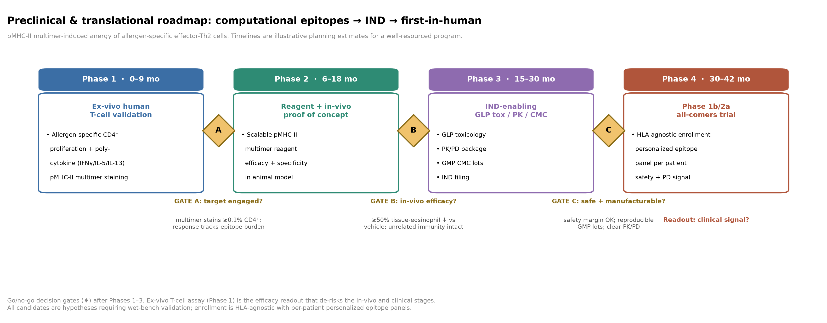
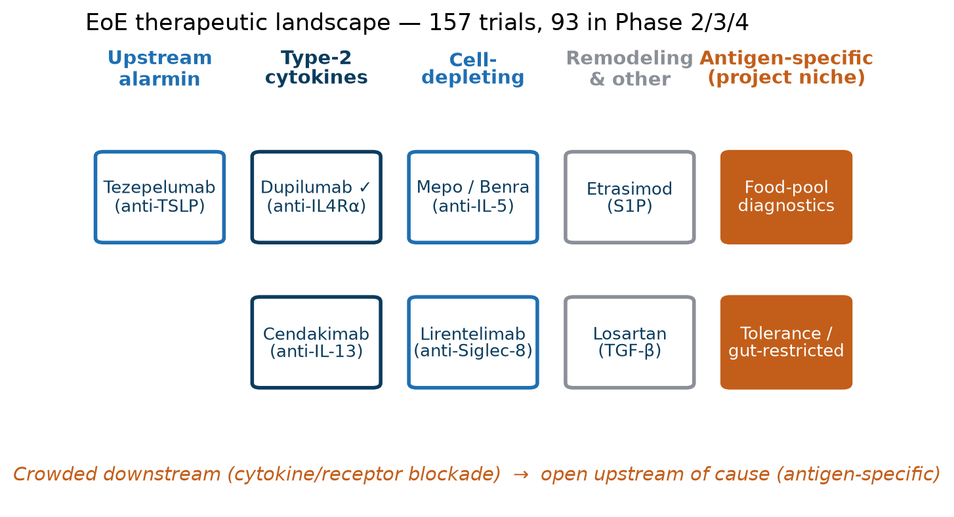
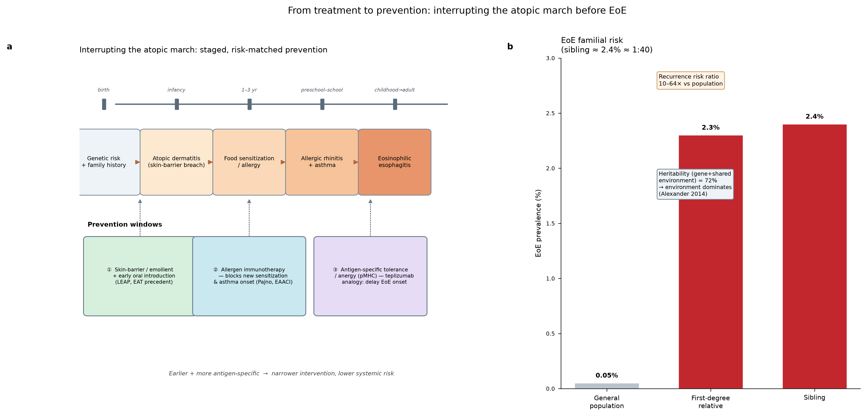
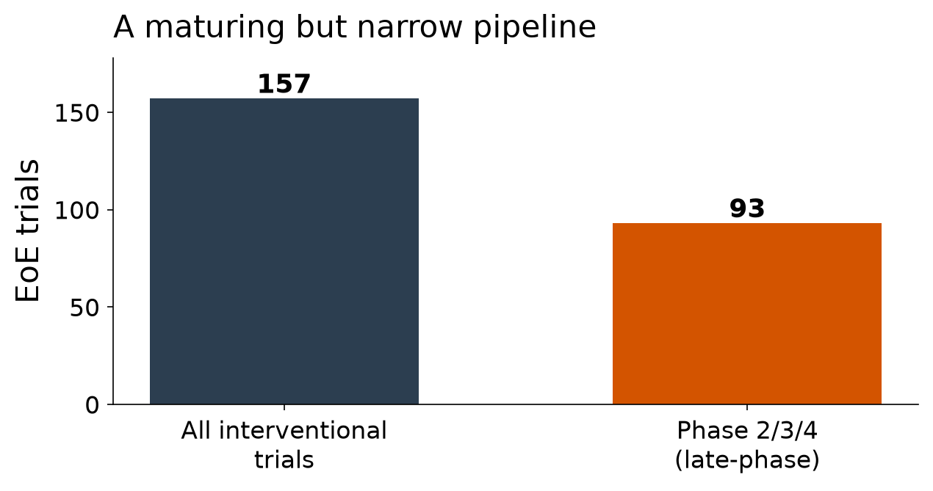
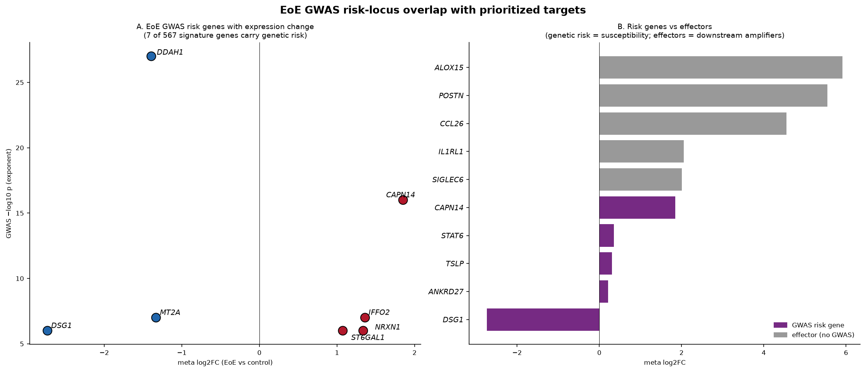
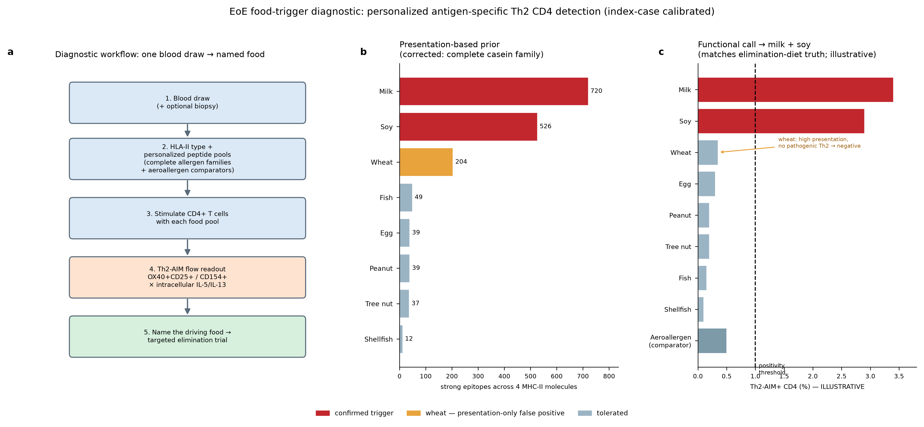
The EoE Therapeutic Landscape: Crowded Downstream, Open at the Cause
EoE Landscape & Strategy Working Group
Built with Claude · Life Sciences Hackathon 2025
Where We Fit
Question & Scope
One Axis, Many Drugs
An Instructive Signal
Prevention as a Frontier
Two open niches: novel effectors (SIGLEC6, IL1RL1/ST2, CCL26/CCR3) and antigen-specific tolerance.
Both sit outside the crowded cytokine-blockade lane and attack the cause rather than the response.
Where is the EoE therapeutic field crowded, and where is the biology still open?
We combined a systematic ClinicalTrials.gov pull with a literature synthesis to map every approved and late-phase mechanism and locate the gaps.
Goal: position novel modalities where they add something the current pipeline does not.
The late-phase pipeline walks successive nodes of one type-2 circuit.
Almost every agent blocks the same IL-13/IL-5/TSLP axis at a different point — so the field is largely one bet placed many times.
Benralizumab depletes eosinophils but gave histologic response WITHOUT full symptom benefit (Kliewer/Dellon 2024).
→ eosinophil count ≠ symptoms
The field's core surrogate is incomplete, which argues for mechanisms upstream of the effector cell.
The atopic march is an interceptable trajectory before EoE onset.
High familial risk plus staged windows means the biggest wins may come from preventing sensitization, not treating established disease.
Computational epitopes → IND → first-in-human roadmap.
Approved & late-phase agents by mechanism; project niches at right.
Staged, risk-matched prevention windows; EoE familial risk.
Conclusions
Genetics Points Upstream
• Pipeline is crowded, downstream, non-antigen-specific, chronic
• Genetics + the benralizumab signal point upstream of eosinophil count
• Our niches: antigen-specific diagnostics & tolerance, plus novel effectors
The Trial Landscape
Risk loci highlight susceptibility genes distinct from the crowded effectors.
Where drugs pile onto downstream cytokines, genetics keeps pointing further up — at the antigen-handling and barrier layer.
A Diagnostic Gap
157 EoE interventional trials; 93 in Phase 2/3/4.
Activity is healthy in volume but clusters on a handful of mechanisms — depth without breadth.
Established Therapy
One blood draw → name the driving food via antigen-specific Th2 readout.
Naming the culprit food directly would replace slow empirical elimination diets with a targeted, testable intervention.
• Swallowed topical steroids (budesonide, fluticasone; ODT successors)
• PPIs — first-line, acid-independent
• Dietary elimination — the only causal therapy
• Dupilumab (anti-IL-4Rα) — first FDA-approved biologic; 8 late-phase trials
Effective but chronic and non-specific — none removes the antigenic cause.
Future Directions
• Prototype the food-trigger diagnostic against elimination-diet ground truth
• Advance SIGLEC6 / IL1RL1 / CCL26 binders toward IND-enabling studies
• Explore antigen-specific tolerance as a disease-modifying, non-chronic modality
93 of 157 trials (59%) are Phase 2/3/4; late-phase activity concentrates on a few mechanisms.
GWAS risk-locus overlap with prioritized targets.
Personalized food-trigger diagnostic workflow (index-case calibrated).
Source: internal EoE literature synthesis + ClinicalTrials.gov analysis (157 trials, 93 Phase 2/3/4) · Part IV targeted-therapy review
Notes:
[Narrow] 157 trials, 93 late-phase — a narrow field.
[One axis] The pipeline walks one type-2 circuit: IL-13, IL-5, Siglec-8, TSLP.
[Established] Steroids, PPIs, diet, dupilumab anchor care.
[Signal] Benralizumab clears eosinophils without full symptom benefit.
[Genetics] Risk loci point upstream, at susceptibility rather than effectors.
[Prevention] The atopic march is interceptable before EoE.
[Diagnostic] One blood draw names the driving food.
[Fit] We occupy two open niches — novel effectors and antigen-specific tolerance.
[Conclusions] We target the cause, not just the downstream cytokine.

