Slide 1
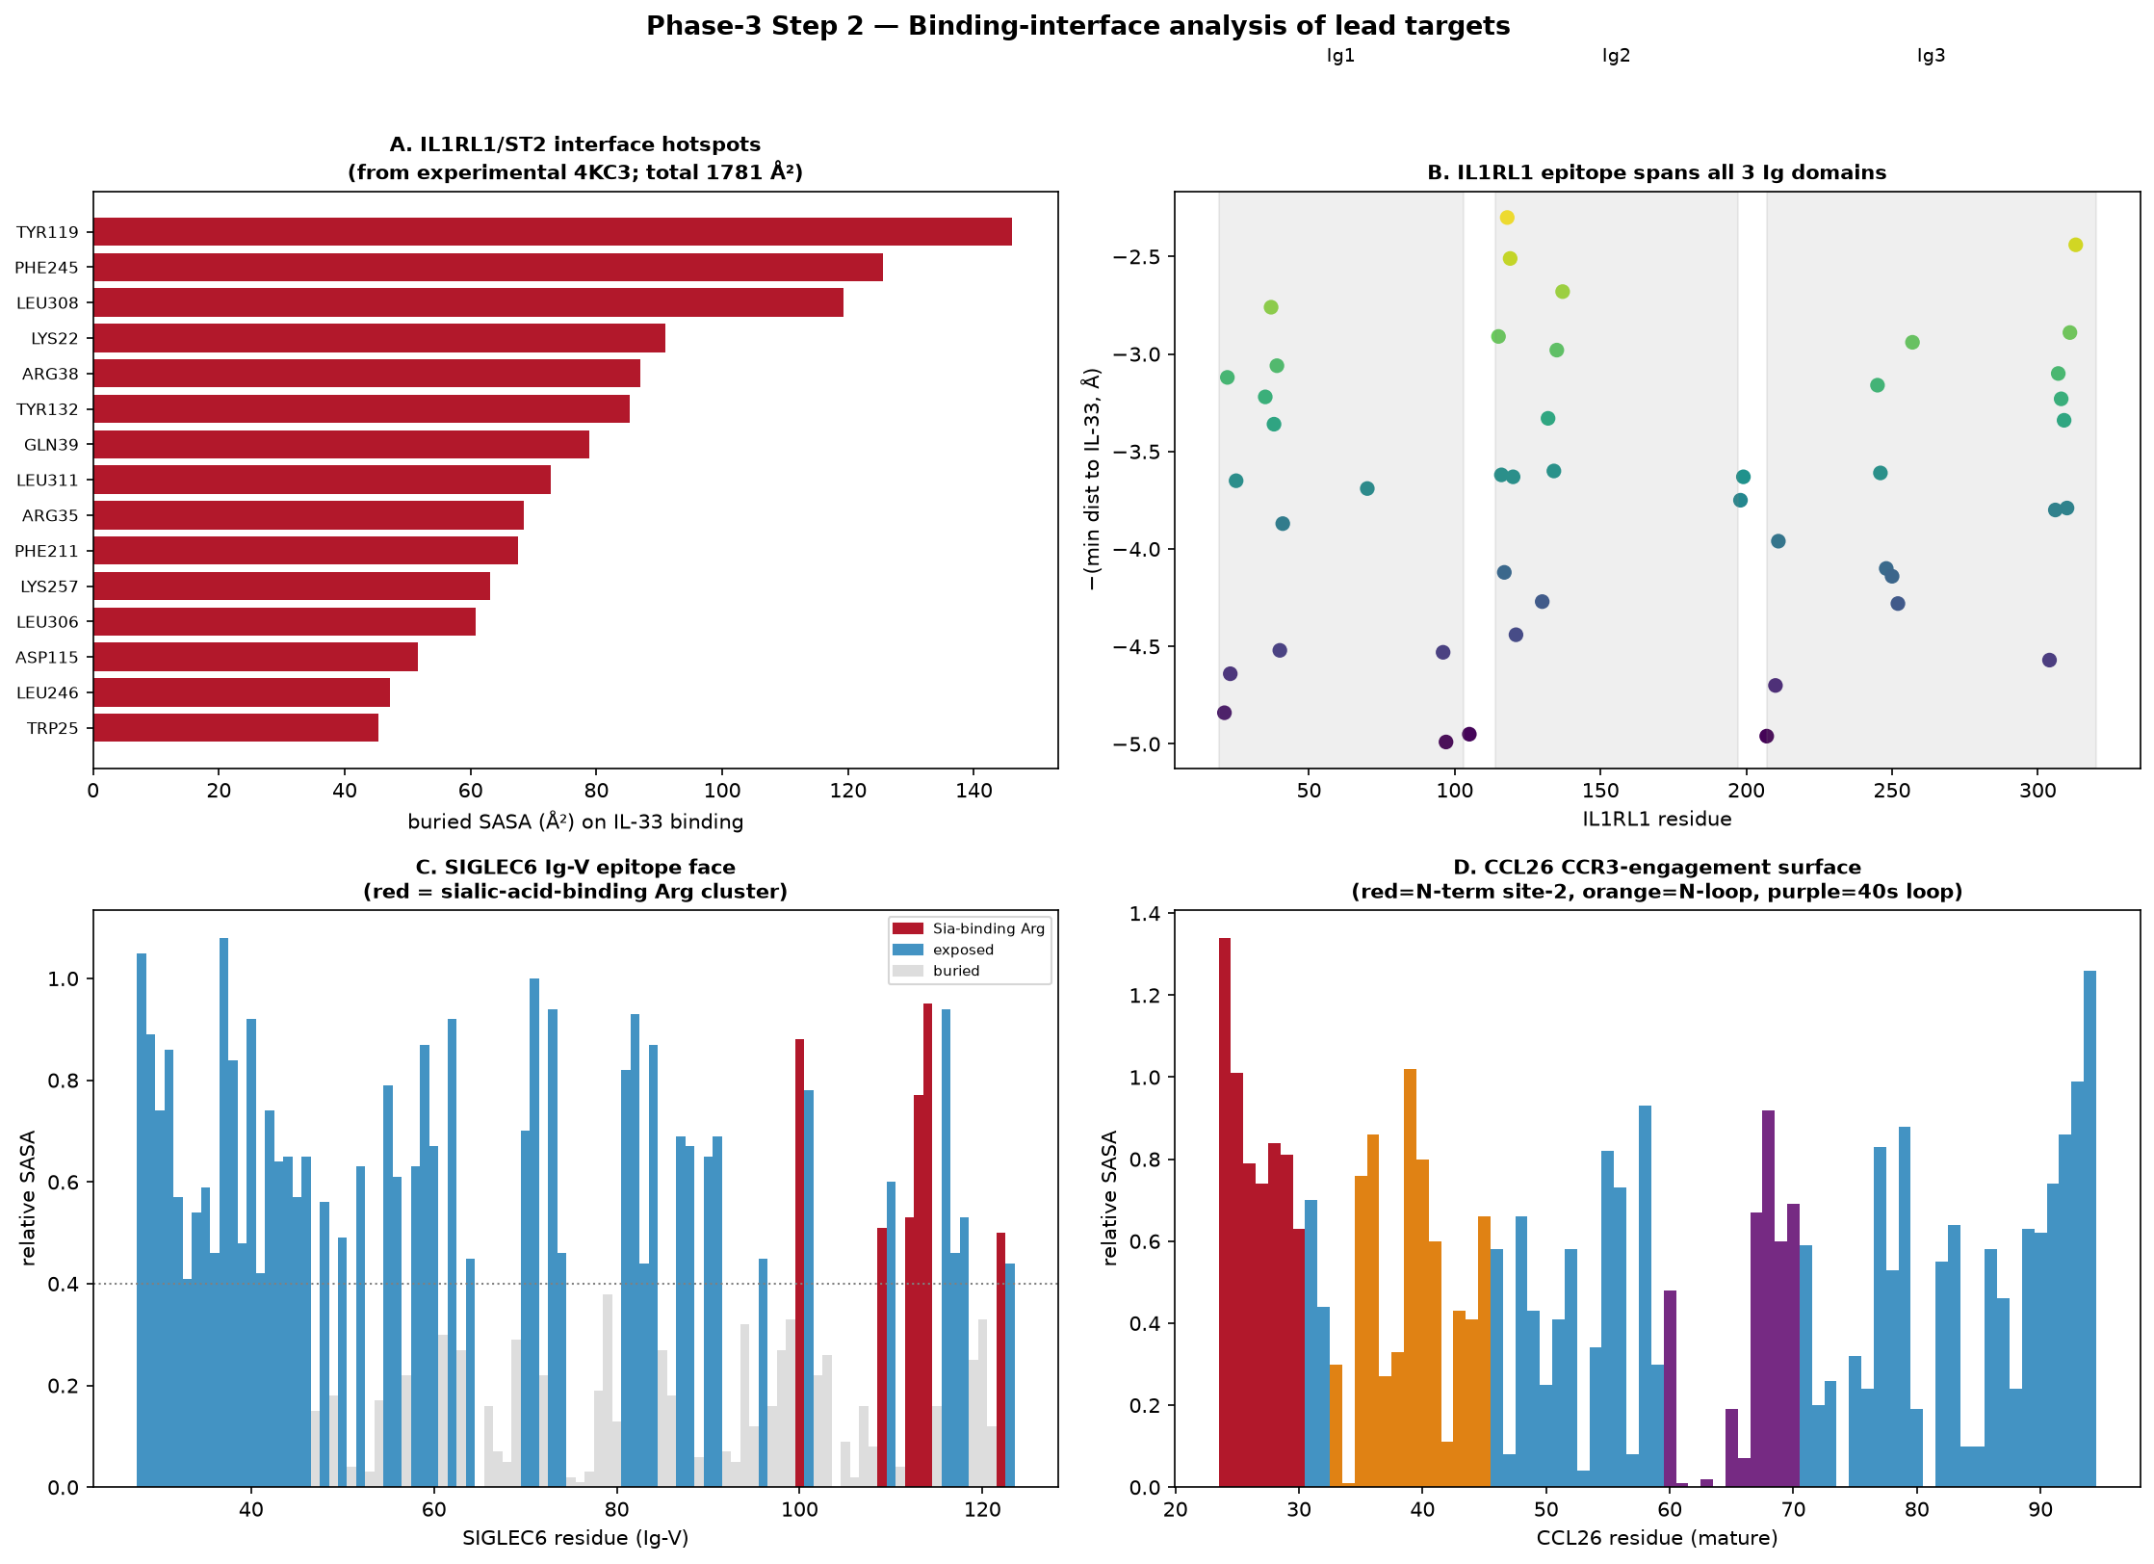
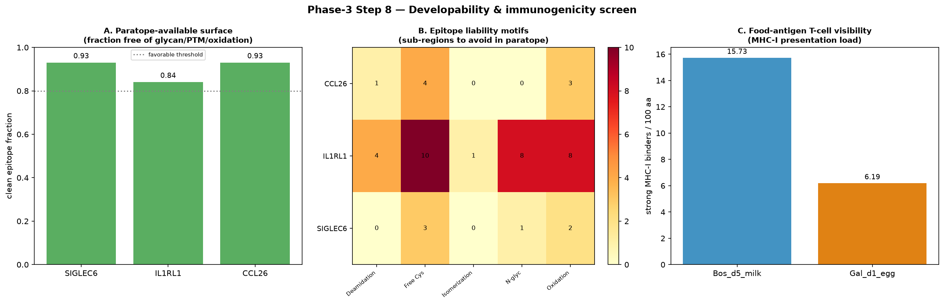
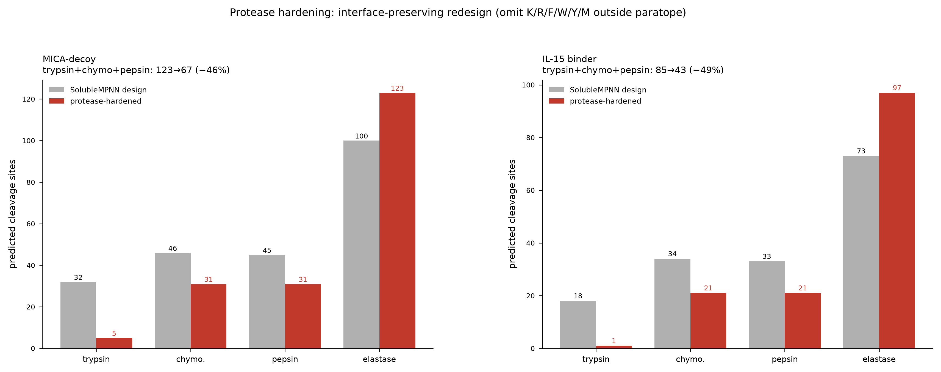
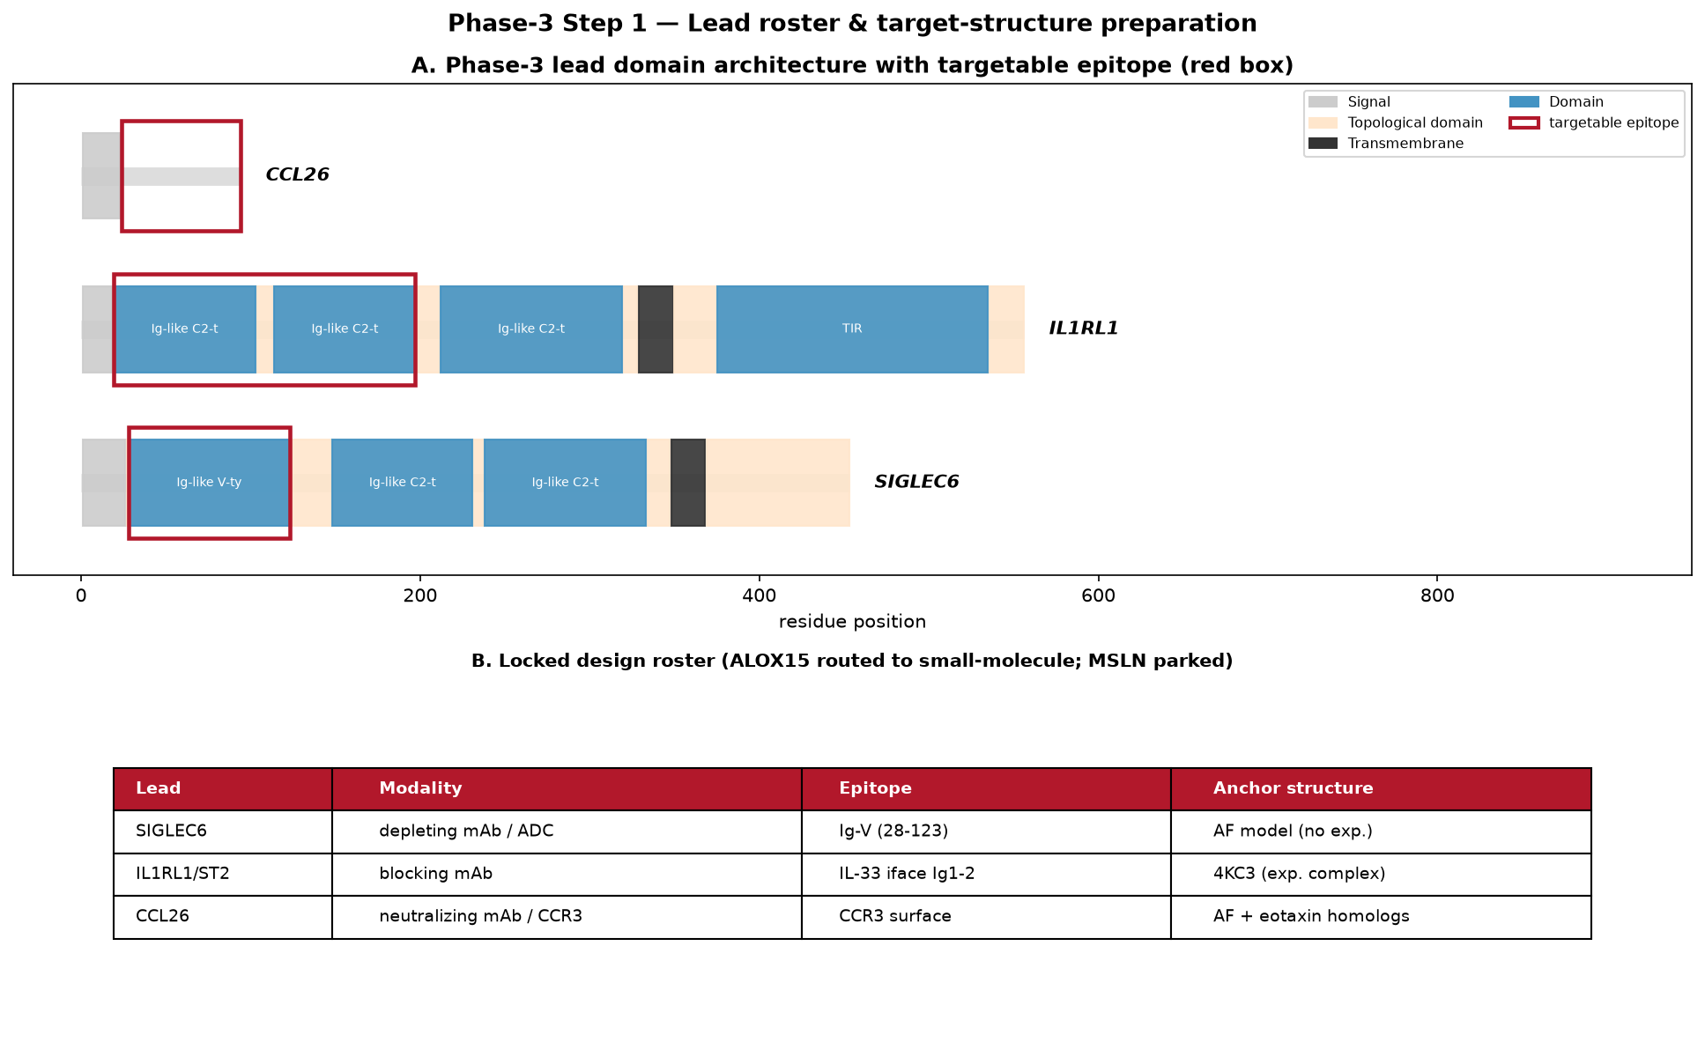
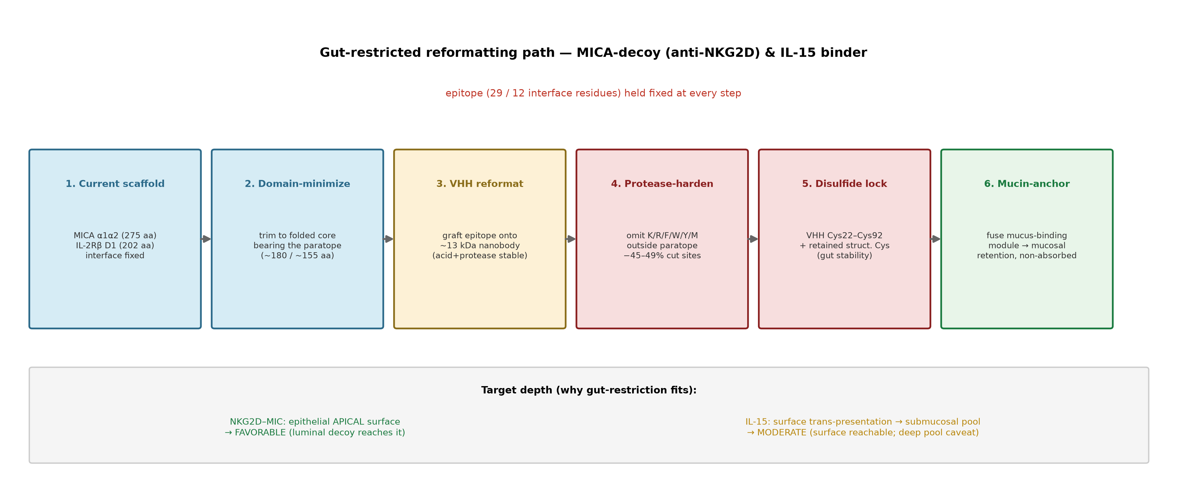

Gut-Restricted Binders for Celiac Disease
Protease-hardened minibinders engineered to act locally in the gut, sparing systemic exposure
Celiac Protein-Design Working Group · Built with Claude · Life Sciences Hackathon 2025
2
lead binders hardened (MICA-decoy, IL-15)
−45–49%
protease-labile sites removed
32→5
trypsin sites (MICA-decoy)
Cys ✓
structural cysteines retained (both leads)
Question & Scope
Trade-off Logged
Can we build binders that act only in the gut — hitting gluten-driven biology locally without systemic immunosuppression?
Scope: harden two validated minibinder scaffolds (MICA-decoy, IL-15) to survive the intestinal protease bath while holding their binding interface fixed.
Interface Analysis
Developability
Binding hotspots mapped from experimental & modeled complexes.
Knowing exactly which residues carry the interface tells us which ones must stay untouched during hardening.
Clean paratope surface; epitope-liability motifs flagged.
Flagging liabilities now, before wet-lab, keeps the leads manufacturable and low-immunogenicity.
Very negative net charge aids non-absorption (intended). Monitor solubility/folding at extreme charge. Structural cysteines retained in both binders.
Charge buys gut-restriction; watch solubility
Why Gut-Restricted
Buried-SASA hotspots and epitope faces for the lead targets.
Paratope cleanliness, liability motifs, and T-cell visibility.
Celiac is driven by gluten peptides presented in the small bowel. A locally-acting binder avoids systemic risk — but the gut is a protease bath, so naive designs are digested before they act.
Conclusions
• Two leads hardened, protease sites cut ~half, fold-critical Cys preserved
• Charge engineering supports luminal, non-absorbed action
• Interface held fixed throughout — binding not sacrificed for stability
Design for the gut: survive proteases, act at the mucosa, stay unabsorbed
Protease Hardening
Lead Roster
Trypsin/chymo/pepsin sites cut ~half; interface preserved.
Cutting labile sites roughly in half while leaving the paratope intact is the central result — stability gained at no binding cost.
Three leads with targetable epitopes and anchor structures.
Each lead has a defined epitope and a structural anchor, so design can proceed on real geometry rather than guesswork.
Reformatting Path
Epitope held fixed across a 6-stage path.
Fixing the paratope at every step means hardening buys stability without trading away the binding we started from.
Future Directions
• Express both leads; assay stability in simulated intestinal fluid
• Confirm retained target binding by SPR/BLI
• Add the mucin-anchor module and test mucosal retention in vivo
Predicted cleavage sites before/after interface-preserving redesign.
Domain architecture with targetable epitope (red) and locked design roster.
MICA-decoy & IL-15 binder → domain-minimize → VHH → harden → lock → mucin-anchor.
Data: internal celiac gut-restricted binder design streams · developability & protease-map analysis · QR: project page
Notes:
[Why] Celiac is driven in the gut; a local-acting binder avoids systemic risk but must survive proteases.
[Reformat] We hold the epitope fixed across a six-stage hardening path.
[Interface] Hotspots come from experimental and modeled complexes.
[Hardening] Protease sites drop by about half with the interface intact.
[Developability] Paratopes are clean; liabilities are flagged.
[Roster] Three leads with defined epitopes and anchor structures.
[Trade-off] Negative charge drives non-absorption; we watch solubility.
[Next] Express and assay gut-stability, then confirm binding.

