Slide 1
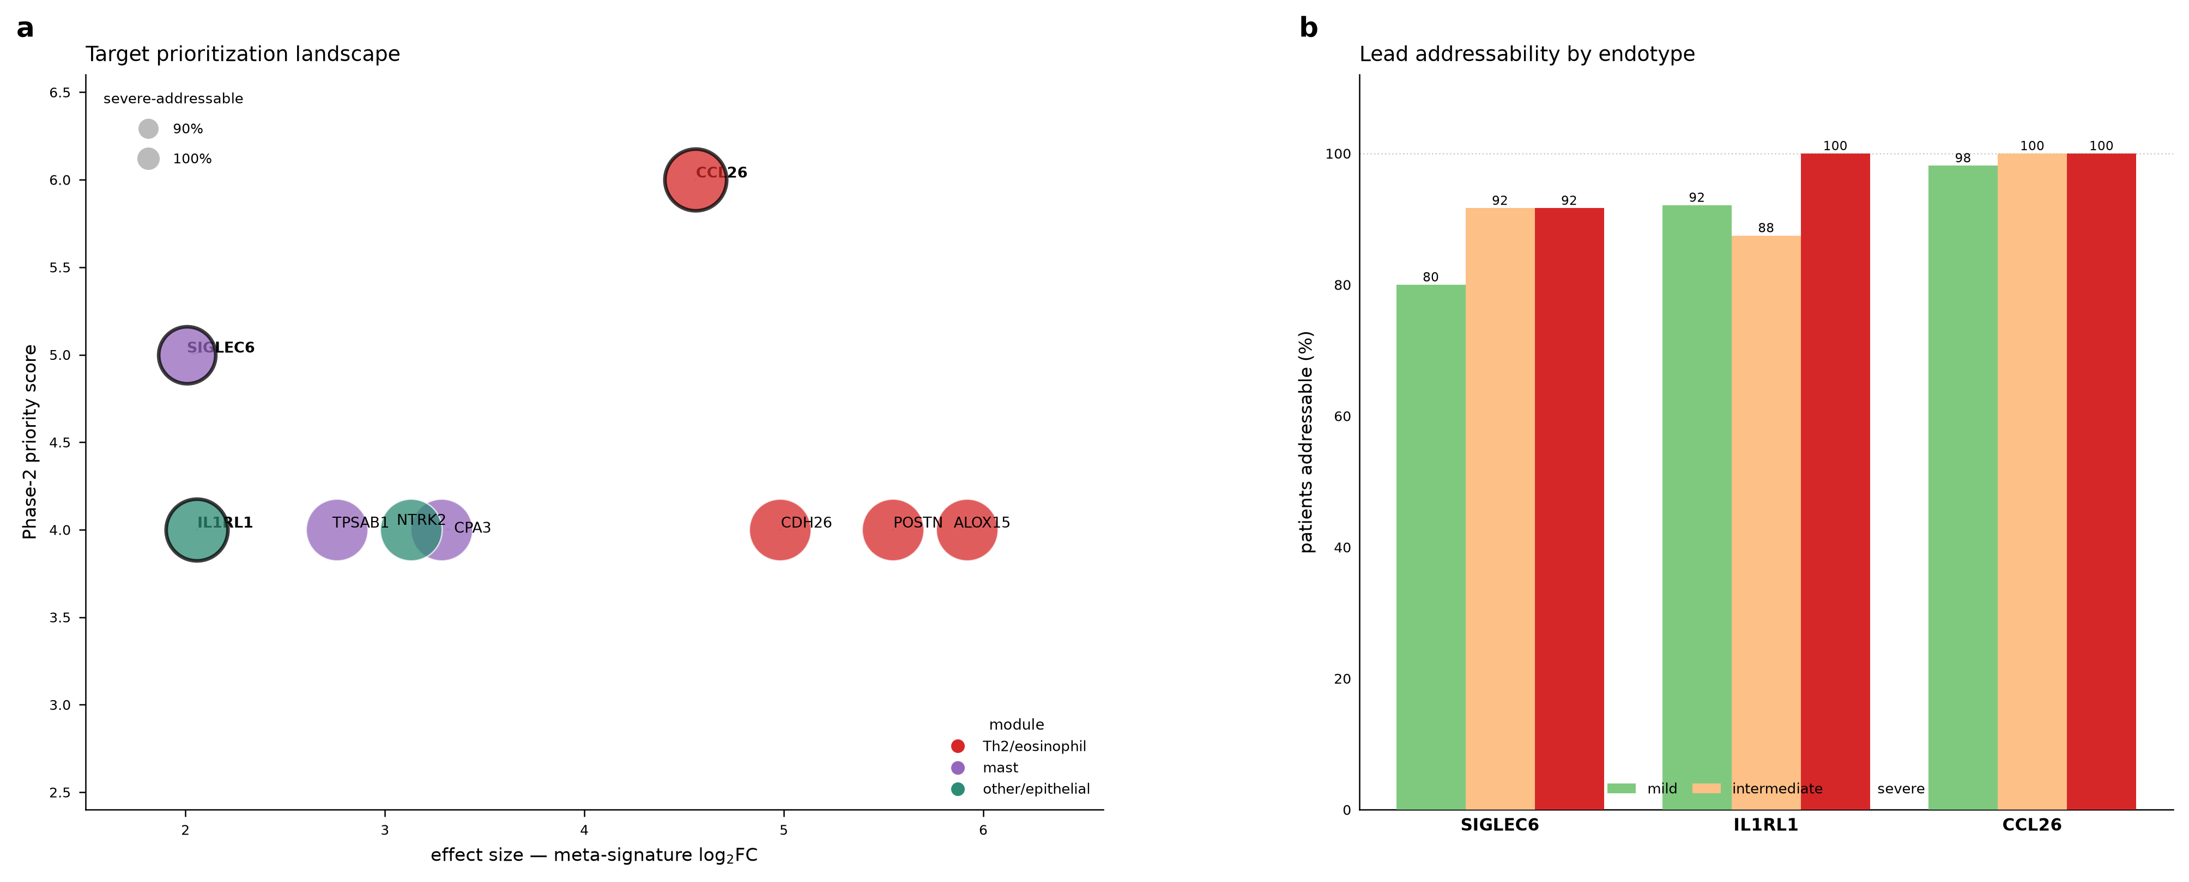
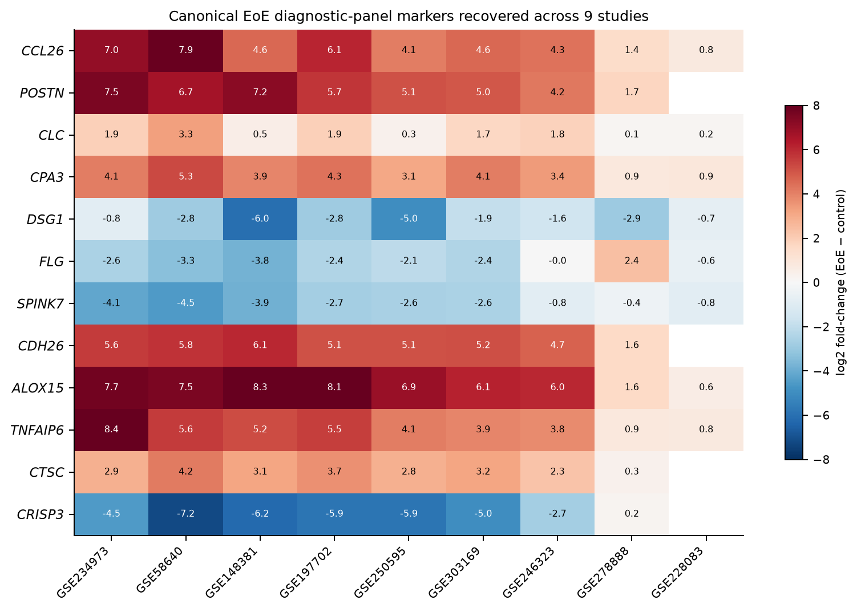
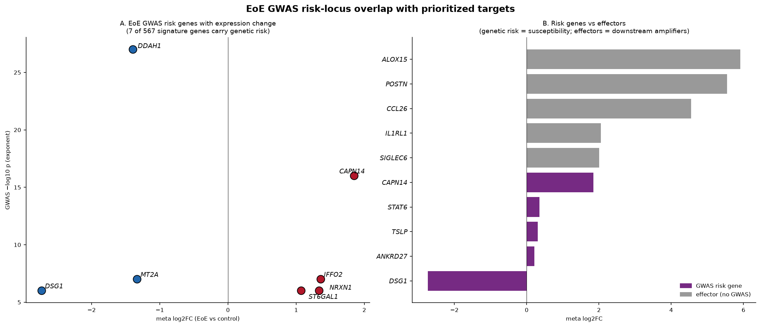
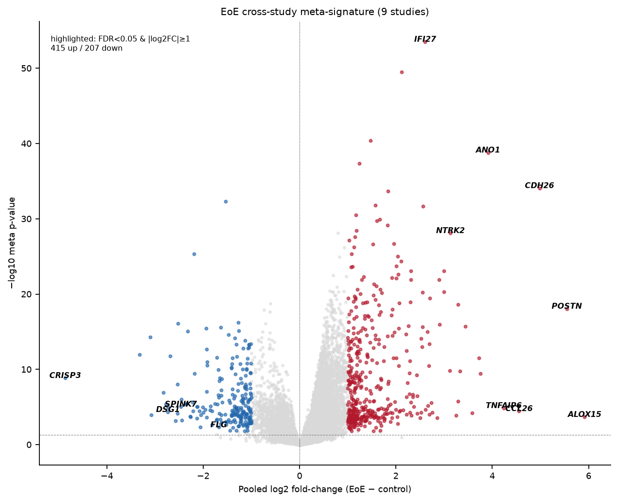
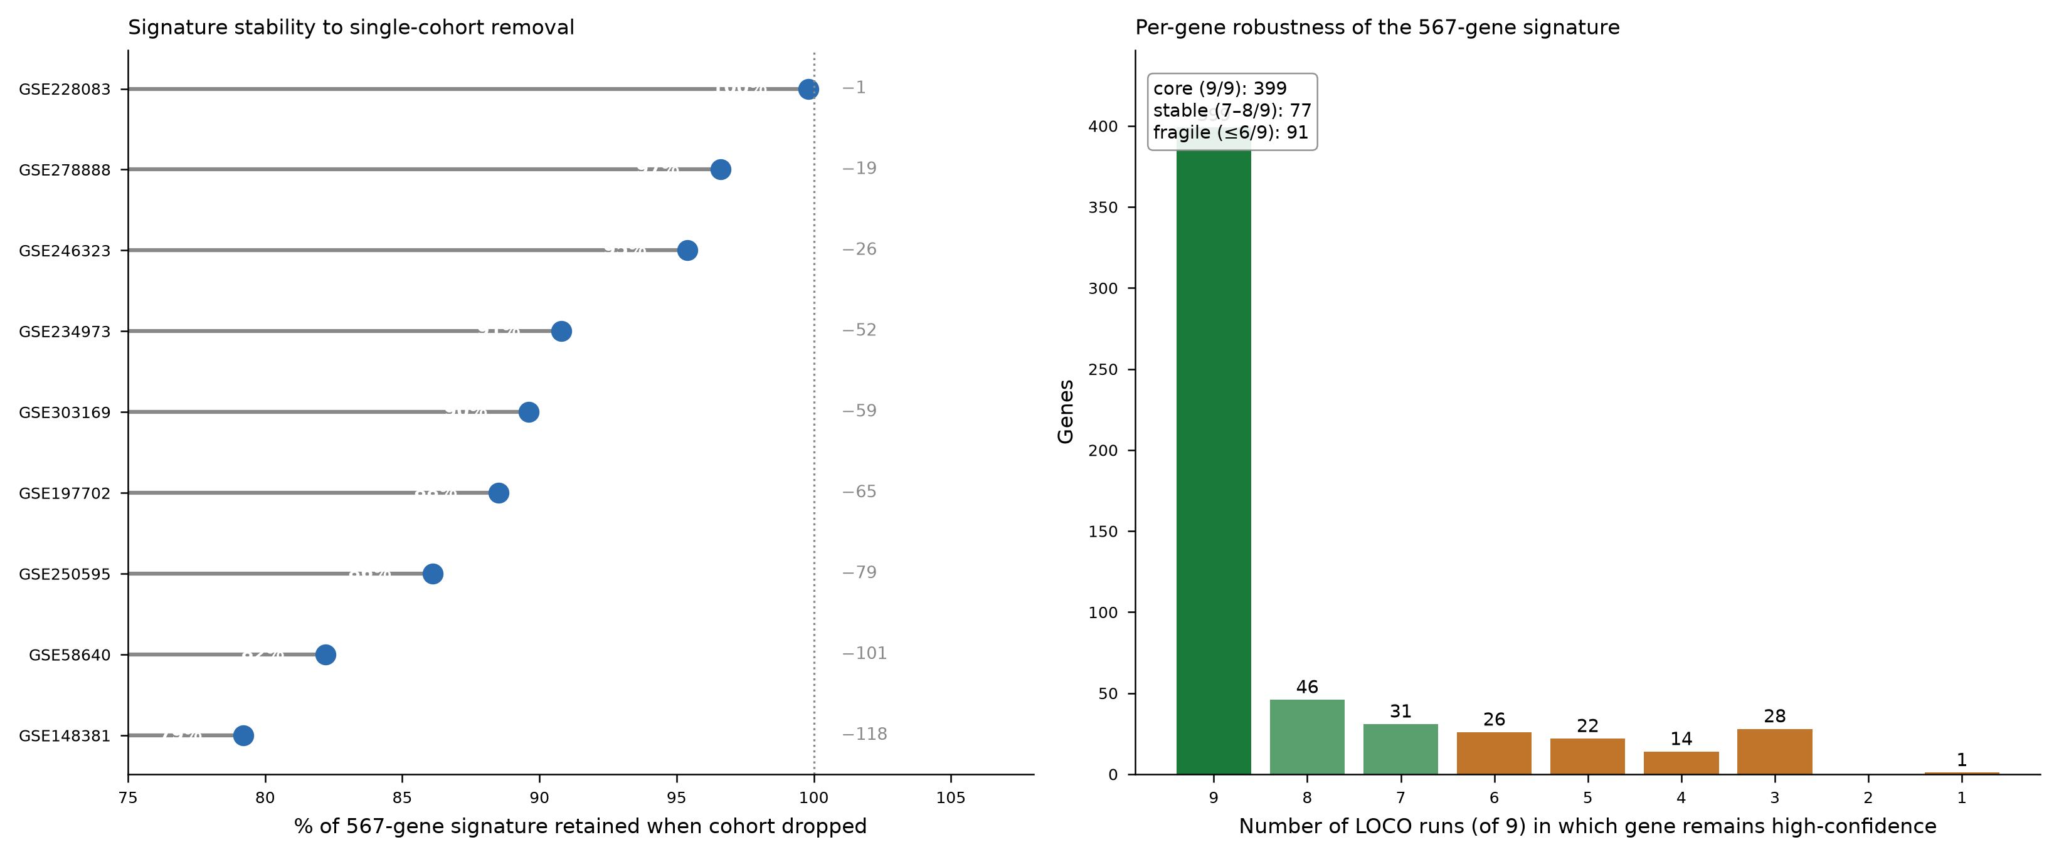
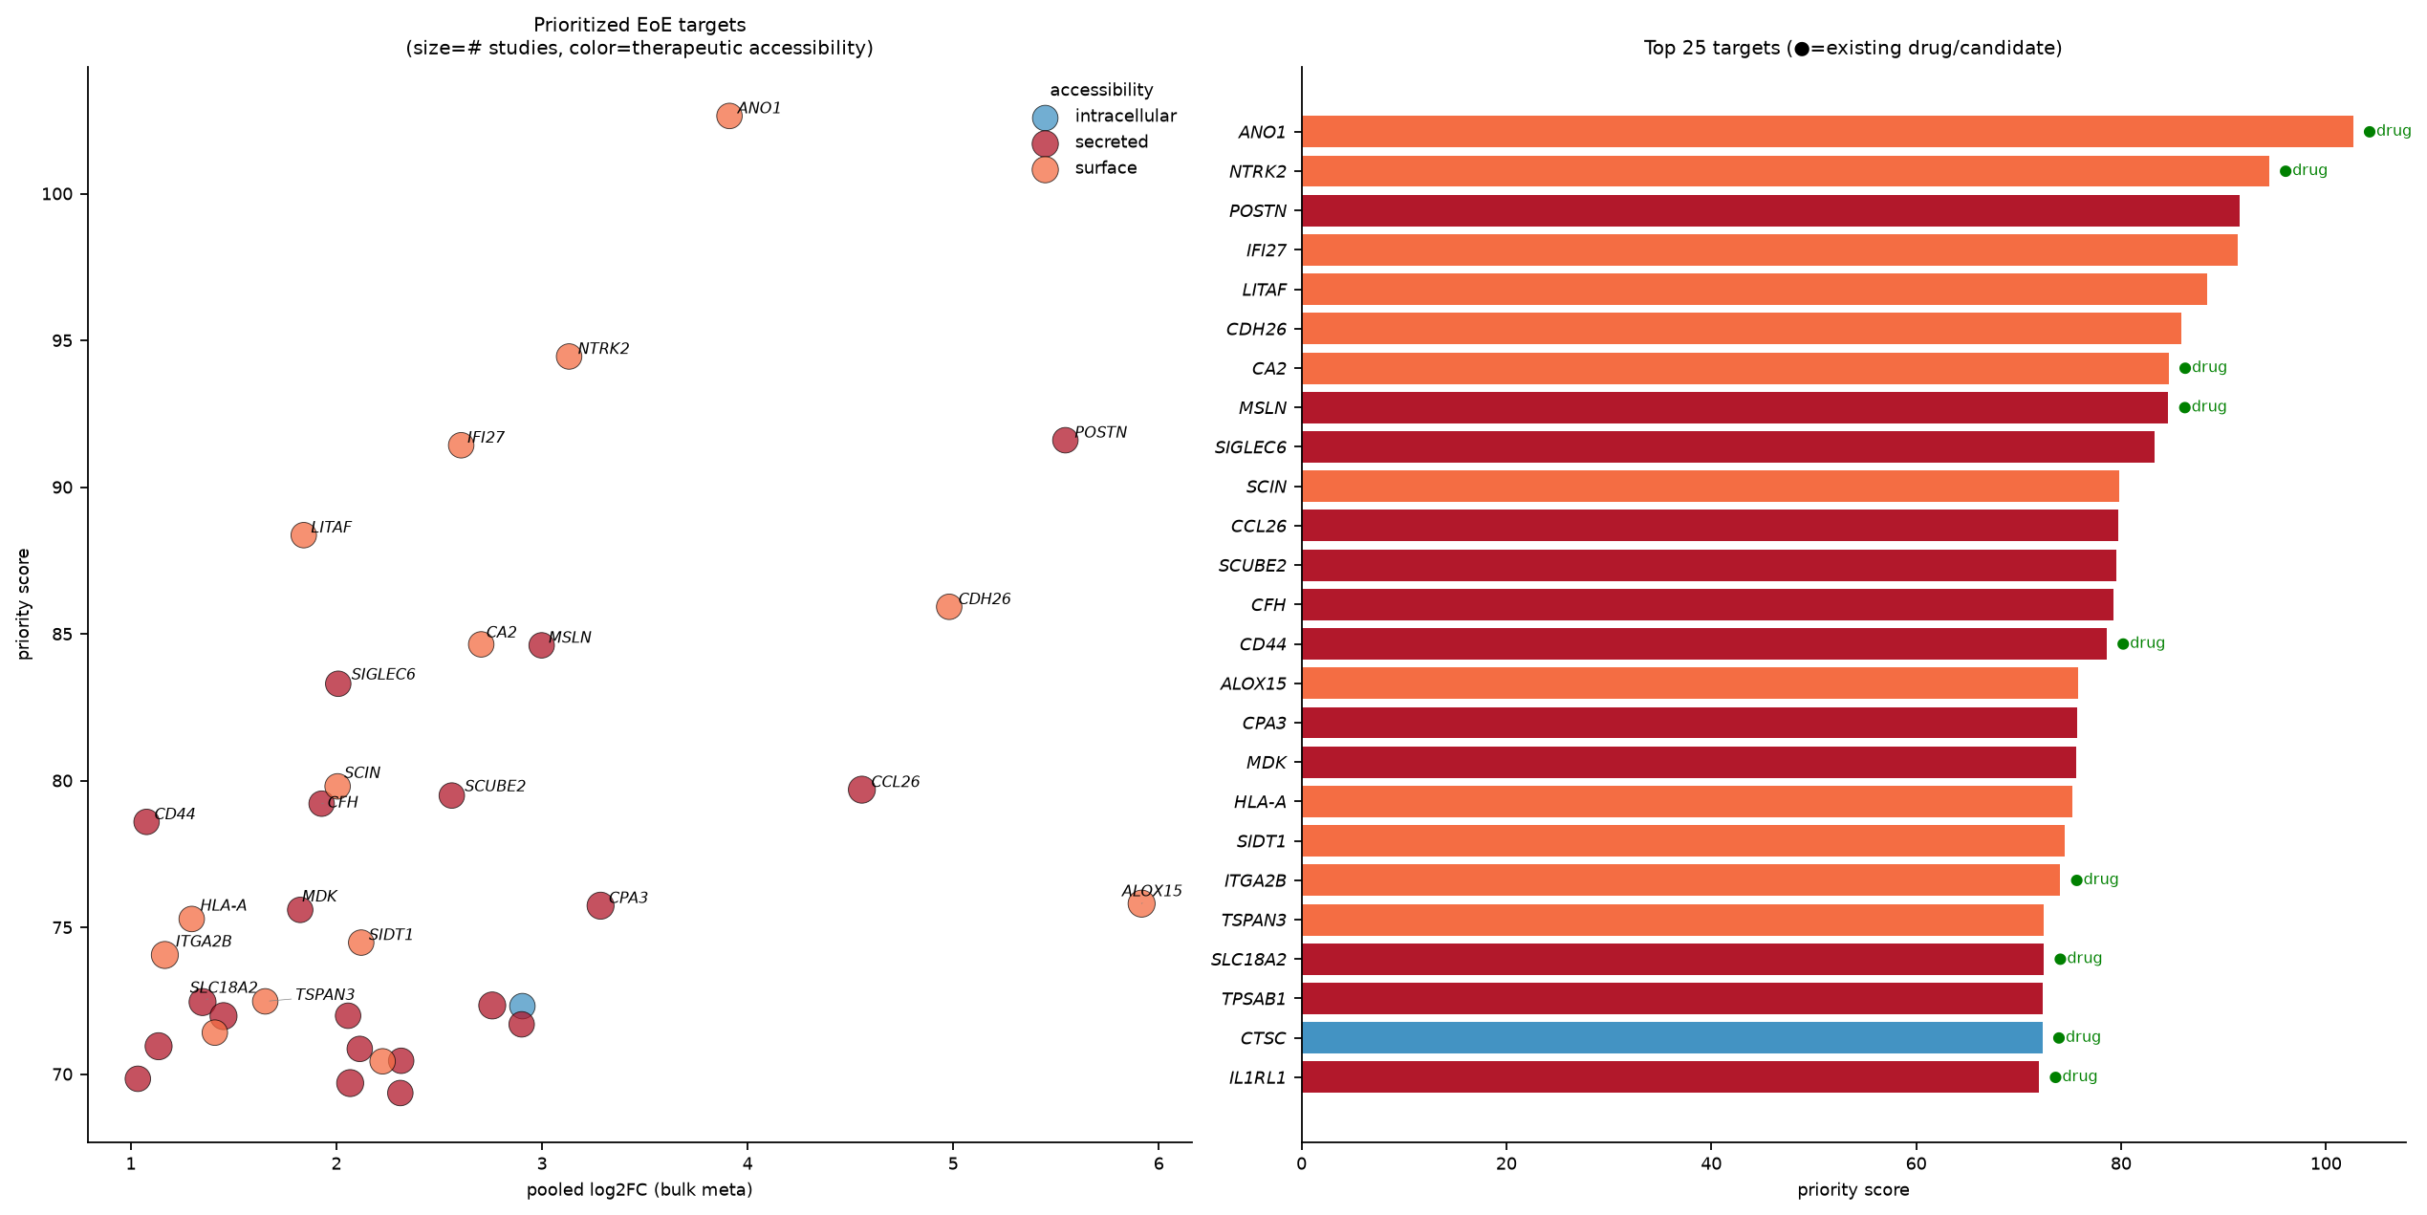
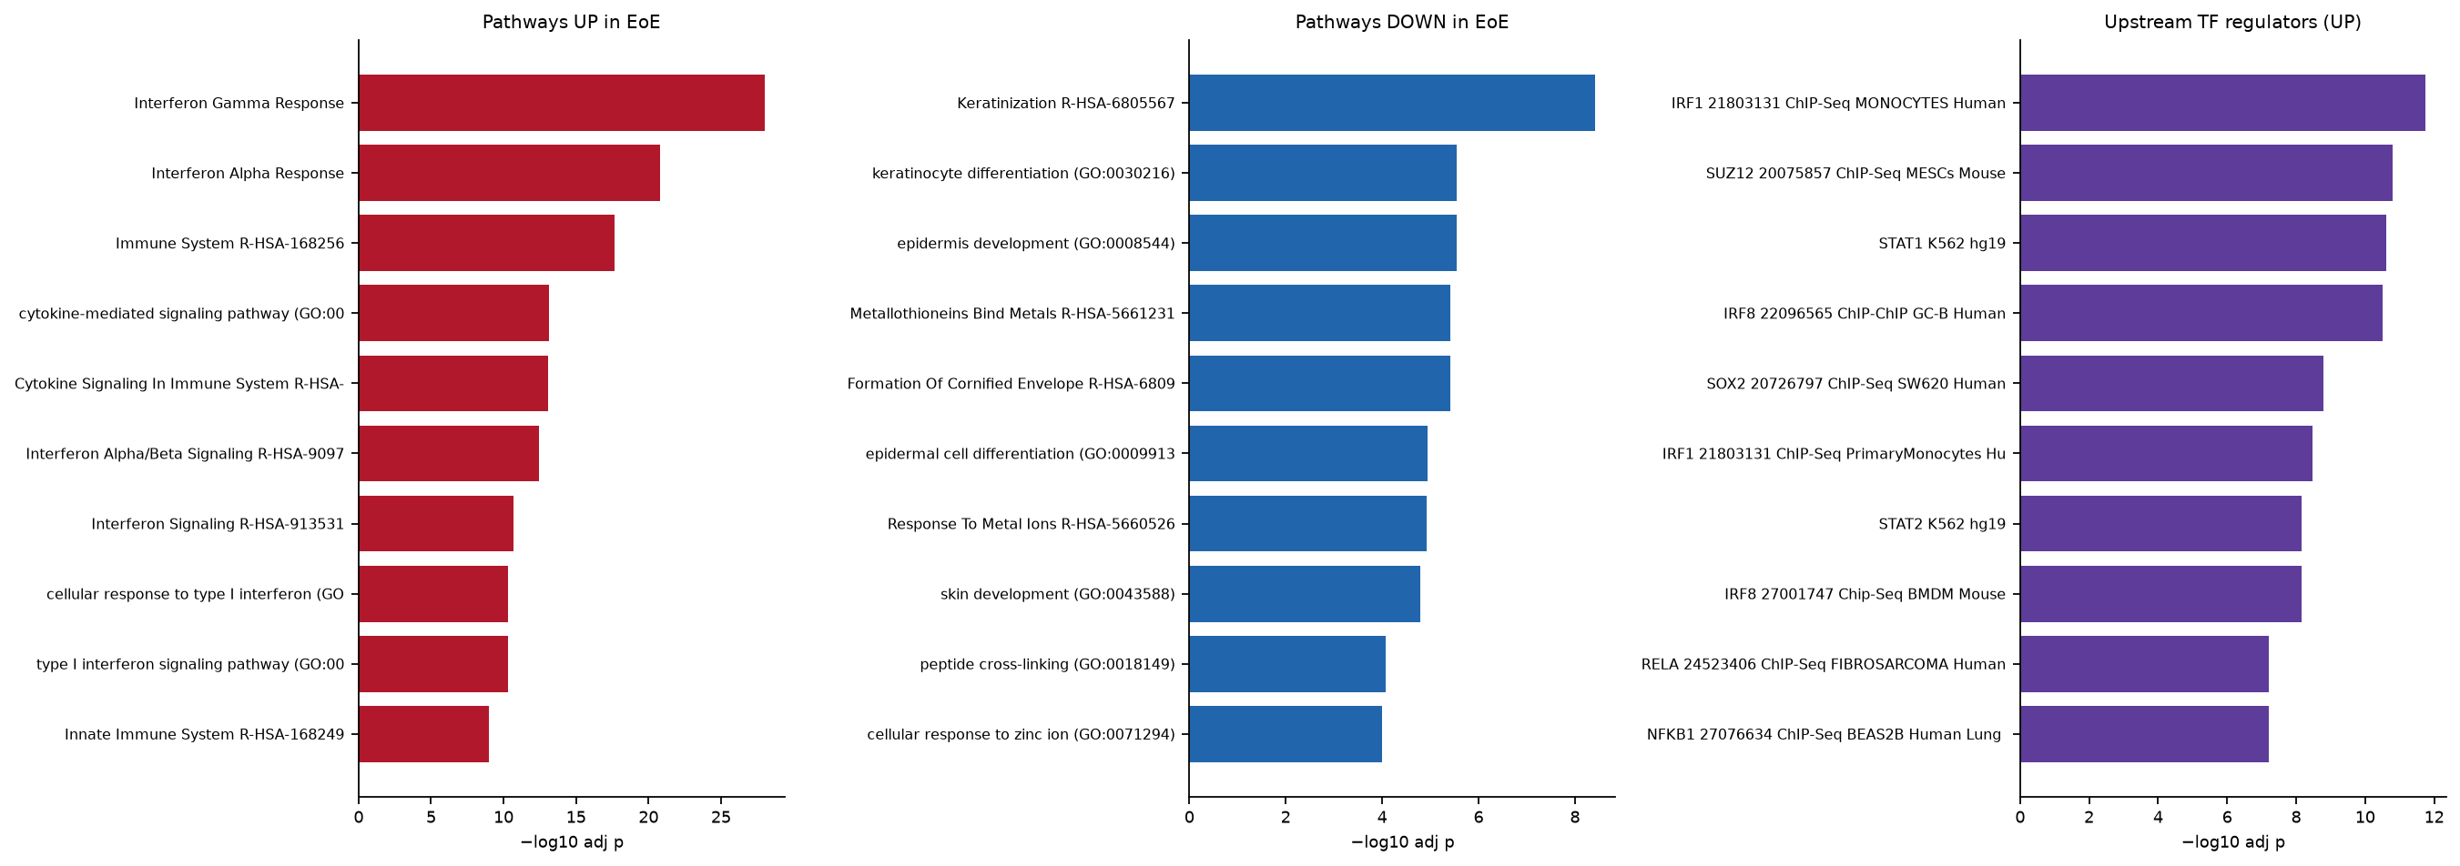
Transcriptome-Wide Target Discovery in Eosinophilic Esophagitis
EoE Omics Working Group
Built with Claude · Life Sciences Hackathon 2025
Question & Scope
Reproducible Across 9 Studies
Genetically Anchored
7 of the 567 signature genes sit at EoE GWAS risk loci (e.g. CAPN14).
Genetic support separates upstream susceptibility genes from downstream effectors — the former are candidate disease drivers, the latter amplifiers worth neutralizing.
Target Landscape
Which EoE genes are real, reproducible, and antibody-tractable?
We ran a 9-study cross-cohort meta-analysis of human esophageal transcriptomes and filtered to a prioritized, druggable target list.
Goal: replace single-study noise with a signature that holds across cohorts and points to concrete therapeutic entry points.
Marker direction is consistent study-by-study.
Consistency this uniform across independent cohorts is the strongest argument that these genes are disease biology, not batch or center effects.
Effect size × priority, colored by module; leads span every endotype.
Spreading leads across modules hedges against any one mechanism failing in the clinic.
Conclusions
• 20 antibody-tractable EoE targets from cross-cohort human data
• Surface (CDH26, ANO1, NTRK2) → direct engagement; secreted (POSTN, CCL26) → ligand-trap
• Genetic + robustness filters separate drivers from amplifiers
Prioritization landscape and per-endotype addressability.
Per-study log2FC for the EoE diagnostic-panel genes.
Risk-locus overlap separates susceptibility genes from downstream effectors.
Cross-Study Meta-Signature
622 genes at FDR<0.05 & |log2FC|≥1 (415↑ / 207↓).
The canonical EoE axis (CCL26, POSTN, ALOX15, CDH26) sits at the extreme right — large, highly significant effects that recur across studies rather than in any single dataset.
Druggability Screen
LOCO-Robust Core
Pathways & Regulators
Future Directions
Interferon + type-2 programs up; barrier/keratinization down.
The up/down split mirrors the clinical picture — active inflammation over a failing epithelial barrier — and nominates both immune and barrier-repair intervention points.
20-gene shortlist, all antibody-tractable (surface or secreted).
Every lead is reachable by an antibody or ligand-trap today — no undruggable intracellular targets carried forward.
• Validate the top 5 by IHC on independent EoE biopsy cohorts
• Design and test binders for CDH26 and ANO1 (surface) and traps for POSTN/CCL26
• Layer single-cell cell-of-origin onto each target to confirm the responding compartment
399 of the 567 high-confidence genes survive leave-one-cohort-out.
Because no single cohort can be driving them, these 399 are the safest to commit design resources against.
Pooled effect vs significance across 9 EoE cohorts; canonical targets labeled.
Robustness ranking; most genes hold when any single cohort is dropped.
Druggability features across the prioritized target set.
Enriched pathways (up/down) and upstream TF regulators.
Source: internal EoE cross-cohort transcriptomic meta-analysis (9 studies) · 20-gene antibody-tractable shortlist
Notes:
[Question] We asked which EoE genes are reproducible and druggable, across nine cohorts.
[Meta-signature] 622 genes pass FDR and fold-change; the canonical targets light up.
[Reproducible] Study-by-study the direction is consistent.
[LOCO] 399 of 567 survive dropping any single cohort — a robust core.
[Genetic] Seven sit at GWAS risk loci, separating cause from effector.
[Pathways] Interferon and type-2 up, barrier down.
[Landscape] Effect size versus priority gives the lead map.
[Druggability] All 20 leads are antibody-tractable.
[Next] Validate top five by IHC and design binders for CDH26 and ANO1.

