Slide 1
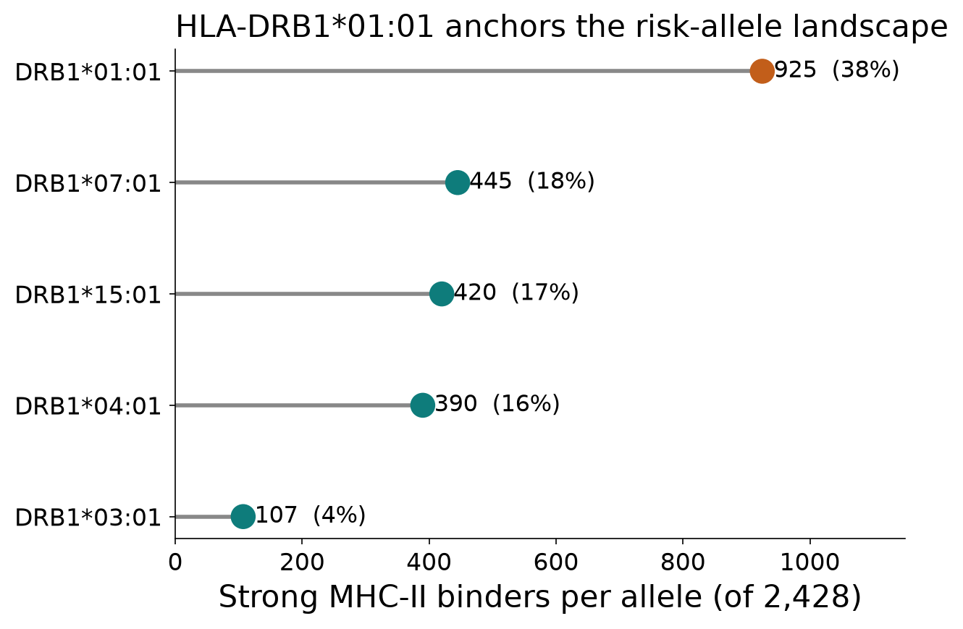
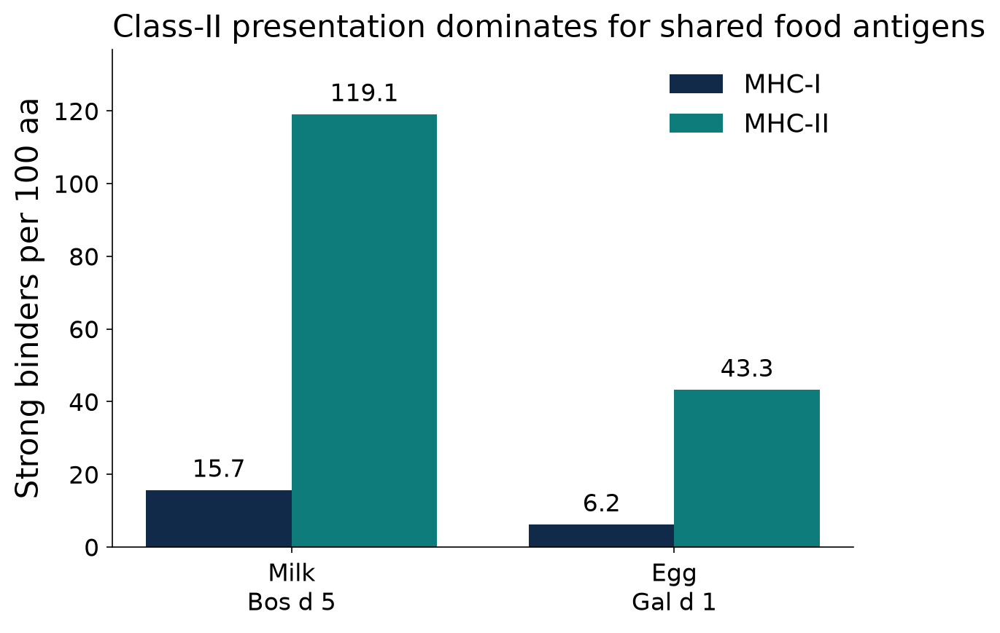
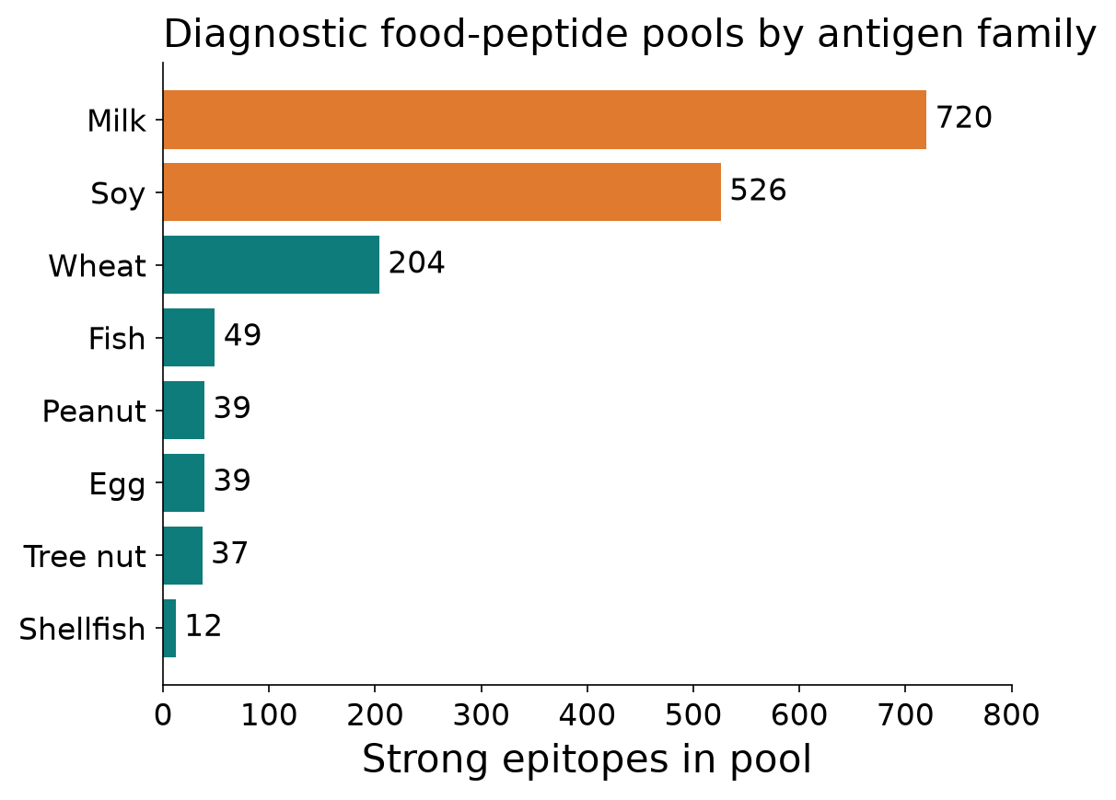
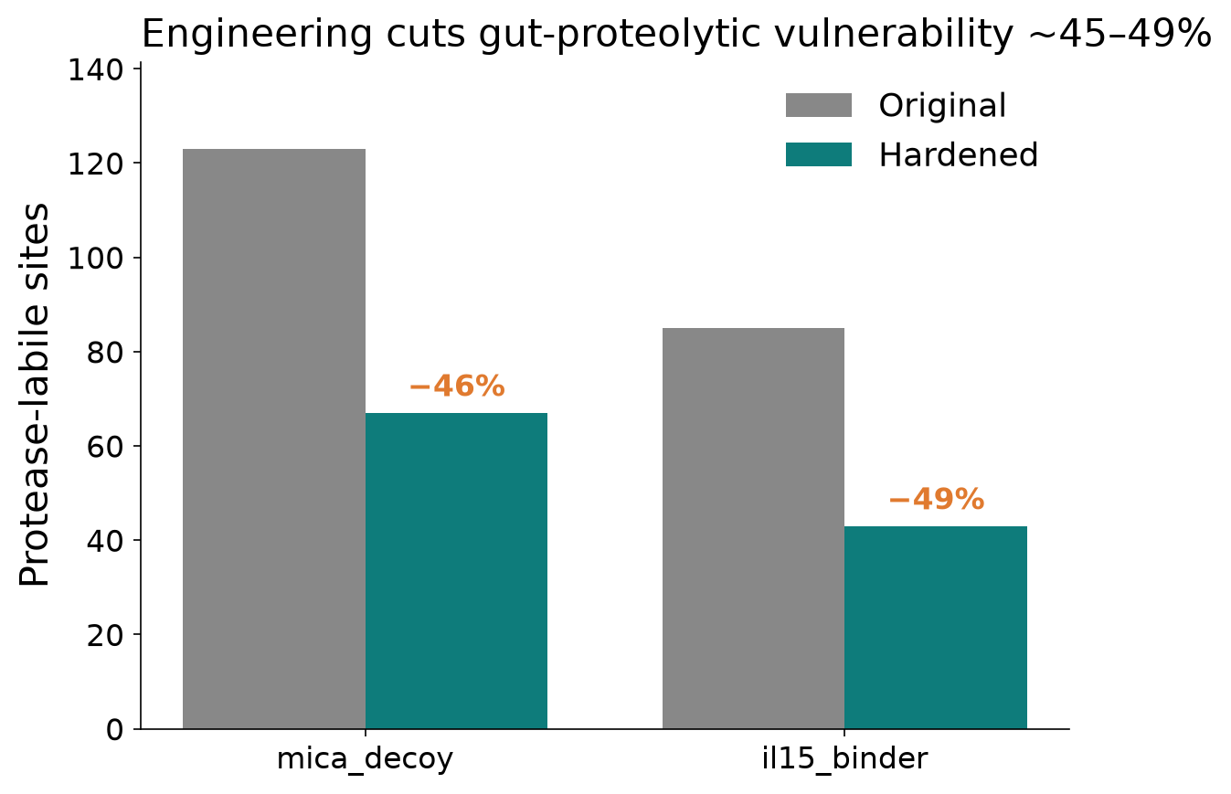

One Antigen, Two Diseases: Shared pMHC Biology Across EoE and Celiac Disease
Food-antigen presentation on MHC-I/II converges across esophagus and gut, nominating shared diagnostics and gut-restricted biologics.
EoE × Celiac pMHC Working Group · Built with Claude · Life Sciences Hackathon 2025
2
diseases · one pMHC pipeline
2,287
strong MHC-II binders · 5 DRB1 alleles
925
strong on HLA-DRB1*01:01 (38% of 2,428)
−49%
protease sites in hardened binders
20
antibody-tractable EoE targets
Background & Rationale
The Shared-Antigen Hypothesis
pMHC-II Risk-Allele Landscape
EoE: food-antigen-driven Th2 esophageal disease
Celiac: HLA-DQ-restricted, gluten-driven small-bowel disease
Both hinge on antigen presentation, not cytokines alone
Elemental diet → remission in >90% of EoE children
Same food proteins cross the barrier in both diseases
Milk Bos d 5 & egg Gal d 1 presented in BOTH panels
One pMHC pipeline + shared antigens → transferable targets
Celiac's mapped epitopes = ground truth for the EoE pipeline
Methods / Pipeline
2,428 peptide predictions per allele across 5 DRB1 risk alleles
Strong = standard netMHCIIpan cutoff; 2,287 strong total
HLA-DRB1*01:01 dominates: 925 strong (38.1%), best 4.26 nM
*07:01 445 · *15:01 420 · *04:01 390 · *03:01 107
Disease-agnostic: antigens → UniProt → HLA binding → burden
Class II: netMHCIIpan (IEDB); class I: netMHCpan-class
Celiac adds TG2 deamidation (native vs deamidated 15-mers)
Benchmarked vs 31 known celiac epitopes; 13-allele cross-check
pMHC-I Landscape (Secondary Axis)
One pipeline, two diseases → transferable targets
372 peptides screened; only 9 strong (≤50 nM) — sparse axis
Across all 372, top HLA-I restrictions: A*02:01, B*08:01, A*03:01
Matches IFN-γ-driven epithelial HLA-I induction
Exploratory sub-study, secondary to the CD4/Th2 class-II arm
EoE Target Shortlist
20 candidate genes, all antibody-tractable
Top effect: POSTN 5.55 · CDH26 4.98 · ANO1 3.91 (log2FC)
Also NTRK2 3.13 · MSLN 3.00
Effector/receptor targets downstream of presentation
Shared Food-Antigen Load: EoE vs Celiac
Strong MHC-II binders per DRB1 allele (of 2,428 predictions each).
Use rank & allele-preference, not absolute IC50, for DQ/DR calls
Milk Bos d 5 (178 aa): 28 MHC-I + 212 MHC-II strong
= 15.7 (I) and 119.1 (II) strong binders per 100 aa
Egg Gal d 1 (210 aa): 13 MHC-I + 91 MHC-II strong
Class II ≫ class I → one shared-antigen reagent set
Diagnostic Peptide Pools
Gut-Restricted Binder Engineering
Milk 720 epitopes / 6 proteins — largest pool
Soy 526/2 · Wheat 204/1
Fish 49 · Egg 39 · Peanut 39 · Tree nut 37 · Shellfish 12
Per-patient HLA-guided pools focus T-cell assays
mica_decoy: protease-labile sites −45.5% (123→67)
trypsin sites 32→5; net charge −10→−42
il15_binder: sites −49.4% (85→43); trypsin 18→1
Structural cysteines retained → survives gut proteases
Conclusions & Next Steps
• Shared milk/egg antigens jointly presented (MHC-I & II) in EoE + celiac; class II dominates
• DRB1*01:01 & DQ2.5 anchor risk; per-patient panels beat allele gating
• Hardened binders cut protease sites 45–49%, keep structural Cys
• Next: shared peptide-pool platform; validate top DQ2.5/DRB1 hits (AIM/tetramer); pair with POSTN/CDH26/ANO1
Strong binders per 100 aa (netMHCpan/netMHCIIpan). Class II ≫ class I.
Strong epitopes per food pool; milk & soy dominate.
Protease-labile sites before/after hardening.
Data: internal EoE/celiac pMHC streams · netMHCpan / netMHCIIpan (IEDB) · contact: pmhc-working-group@example.org
Notes:
[Background] EoE and celiac are both antigen-driven diseases where food proteins cross a defective barrier and get presented via MHC to T cells -- EoE via CD4/Th2, celiac via HLA-DQ-restricted gluten response. [Hypothesis] We tested whether a single pMHC pipeline, run across both diseases, finds shared food antigens and transferable design lessons. [Methods] Same antigen-to-panel pipeline, with celiac adding a TG2-deamidation step and a unique benchmark against 31 known Sollid epitopes. [Landscape] Class II dominates: DRB1*01:01 carries 925 of 1800 strong binder predictions; class I is sparse (9/372 strong) and secondary. [Shared load] Milk and egg antigens are jointly presented in both diseases, with class-II binder density around 10x class-I. [Engineering] Protease-hardening cut cleavage sites by 45-49% in two candidate binders, aimed at gut-stable reagents. [Diagnostics] Milk and soy dominate the diagnostic peptide-pool sizes (720 and 526 strong epitopes). [Ask] We're seeking collaborators for functional validation (tetramer/AIM assays) of top-ranked DQ2.5/DRB1 peptides and feedback on the shared-antigen diagnostic pool design.

